Slide 1


APASL TASHKENT 2025
Results of the implementation of Hepatitis B elimination program
in the Northwest of Russia
Professor
ESAULENKO ELENA V.
Saint-Petersburg State Pediatric Medical University
Russian Federation
Notes:
Итоги реализации программы элиминации гепатита В на Северо-Западе России

Slide 2

Hepatitis B in the XXIth century
2022
Nowadays, despite the use of a preventive vaccine for several decades, and the use of effective and well-tolerated drugs to suppress viral replication since 1998.
Approximately 254 million persons worldwide remain infected with the hepatitis B virus, representing 3.3% of the world's population.
Treatment coverage is estimated to remain low in both developing and high-income countries. In the USA, according to CDC, only one third of HBV infected patients are aware of their contaminated state.
Low rates of diagnosis and treatment coverage are due to the asymptomatic clinical course of chronic hepatitis B until late stages, and the lack of knowledge about the disease among both service providers and patients.
Hepatitis B virus (HBV) is one of the main risk factors for liver malignancy and overall mortality, exceeding malaria and tuberculosis.
https://www.who.int/ru/news-room/fact-sheets/detail/hepatitis-b

Slide 3
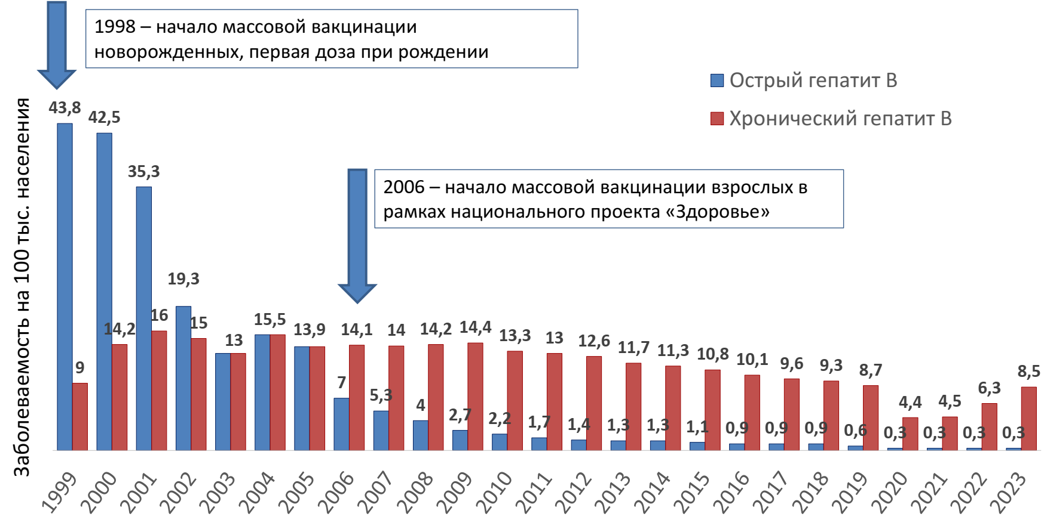
Modern epidemiology of hepatitis B
1998 – start of mass vaccination of newborns. First dose at birth
1998 – start of mass vaccination of newborns. First dose at birth
RUSSIA
Acute hepatitis B
Chronic hepatitis B
2006 – start of mass vaccination of adults in the scope of the “Health” national project
Vaccination coverage in 2023:
97.07% - children aged 12 months and less
97.79% - 18 to 35 years
92.06% - 36 to 59 years
44.20% - 60 years and older
Morbidity per 100 thnd persons
The epidemiology of hepatitis B (HBV) has changed significantly over the past 10 years due to global vaccination policies, the development of effective antiviral drugs against hepatitis B, and serological screening of risk groups.

Slide 4
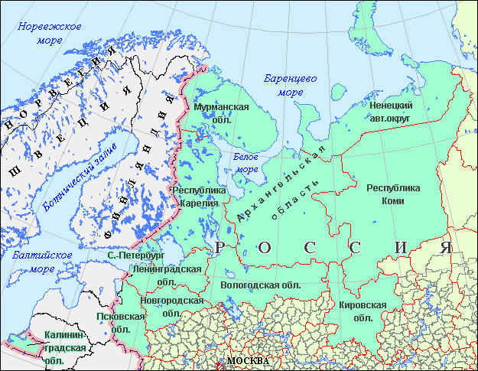
Program of elimination of acute hepatitis B
Acute Hepatitis B Elimination Program in the North-West Federal District
2010
Initiation of the development of the AHB elimination program in the North-West of Russia in 2010 in the Saint-Petersburg Louis Pasteur Institute
2012
Meeting for discussing the draft program of the step-by-step AHB elimination within the territory of the North-West of Russia
PROGRAM IMPLEMENTATION PHASES
Phase 1. 2013 - 2015: Reduction of AHB morbidity to the level of < 1.0 per 100,000 persons of population within 80% of the territories of the North-Western Federal District (NWFD)
Phase 2. 2016 - 2018: Achieving the AHB morbidity level < 1.0 per 100,000 persons of population within all of the territories of the North-Western Federal District (NWFD) by increasing vaccination coverage of the adult population and improving epidemiological surveillance of chronic hepatitis B
Phase 3. 2019 - 2021: Reduction of AHB morbidity to the level of < 1.0 per 100,000 persons of population and zero encounter within all of the territories of the North-Western Federal District (NWFD), reduction of CHB morbidity, achievement of 90% vaccination coverage of adult (55 years and under) of population in 100% of the NWFD entities and territories
Phase 4. 2022 - 2024: Reduction of AHB morbidity to the level of < 1.0 per 100,000 persons of population and zero encounter within all of the territories of the North-Western Federal District (NWFD), reduction of CHB morbidity, achievement of 90% vaccination coverage of adult (55 years and under) of population in 100% of the NWFD entities and territories
Viral hepatitis in the Russian Federation/Edited by V.G. Akimkin, A.A. Totolyan A.A., SPb, Federal State Funded Institution of Science N.F.Gamaleya Research Institute of Epidemiology and Microbiology 2024, 196 p.

Slide 5
Morbidity of acute viral hepatitis B in the Russian Federation and in the North West Federal District, 2006–2024.
Lyalina L.V., Esaulenko E.V., Khorkova E.V., et al. Results of implementation of viral hepatitis B elimination program in the North-West Russia // Russian Journal of Infection and Immunity - Infection and immunity, 2021, vol. 11, No. 5, pp. 875–886. DOI: 10.15789/2220-7619-ROT-1785

Slide 6
Dynamics of acute hepatitis B incidence in children and adults
AHB morbidity in children
AHB morbidity in adults

Slide 7
Age structure of acute HB patients In the North Western Federal District

Slide 8
Hepatitis B virus viral load in fertile women with chronic hepatitis B (15 – 49 лет)

Slide 9
Dynamics of hepatitis B incidence in the Russian Federation
Linear
Linear
Linear

Slide 10
Hepatitis B vaccination coverage in the Russian Federation

Slide 11
Assessment criteria of vaccination audit
Vaccination coverage
Seroconversion
Factors
Percentage of persons having positive vaccination status
Presence of HBsAg antibodies after vaccination
(≥ 10 MIU/mL)
Vaccination age;
Post-vaccination period; Vaccination schedule;

Slide 12
Age structure (n =409)
80% of examined subjects aged 19-24

Slide 13
Results of vaccination audit

Slide 14
Impact of primary vaccination age on the creation of post-vaccination immunity
The number of seropositive individuals in all study groups surpassed 50%, which shows that in childhood, the immune system is more “flexible” and the body responds better to the introduction of vaccine, creating a longer and more intense post-vaccination immunity.

Slide 15
Anti-HBs seroconversion after vaccination (n=381)
The proportion of individuals with projective immunity in the analyzed sample was 83.7%.
Seropositive subjects were more likely to have an average level of immunity (100 – 1000 MIU) – 42.8%.

Slide 16
Anti HBs seroconversion after vaccination depending on vaccination

Slide 17
Morbidity of chronic viral hepatitis B in the Russian Federation and in the North West Federal District, 2006–2024
Lyalina L.V., Esaulenko E.V., Khorkova E.V., et al. Results of implementation of viral hepatitis B elimination program in the North-West Russia // Russian Journal of Infection and Immunity - Infection and immunity, 2021, vol. 11, No. 5, pp. 875–886. DOI: 10.15789/2220-7619-ROT-1785

Slide 18
Summary of key actions for hepatitis B elimination and their impact on comprehensive health care
Increasing community engagement, education and needs
Key steps needed to ensure cure readiness to achieve hepatitis B virus elimination, included in the 5 strategic directions of the latest elimination program for 2022–2030.
World Health Organization, Global health sector strategies on HIV, viral hepatitis and sexually transmitted infections, for the period of 2022–2030. WHO; 2022.
Investing in diagnostic access and infectious surveillance
Simplifying guidelines and investing in models of health care
Investment into prevention measures
Increasing investments into VH elimination including therapy methods
Prevention
Diagnostics
Nursing
Medical treatment
Howell J, Seaman C, Wallace J, Xiao Y, Scott N, Davies J, et al. Pathway to global elimination of hepatitis B: HBV cure is just the first step. Hepatology. 2023;78:976–990. https://doi.org/10.1097/ HEP.0000000000000430

Slide 19
CONCLUSION
The development of the program for the elimination of AVHB in the North-Western Federal District was justified, on the one hand, by the success of vaccination against this infection, which ensured a decrease in the morbidity of AVHB, and on the other hand, by the high incidence rate of chronic hepatitis B.
The implementation of the program contributed to an increase in the vaccination coverage of the adult population and a decrease in the incidence of acute and chronic forms of this infection.
Over the years of implementing the program, unique experience has been accumulated that may be useful for other regions of the Russian Federation.
Creating a protective immunity against hepatitis B depends on the vaccination schedule. In the group of subjects vaccinated according to the schedule recommended by the Ministry of Health of the Russian Federation (0-1-6 months), immunological protection was maintained for over 20 years in 100% of cases. Long-term intense immunity (up to 17 years) was formed in individuals who received the full vaccination schedule at the age of one month to three years of life. In case of breach of the vaccination schedule, a decrease in post-vaccination immunity was established within 11-15 years, which requires the introduction of a booster dose

Slide 20

CREDITS TO CO-AUTHORS
Employees of the Saint-Petersburg Pasteur Institute
Professor LYALINA L.V.
Research officer SKVORODA VSEVOLOD

Slide 21
APASL TASHKENT 2025
Thanks for your attention!
Notes:
Итоги реализации программы элиминации гепатита В на Северо-Западе России

