Slide 1


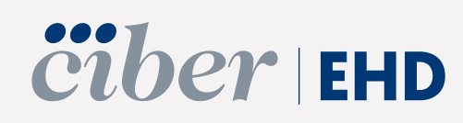
Elimination of hepatitis C in Catalonia Spain
Dra. María Buti.
Liver Unit
Hospital Universitario Vall d'Hebron. Barcelona.Spain

Slide 2
Disclosures
Advisory Board and /or speaker: Abbvie, Altimmune, Gilead, GSK, Janssen and Roche
Grants: Gilead Sciences

Slide 3
Current situation
1

Slide 4
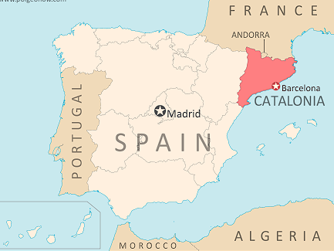
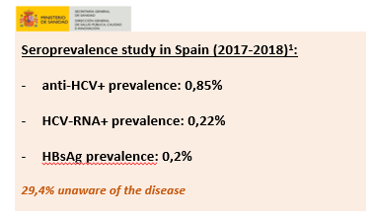

Current situation in Spain/Catalonia Spain: 49 million inhabitants Catalonia: 8 million inhabitants
Highest GDP
Highest Proportion of Migrants
Highest rate of Hepatologists
General population (2019)¹
Anti-HCV+ adults: 1.02%
HCV-RNA: 0.49%

Slide 5
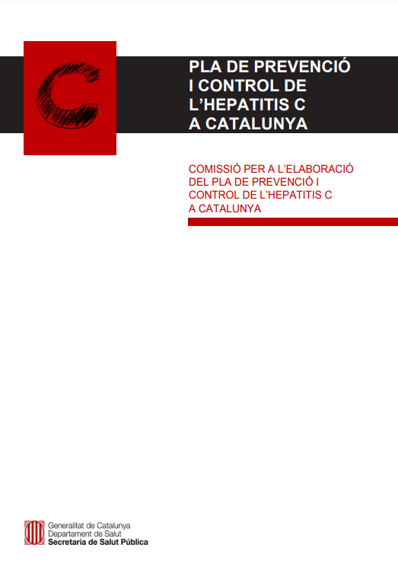




Hepatitis C Prevention and Control Plan in Catalonia
Purpose:
To facilitate the adoption and implementation of the necessary measures to reduce the incidence, morbidity and mortality associated with HCV infection in Catalonia, in order to achieve the elimination of the infection as a serious public health problem by 2030.
General objectives:
Screening based on risk factors
Search for diagnosed patients
Identification of vulnerable populations
Test & Treat
Linkage to care
Simplification of procedures
6 general objectives
47 specific objectives
131 actions

Slide 6




Integration
HIV + STI + Viral Hepatitis
The Sub-Directorate is the reference and institutional coordination body for issues related to these infections, with the aim of planning, promoting, coordinating and evaluating the actions carried out in Catalonia to reduce the incidence of these infections and improve care for those affected.
De la prevenció al tractament de les hepatitis víriques: les accions des de la salut pública > situació actual

Slide 7











Current situation in risk groups in Catalonia
PWID - Persones who inject drugs²
Prevalence Ac+: 74%*
Viremia: 54,2%
Homeless people
Anti-HCV+ve : 5,0%
HCV-RNA 0,9%
Drug users from drug care centres (CAS) ³
Prevalence Ac+: 23%
Viremia: 8%
(N= 7.563)
MSM – Trans women⁷
Anti-HCV+ve 0,5% - 2,0%
Viremia: 0,1% - 2,0%
Vulnerable
populations
Coinfected people with HIV-HCV⁴
Anti-HCV ve+: 29,9% (en qualsevol moment de la vida han estat infectades pel VHC)
Viremia: 1,1%
Migrant people from high HCV/HBV prevalence countries ⁶
Prevalence Ac+: 0,4% - 3,3%
Viremia: 0,0 – 1,1%
Prisoners ⁵
HCV-RNA +ve 0,09%
2. PQID Ac+: Estudi Bio-Conductual 2019 (Estudi REDAN), CEEISCAT. Persones que s’injecten drogues (PQID) reclutades en Centres de Reducció de Danys: https://drogues.gencat.cat/web/.content/minisite/drogues/professionals/reduccio_danys/informes/REDAN_Informe_2019_def.pdf; Virèmia: Extrapolació resultats de lEstudi HepCDetect II: The hepatitis C care cascade among people who inject drugs in Catalonia: major gaps among migrants (Folch C., Saludes V., Reyes-Ureña J., Antuori A., Ibáñez N., Majó X., Colom J., Matas L., Casabona J., Martró E.; HepCdetect II Study Group). 3. CAS: Resultats Informe Monitoratge del Projecte d’Eliminació de l’Hepatitis C als CAS de Catalunya . Informe n2 Abril 2023. 4. COINFECCIÓ VIH-VHC: Cohort Poblacional PISCIS 2022. CEEISCAT (no publicat) 5. PRESONS: Departament de Justícia: http://www.gencat.cat/justicia/estadistiques_serveis_penitenciaris/12_pob.html (consultat Juliol 2023); 6. MIGRANTS: Resultats del projecte pilot MiCatC - (no publicat). HepC-Link: Martró E, et al. Liver Int 2022 (epub); HepBC-Link: Not A, et al. International Viral Hepatitis Elimination Meeting (IVHEM), 2021; 7. HSH: Resultats Barcelona CHECKPOINT (d'agost de 21- febrer 23)- Detecting Hepatitis C Outbreaks Among Men Who Have Sex with Men: Findings from a CommunityBased Screening Program in Barcelona (À. Rivero; F. Pérez , A. Dalmau-Bueno , P. Coll, JM. Cabrera, M. Lucejko, J. Reguant, J. Fernandez, J. Calderon, J. Romero, F. Caballero, G. Marazzi , C. Oro1, D. Jacobs, H. Vicioso, L. Moises, H. Taboada, J. Saz, F. Pujol, M. Meulbroek, R. Paredes) . 8. POBLACIÓ PSIQUIÀTRICA: resultats preliminars: Programa de cribratge d’hepatitis virals en la població amb trastorn mental greu – Hospital Clínic de Barcelona (Projecte PSIQUI-CLINIC) + Projecte de microeliminació de l'hepatitis C en pacients amb patologia psiquiàtrica atesos al centre de salut mental ambulatori de Tarragona (CSMA-Tarragona)
Notes:
enfermedad mental, aunque la mayoría referidos a EEUU.

Slide 8
Challenges posed by viral hepatitis from a public health point of view. What public health strategies have been put in place?
2

Slide 9
The challenges posed by HVs from a public health perspective
Hepatitis C
1
2
3
4
Undiagnosed infected people and hidden cases with diagnoses or biological markers (serologies and viremias) without treatment
High incidence focused on people who inject drugs
Migrant people born in countries with medium or high prevalence
High prevalence in prisons due to concentration of people with risk factors
General population
PWID
Migrant population
Prison inmates

Slide 10
The challenges posed by HVs from a public health perspective
Hepatitis C
1
2
3
4
Undiagnosed infected people and hidden cases with diagnoses or biological markers (serologies and viremias) without treatment
High incidence focused on people who inject drugs
Migrant people born in countries with medium or high prevalence
High prevalence in prisons due to concentration of people with risk factors
General population
PWID
Migrant population
Prison inmates

Slide 11
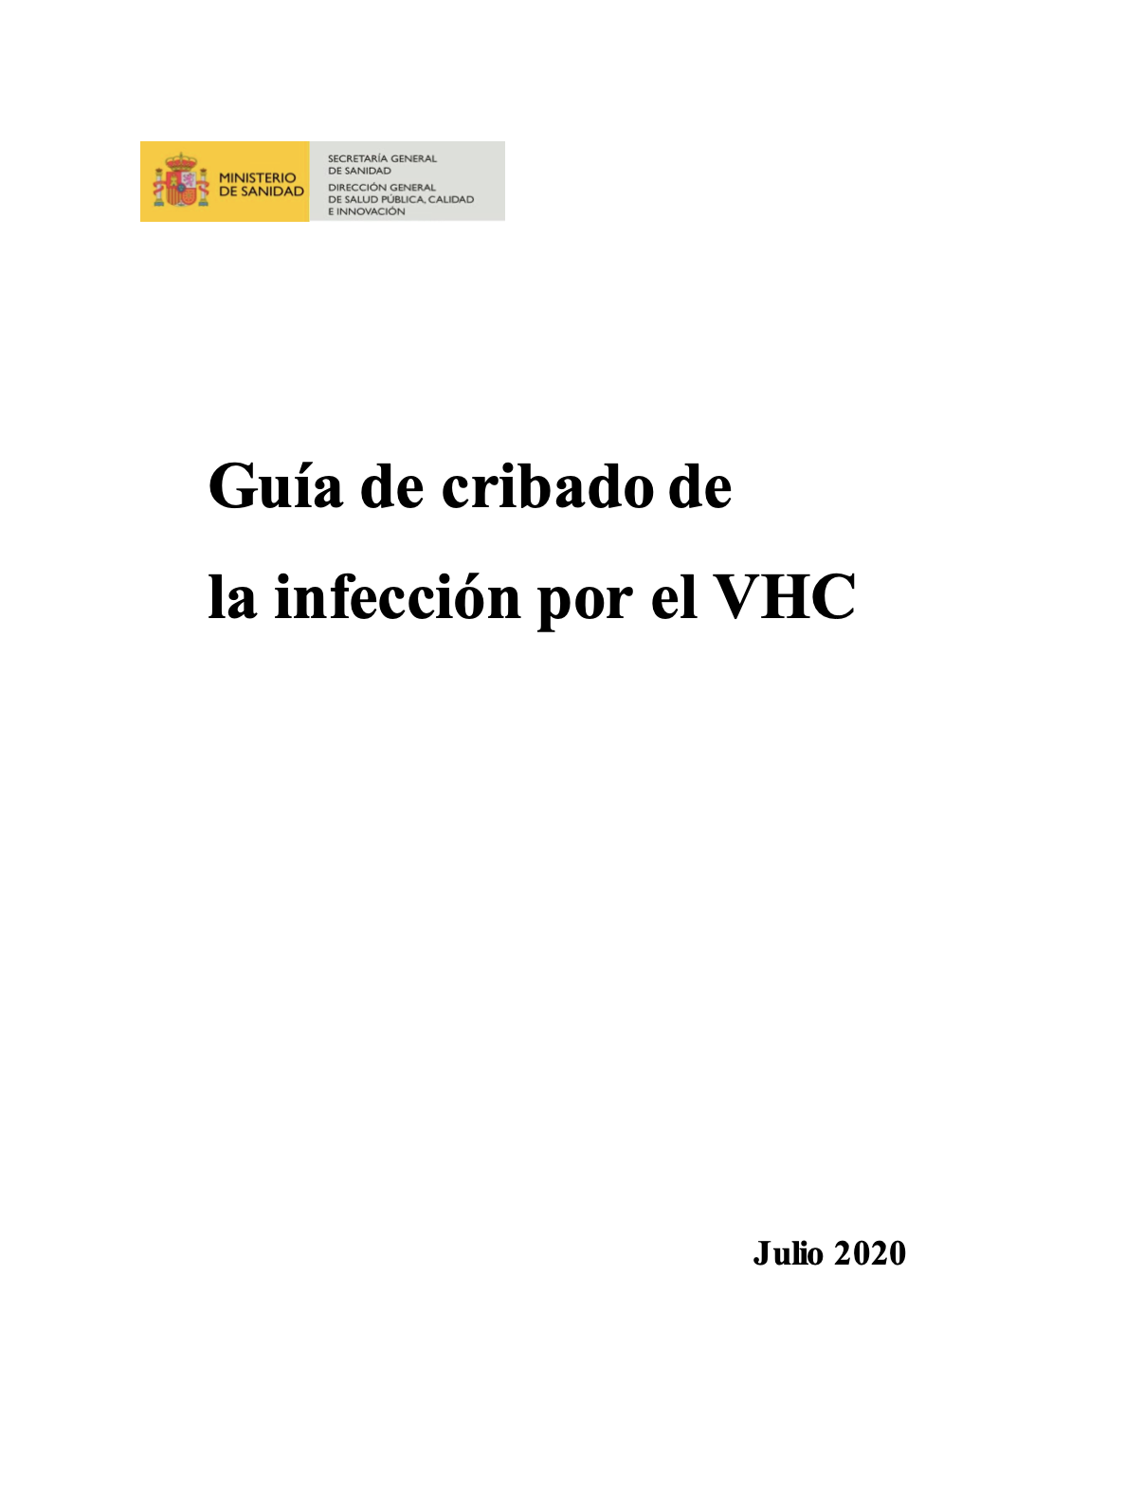
Undiagnosed HCV infected people : Interventions in primary care
Promotion of screening for risk conditions
"Guidelines to screening for HCV and HBV infection" of the Ministry of Health, agreed with the Autonomous Communities.
Reflex Test implemented:
Anti-HCV reflex test + reflex viremia with fibrosis scores (FIB4, APRI, ...)
A GP expert in every Primary Care Centre
Training for GPs and Nurses

Slide 12

Retrieval of hidden HCV cases
Use of health databases for case identification
1
Cross-referencing diagnosed patients with treated patients
Retrieve laboratory variables and inform each hepatologist to review clinical records
2
De la prevenció al tractament de les hepatitis víriques: les accions des de la salut pública > reptes

Slide 13





Active search to retrieve diagnosed but untreated patients with HCV
Retrospective search for HCV RNA+ cases from central lab of the Barcelona, Spain health area followed by medical record review, phone contact, treatment, and Markov model of health and economic outcomes
Retrieval strategy (Jan 19-May2021)
Cost-effectiveness analysis
Number of cases of liver complications and mortality over patients' lifetime
Search to identify DBU HCV patients
Call candidates by phone
Visit to specialist
Repeat HCV RNA and fibrosis assessment
HCV DAA treatment
-26%
-31%
-27%
Patients engaged and treated
41/104 (39%) of located patients were treated
-20%
Number of patients
A cost-saving of €456,796 for the public health system because of the estimated reductions in liver disease complications and mortality
*Difference between the number of patients who were HCV RNA+ and who were selected for retrieval is mostly attributed to patients who had already been treated, linked to care, or had died. DAA, direct-acting antiviral; DBU, diagnosed but untreated; HCC, hepatocellular carcinoma. Vargas-Accarino E et al. J Viral Hepat 2022;29(7):579–83.

Slide 14
Retrieval of hidden HCV cases
1
Cross-referencing diagnosed patients with treated patients
Resultats of Register of Laboratory matched with the DAAs Registry from 2015 onwards
57.113 People diagnosed
24.658 People treated
~ 90 persons per Basic Area of Health
374 Basic áreas of Heath
Notes:
Resultats creuament tot

Slide 15


Pilot results in Barcelona
1
Cross-referencing diagnosed patients with treated patients
Hidden cases identified
Results after reviewing 4.617 cases with the registry of people treated
436 treated before pilot
85 treated after the pilot
521 people treated
31/07/2024
11% of reviewed cases (n=4.617)
Deploy it to the rest of Catalonia

Slide 16
The challenges posed by HVs from a public health perspective
Hepatitis C
1
2
3
4
Undiagnosed infected people and hidden cases with diagnoses or biological markers (serologies and viremias) without treatment
High incidence focused on people who inject drugs
Migrant people born in countries with medium or high prevalence
High prevalence in prisons due to concentration of people with risk factors
General population
PWID
Migrant population
Prison inmates

Slide 17
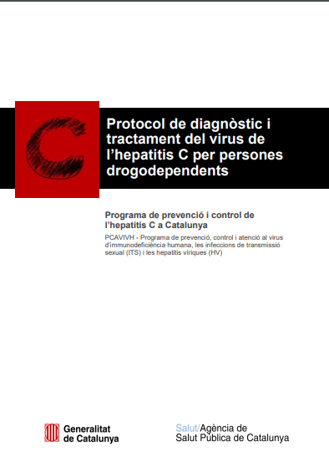
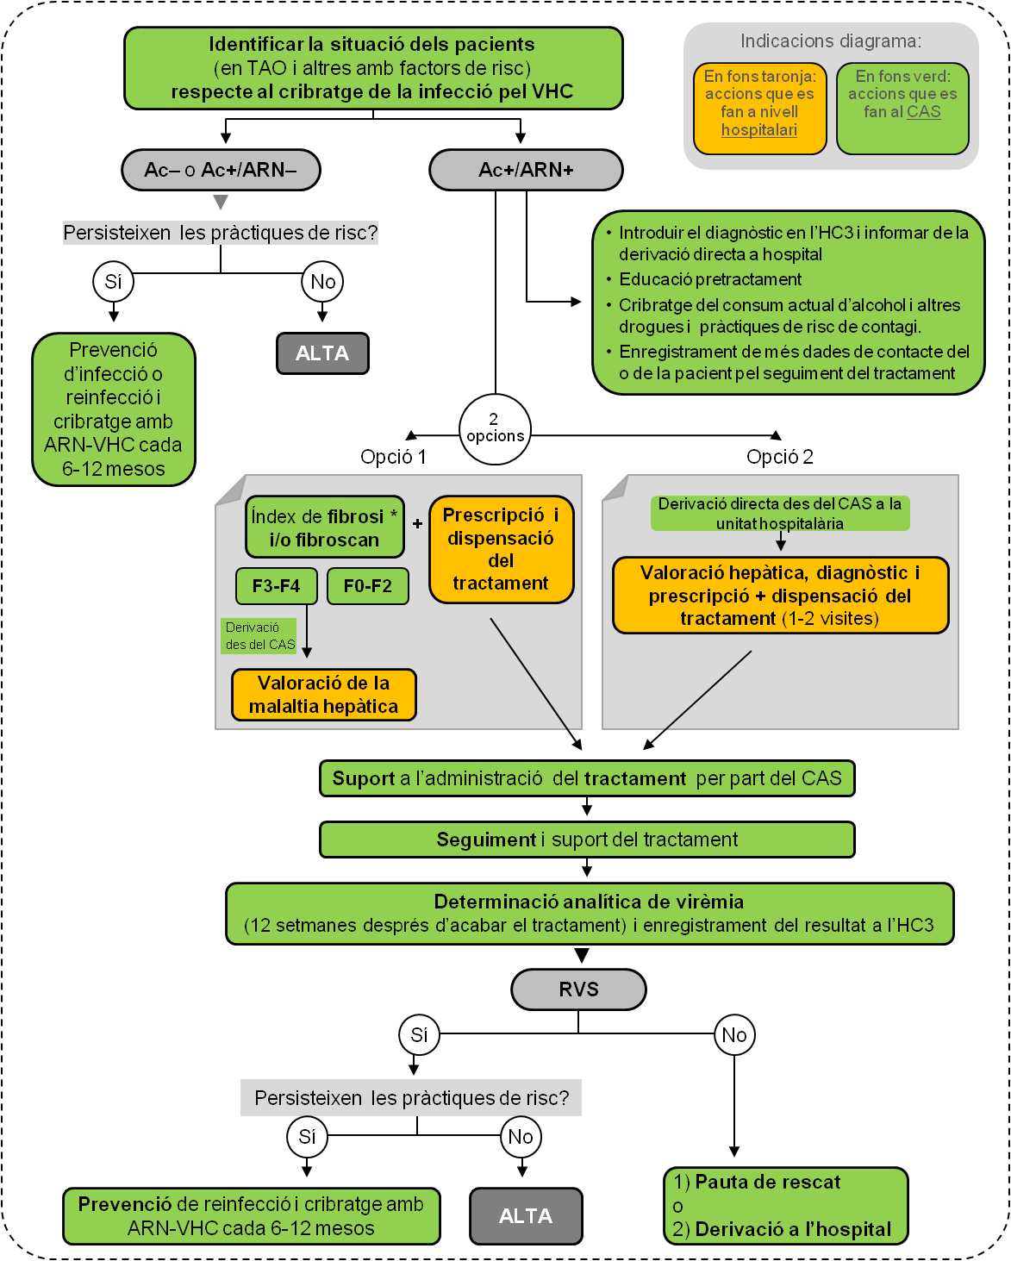
HCV management guidelines for people who use drugs
14.137 admitted to addition treatment centers in 2023; 1.115 (8%) for heroin
/
2 key approaches
TEST AND TREAT
ONE STOP SHOP
Ideally in the drug care centres
Integration of Addition therapy and HCV (Socias et al 2019)
Better Adherence and SVR. Therapies given at the center (Akiyama MJ et al 2019)
Positive impact of HCV therapy in the addiction, Reduction of drug consumption (Coven et al 2019)
Friendly place
Informe sobre l’indicador d'inicis de tractament ambulatori amb o sense substància: any 2023. Barcelona: Subdirecció General de Drogodependències; 2024 https://drogues.gencat.cat/ca/professionals/observatori/indicadors-epidemiologics/inicis-de-tractament
Notes:
Elaboració del protocol: Clínics (drogues i hepatitis), Catsalut i PCAVIHV.
Punts claus:
Derivació directa
Treure el medicament de l’hospital
Si cal tractar sense o mínima valoració hepàtica
Cribratge: Analítiques als CAS - Test sang seca

Slide 18
Managment for PWIDs
Prevention strategy
Harm reduction (PIX, consumption rooms, education,...)
Opiate Agonist therapies
TREATMENT as prevention
Martin et al 2011; Hellard et al 2014; de Vos et al 2015; Couisen et al 2016...)

Slide 19
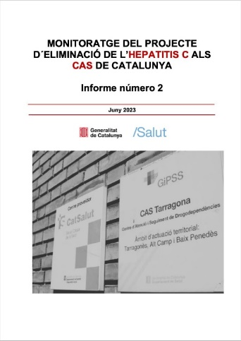
Elimination of HCV in Drug Addiction Centers(DAC)
Cascade of hepatitis C screening and treatment in DAC in Catalonia with protocol start date from 2021 to 12/31/2023
% screened
% infected
44/63 DAC
75%
23%
5%
78%
58%
8%
3%
6%
5%
0%
Notes:
.

Slide 20
The challenges posed by HVs from a public health perspective
Hepatitis C
1
2
3
4
Undiagnosed infected people and hidden cases with diagnoses or biological markers (serologies and viremias) without treatment
High incidence focused on people who inject drugs
Migrant people born in countries with medium or high prevalence
High prevalence in prisons due to concentration of people with risk factors
General population
PWID
Migrant population
Prison inmates

Slide 21
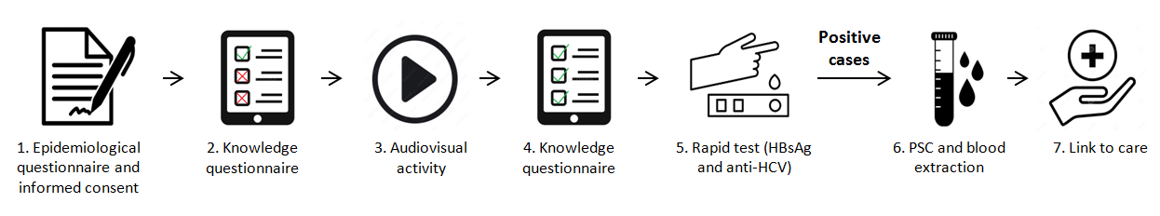
Migrants: Hepatitis B, C, and D Screening in Mongolians in Catalonia
Design of the community program performed in 3 Spanish cities (Barcelona, Madrid and San Sebastián):
Viral hepatitis screening
Anti HCV: 6,3% (14/222)
HBsAg: 4,1% (9/222)
Anti HDV: 0,9% (2/222)
280 subjects were contacted by a community worker, and 222 (79%) attended the program. Participants were mainly women, median age 42, and 22% were vaccinated against HBV.
Active infection
Knowledge questionnaire (8 questions) and educational activity (N=89)
Before audiovisual
Mean correct answers=4.7
After audiovisual
Mean correct answers=6.3
HCV-RNA: 0,9% (2/222)
HBV-DNA: 3,6% (8/222)
HDV-RNA: 0,0% (0/222)
100% linked to care
The community program for viral hepatitis education, screening and linkage to care of Mongolians was feasible and widely accepted.
The program allowed to detect 14 cases of anti-HCV, 9 HBsAg and 2 anti-HDV.
Half of them were unaware of the infection.
Palom A. Community Strategy for Hepatitis B, C, and D Screening and Linkage to Care in Mongolians Living in Spain. Viruses. 2023

Slide 22


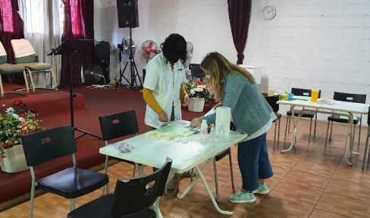
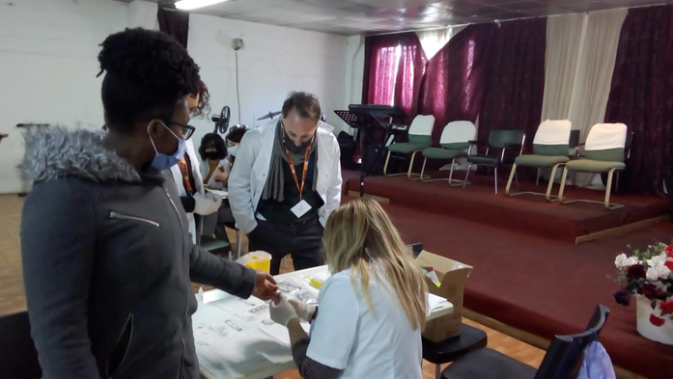
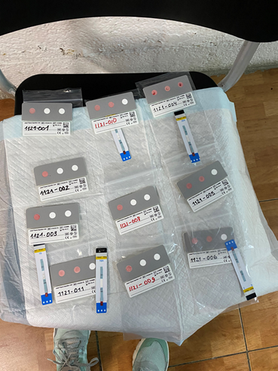
Migrants: HBV-COMSAVA and COMSAVAC
Hepatitis B Virus Community Screening and Vaccination in Africans study aims to use point-of-care testing and simplifed diagnostic tools to identify, link to care, or vaccinate African migrants initially in Barcelona and after in 4 European cities
Program | People screened | Age | Recently arrived (< 5yrs ) | HBsAg+ | Anti-HCV+ | Linkage to care
Barcelona | 624 (79.8% Ghana 16.2% Senegal) | 41,93 yrs | 23,7% | 10,1% | 0% | 70%
Europe | 335 (54. Ghana 11% Guinea 7.5% Morocco 5. Philippines 5.1% Senegal) | 40,36 yrs | 34,8% | 5,37% | 0,6%
Picchio CA, et al. Community-based screening enhances hepatitis B virus linkage to care among West African migrants in Spain Commun Med (Lond). 2023 Dec 14;3(1):182.

Slide 23

Community based interventions in Catalonia, 2021-2023
 | Interventions | People screened | HCV+ | HBV+
ESPIC | 75 | 830 | 13 | 16
Hep-BC link |  | 768 | 16 | 30
MICATC | 150 | 1.449 | 49 | 44
UM Red Cross | 615 | 1.850 | 400 | 20
COMSAVA | 56 | 959 | 2 | 81
DEVO |  | 2.685 | 36 | 0
Mongolia |  | 222 | 14 | 9
ASPB apps cites |  | 204 | 4
Total | 896 | 8.976 | 534 | 200

Slide 24

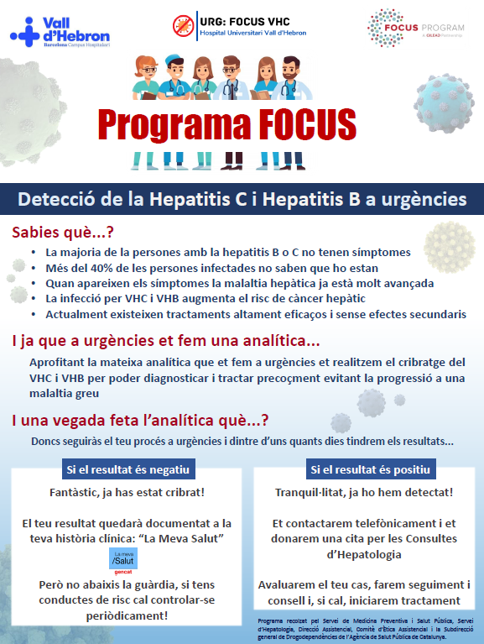
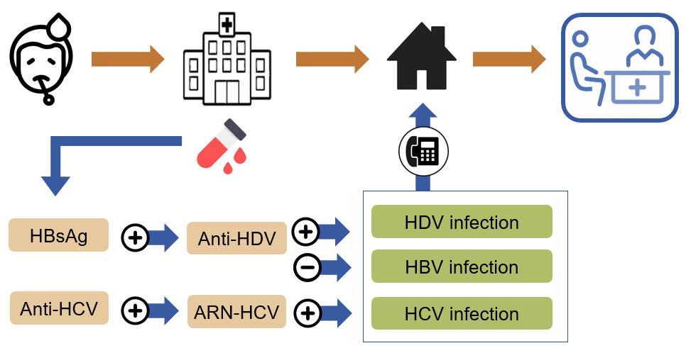

Emergency department screening: FOCUS
The FOCUS program is a public health initiative that promotes best practices for screening and linking individuals to healthcare for blood borne virus transmission, following the screening guidelines established by public health authorities.¹
Screening in adults attending an emergency department and requiring a blood test
.
Opt-out consent
1. Llaneras. Integrating viral hepatitis management into the emergency department: A further step towards viral hepatitis elimination. J Hep Rep. 2023
“Gilead Sciences’ FOCUS Program funding supported screening & linkage to a first appointment after diagnosis"​

Slide 25
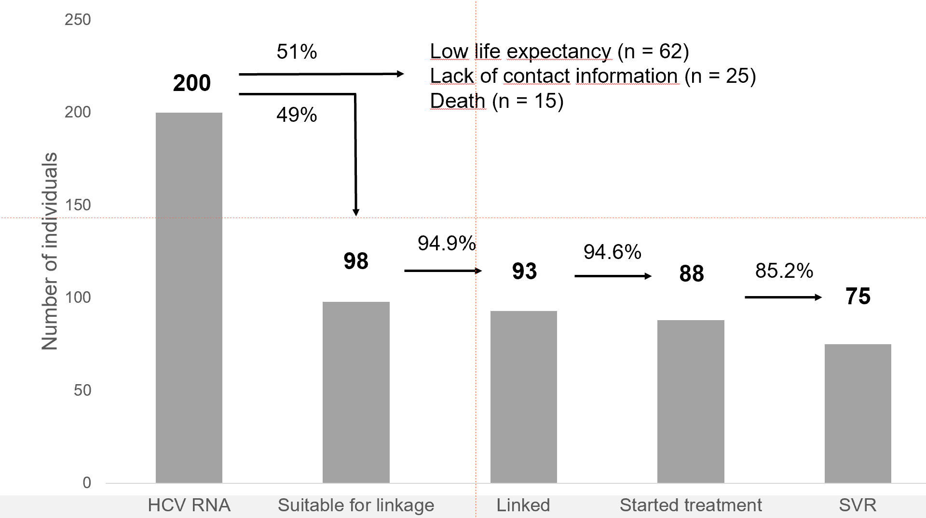
Emergency department (ED) screening: FOCUS
36.307 patients were screened at ED January 2020- Feb 2025 2023.
Anti-HCV 3.6%%
HCV-RNA 0.55%
HBsAg 0.59%
Prevalence of viral hepatitis in the Emergency Department of our hospital is 3 times higher than in the Spanish general population
46% of patients were unaware of the infection
Screening program is Cost-effective
€25,000 per QALY gained
Ruiz-Cobo JC. Integrating Viral Hepatitis Screening into the emergency department. HepHIV. 2023
Llaneras. Integrating viral hepatitis management into the emergency department: A further step towards viral hepatitis elimination. J Hep Rep. 2023
Gilead Sciences’ FOCUS Program funding supported screening & linkage to a first appointment after diagnosis

Slide 26
The challenges posed by HVs from a public health perspective
Hepatitis C
1
2
3
4
Undiagnosed infected people and hidden cases with diagnoses or biological markers (serologies and viremias) without treatment
High incidence focused on people who inject drugs
Migrant people born in countries with medium or high prevalence
High prevalence in prisons due to concentration of people with risk factors
General population
PWID
Migrant population
Prison inmates

Slide 27
HCV elimination program in Catalan prisons
Since 2016
Number of DAA treatments and HCV infection in inmates in Catalonia (2016-2023)
Infection detection: Systematic screening on admission
Treatment in the center
Linkage to community specialist on leaving the centre (liaison nurse) ³
Reduction in loss of post-release follow-ups
Improvement of links with specialists
Data on viremia in inmates in Catalonia. Prison Health Program (ICS) 2024
Notes:
En les presons catalanes el nombre de persones que s’injecten drogues (PQID) s’ha reduït considerablement en els últims vint anys. A finals de 2021, el percentatge de persones amb presència d’anticossos contra el VHC en el total de persones internes a presons va ser del 3,0%, i d’un 0,8% de persones amb virèmia..

Slide 28

Treatment of Hepatitis C in Catalonia, 2015 - 2023
MEAN AGE
54 YEARS
age range 31–83
MEN
60,8% (n=17.357)
28,556
PEOPLE
WOMEN
39,2% (n=11.199)
12
MEAN WEEKS
(RANGE 8-24)
0,65%
16,42%
18,62%
32,63%
TREATMENT DURATION
(WEEKS)
HEPATO-CARCINOMA
COINFECTION WITH HIV
PRIOR TREATMENT
ADVANCED LIVER DISEASE
Source: Registre de Pacients i Tractaments (RPT). Gerència del medicament. CATSalut 2024
Notes:
ESPANYA: 143.955 pacients tractats des de 1 de gener de 2015 fins 31 d’agost de 2020. Presentació Octubre 2020: https://docreader.readspeaker.com/docreader/?jsmode=1&cid=cesks&lang=es_es&url=https%3A%2F%2Fwww.mscbs.gob.es%2Fciudadanos%2FenfLesiones%2FenfTransmisibles%2FhepatitisC%2FPlanEstrategicoHEPATITISC%2Fdocs%2FPlan_Estrategico_Abordaje_Hepatitis_C_%28PEAHC%29.pdf&referer=https%3A%2F%2Fwww.mscbs.gob.es%2F&v=Google%20Inc

Slide 29
Hepatitis C : Fewer Candidates to therapy and lower rate of Advanced Liver Disease
% of people with Advanced liver disease at the time of therapy
People undergoing treatment for the first time (2015-2023)
Malaltia hepàtica avançada: es defineix com a presència de fibrosi significativa (≥ F3 avaluada per una puntuació APRI > 1,5, FIB-4 > 3,25, Fibrotest > 0,59, o alternativament elastografia [fibroscan] > 9,5 kPa i biòpsia hepàtica ≥ METAVIR en estadi F3) sense tractament antiviral previ.
Source: Registre de Pacients i Tractaments (RPT). Gerència del medicament. CATSalut 2024

Slide 30
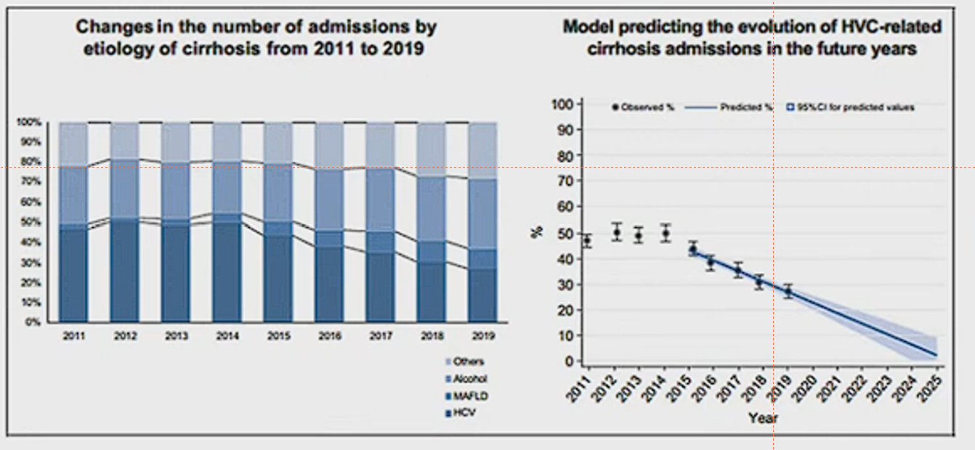
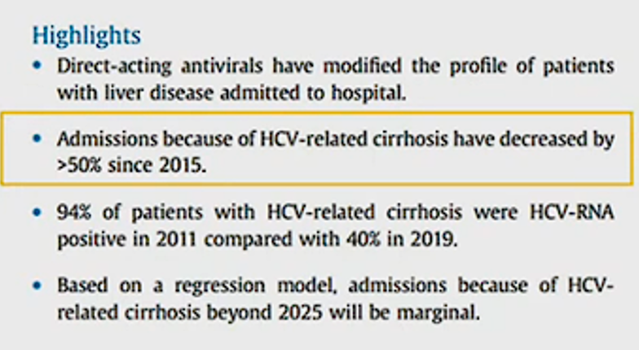
Reduction in Hospital Admission Related to HCV Infection
Rodriguez-Taje S et al J Hepatol 2020

Slide 31
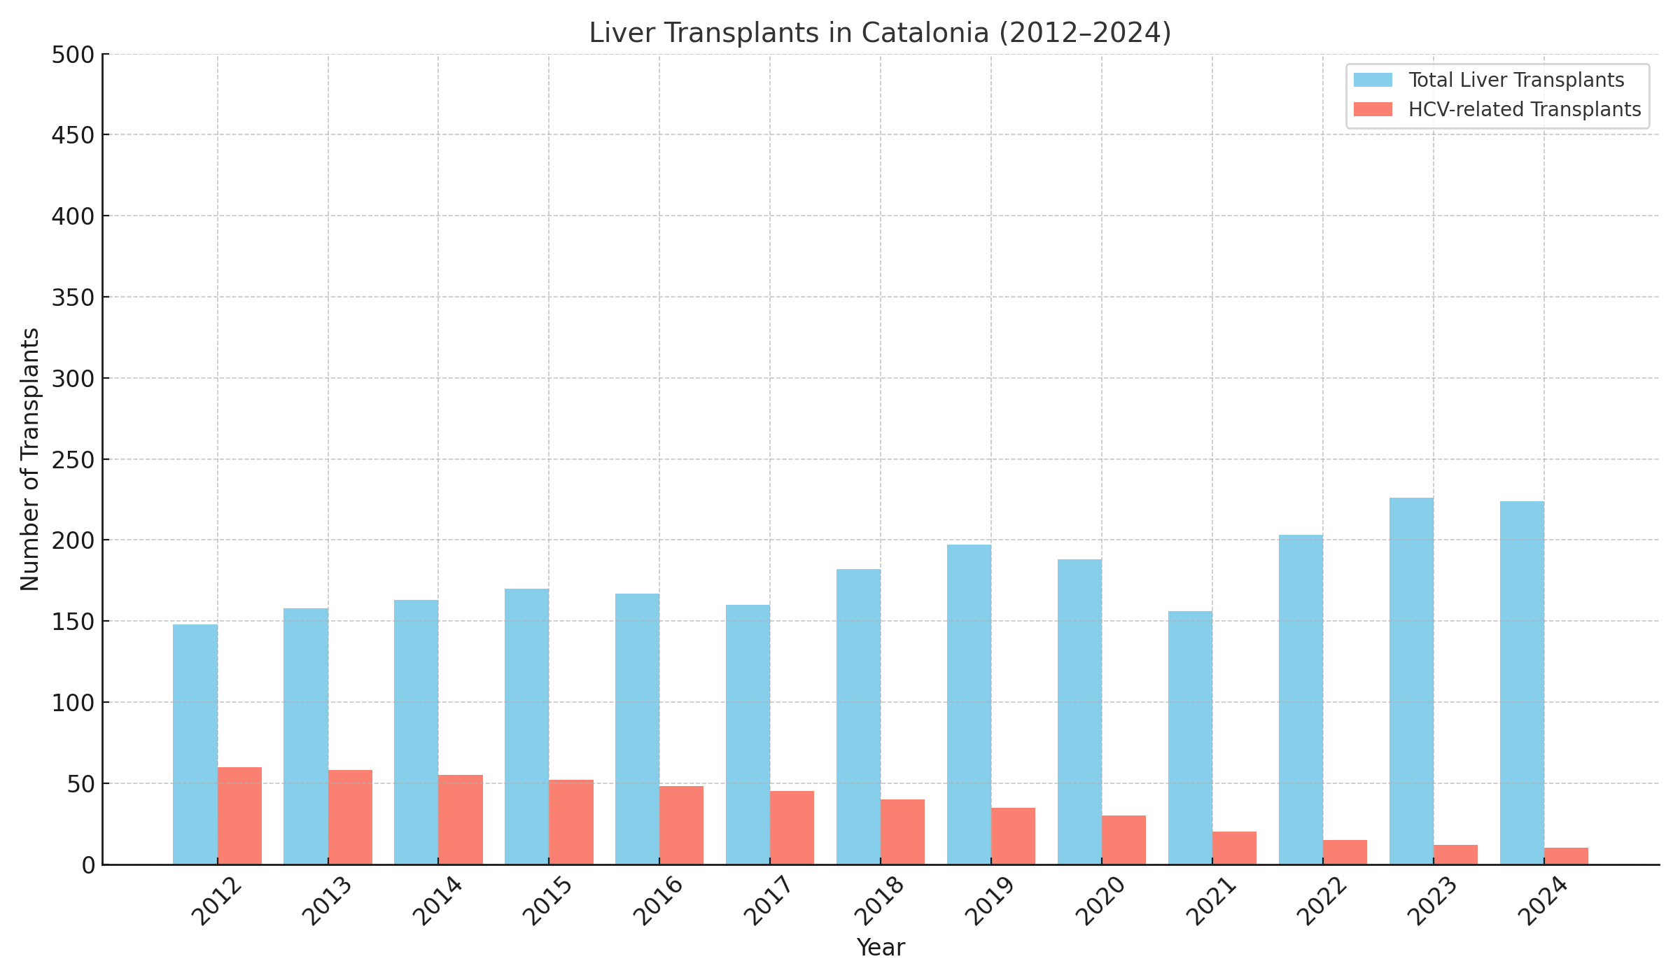
Proportion of liver transplant related to hepatitis C in Catalonia

Slide 32
Hepatitis B and C combined mortality
864 deaths in Catalonia registered with causes of death attributable to HCV and HBV
Mortality rates attributable to HBV and HCV in Catalonia
Morts x 100.000 persones
Catalonia Transplanation Registry

Slide 33

Hepatitis C Where are we?
We are treating fewer and fewer people... because there are fewer and fewer people left to treat!
We must make an intensive equity effort to find the most vulnerable people and those with the highest barriers to access the healthcare system.
No one can be left behind!

