Slide 1
Achieved results in screening and treatment of hepatitis B and C in Uzbekistan
Laziz Tuychiev, MD, Professor
Research Institute of Virology
of the Republic of Uzbekistan

Slide 2
Creation of a monitoring system for chronic viral hepatitis B, C and Delta (Stage 1)
Resolution of the Cabinet of Ministers No. 537
2017-2021
Specialized structures have been created in 13 regions of Uzbekistan.
Start of antiviral therapy for patients with viral hepatitis C at the state expense (1 million US dollars annually).
UHEP With the support of CDAF (USA)
2018-2020
Start of screening of population for viral hepatitis B and C in Tashkent (62,000 people).
2021-2022
Expansion of population screening for viral hepatitis B and C in Tashkent and 6 regions (500,000 people).

Slide 3
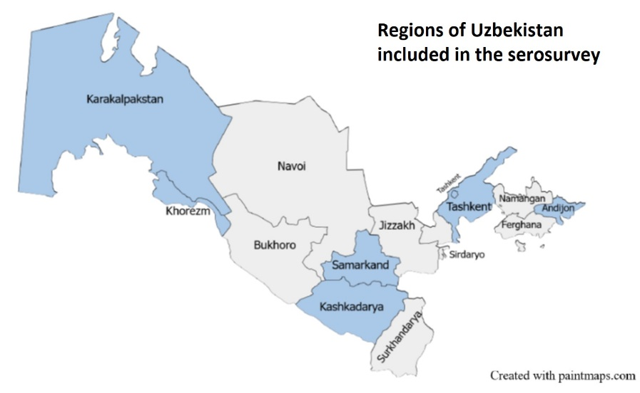
Serological survey for Hepatitis B and Hepatitis C
in Uzbekistan, 2021 (with CDC support)
It was first population-based study on hepatitis B and C in 7 regions of Uzbekistan.
More than 9000 adults and 4000 children.
Testing for hepatitis B, C and D viruses provided valuable information, such as:
Prevalence;
Epidemiology – age, sex, geographic distribution, risk factors;
Testing, treatment and vaccination;
Population awareness and knowledge.

Slide 4
Prevalence of Hepatitis B, C, D
Hepatitis | Markers | Overall (≥5 years), % (95% CI) | Adults (≥18 years), % (95% CI) | Children (5-17 years), % (95% CI)
В | anti-HBc | 34,5 (32,2-36,8) | 44,1 (41,6-46,6) | 7.1 (4.4-9.8)
 | HBsAg | 4.1 (3.2-5.0) | 5.4 (4.2-6.5) | 0,4 (0,1-0,7)
С | anti-HCV | 3,4 (2,9 – 3,9) | 4,3 (3,6–5,0) | 0,8 (0,4–1,3)
 | RNA HCV | 1,5 (1,2 – 1,9) | 1,9 (1,5–2,3) | 0,4 (0,1–0,8)
D | anti-HDV (among HBsAg+) | 16,0 (8,9-23,0) | 15,8 (8,6–23,0) | 22,4 (0,0–51,7)
 | RNA HDV (among anti-HDV+) | 74,8 (60,5-89,2) | 73,9 (58,9-88,9)​ | 100.0 (-)​
 | RNA HDV (among HBsAg+) | 11,9 (5,6-18,3) | 11,7 (5,2 – 18,1) | 22,4 (0,0 – 51,7)
Notes:
Полученные результаты показывают высокий уровень

Slide 5
Awareness and Knowledge of Hepatitis
Only about half responders had heard of hepatitis B or hepatitis C.
More respondents had heard of viral hepatitis B (55%) than of viral hepatitis C (41%).
Knowledge of transmission routes and prevention of viral hepatitis:
On average, participants answered about half of the questions correctly.
~50% knew about transmission through blood, through the use of shared needles/syringes, etc.
~50% indicated avoiding unsterile medical equipment and sharing needles/syringes, as well as vaccination against hepatitis B as ways to prevention, 22% believe that hepatitis C can be prevented with a vaccine.
Very few knew about sexual transmission and mother-to-child transmission.

Slide 6
Hepatitis Awareness and Knowledge
Overall, awareness and knowledge about viral hepatitis is low, with some mistaken beliefs.
Low awareness of viral hepatitis B and C leads to low knowledge and, as a result, low coverage of viral hepatitis testing, treatment and adult vaccination, as well as suboptimal behavioral practices.
Improving the implementation of information and educational activities in the national viral hepatitis plan can be suggested.

Slide 7
4-year program for screening of hepatitis B and C, treatment of viral hepatitis C (Stage 2) by Resolution of the President of the Republic of Uzbekistan No. 243, 2022
Increasing screening for viral hepatitis B and C in all regions of the country.
Covered by vaccination of health workers against hepatitis B.
Free treatment of patients with viral hepatitis C.
Creation and maintenance of a single electronic registry of chronic viral liver diseases.
Improving control over the safety, quality and effectiveness of vaccines, test kits and antiviral drugs.
Conducting scientific research on the problems of viral infections.
Organization of widespread explanatory and informational work among the population on measures to prevent viral hepatitis

Slide 8

Maintaining high levels of childhood vaccination (94-96%)
Type of vaccine | Plan | Number of vaccinations | %
HBV | 926001 | 921875 | 99,6
BCG | 925423 | 920816 | 99,5
OPV | 3914927 | 3783702 | 96,6
Rotavirus | 2666952 | 2644008 | 99,1
Pentavalent | 2491649 | 2399326 | 96,3
Number of vaccinations | Plan | Number of vaccinations | %
Pneumococcus | 2549913 | 2486868 | 97,5
MMR | 1606254 | 1593743 | 99,2
TDaP | 871267 | 857571 | 98,4
IPV | 1700377 | 1683350 | 99,0
АDT-М | 1261512 | 1252987 | 99,3
HPV | 743922 | 740608 | 99,6

Slide 9
Regions | Rapid test for HBsAg (2023-05.2025) | HBsAg positive (2023-05.2025) | %
Republic of Karakalpakstan | 110 089 | 2 111 | 1,9
Andijan region | 154 509 | 5 644 | 3,7
Bukhara region | 97 506 | 4 319 | 4,4
Jizzakh region | 82 976 | 2 018 | 2,4
Kashkadarya region | 76 363 | 2 767 | 3,6
Navoi region | 78 070 | 1 667 | 2,1
Namangan region | 112 996 | 4 093 | 3,6
Samarkand region | 101 973 | 2 840 | 2,8
Syrdarya region | 68 939 | 1 545 | 2,2
Surkhandarya region | 129 952 | 3 124 | 2,4
Tashkent region | 101 254 | 2 723 | 2,7
Fergana region | 145 145 | 3 988 | 2,7
Khorezm region | 108 055 | 2 394 | 2,2
Tashkent city | 180 965 | 3 516 | 1,9
Total | 1 548 792 | 42 749 | 2,8

Slide 10
New national recommendations for antiviral treatment of hepatitis B (MOH, 2024)
Significant liver fibrosis (F2) or cirrhosis (F4) - regardless of HBV DNA level and ALT level
Or HBV DNA>2000 and ALT level above the upper limit of normal (6-12 months)
Without access to HBV DNA testing:
persistently elevated ALT levels (more than two normal values ​​over a 6-12 month period), patients with HBsAg (quantitative) >1000 IU/ml
Or presence of co-infection with HIV, HDV, HCV, family history of liver cancer or cirrhosis
Immunodeficiency
Concomitant diseases (diabetes, steatohepatitis)
Extrahepatic manifestations (glomerulonephritis, vasculitis)

Slide 11
Regions | Rapid test for anti HCV (2023-2025) | Anti HCV positive (2023-2025) | %
Republic of Karakalpakstan | 110 088 | 3 282 | 3,0
Andijan region | 154 776 | 7 444 | 4,8
Bukhara region | 97 390 | 3 845 | 3,9
Jizzakh region | 82 976 | 1 001 | 1,2
Kashkadarya region | 76 563 | 4 085 | 5,3
Navoi region | 78 071 | 2 140 | 2,7
Namangan region | 112 429 | 4 422 | 3,9
Samarkand region | 101 966 | 1 686 | 1,7
Syrdarya region | 68 898 | 1 018 | 1,5
Surkhandarya region | 129 963 | 2 559 | 2,0
Tashkent region | 101 065 | 2 145 | 2,1
Fergana region | 145 054 | 4 867 | 3,4
Khorezm region | 108 068 | 3 252 | 3,0
Tashkent city | 181 620 | 10 112 | 5,6
Total | 1 548 927 | 51 858 | 3,3

Slide 12
HCV PCR determination (qualitative)
Regions | Anti HCV positive (2023-2025) | Tested for HCV PCR | Tested for HCV PCR in %
Republic of Karakalpakstan | 3 282 | 2 540 | 77,4
Andijan region | 7 444 | 2 675 | 35,9
Bukhara region | 3 845 | 1 215 | 31,6
Jizzakh region | 1 001 | 564 | 56,3
Kashkadarya region | 4 085 | 1 959 | 48,0
Navoi region | 2 140 | 1 651 | 77,1
Namangan region | 4 422 | 2 431 | 55,0
Samarkand region | 1 686 | 326 | 19,3
Syrdarya region | 1 018 | 410 | 40,3
Surkhandarya region | 2 559 | 1 965 | 76,8
Tashkent region | 2 145 | 932 | 43,4
Fergana region | 4 867 | 3 500 | 71,9
Khorezm region | 3 252 | 3 153 | 97,0
Tashkent city | 10 112 | 7 374 | 72,9
Total | 51 858 | 30 695 | 59,2

Slide 13
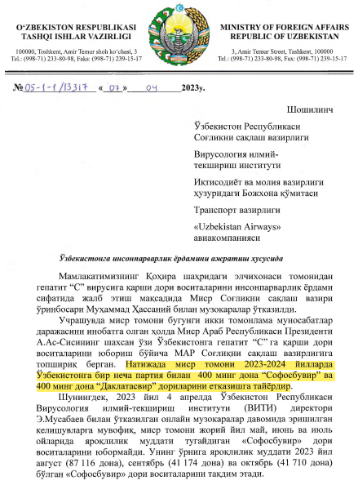
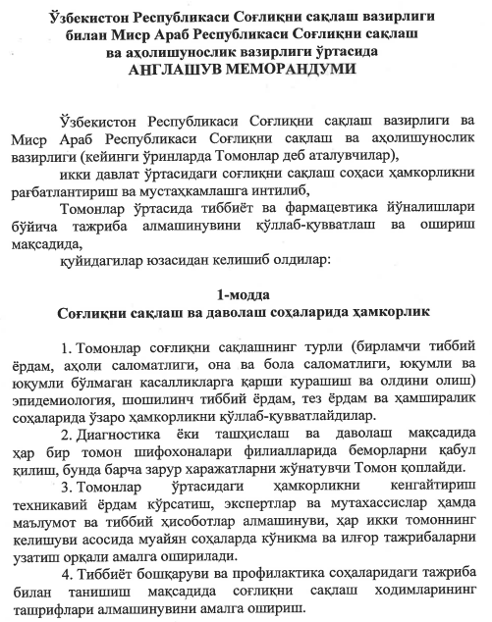
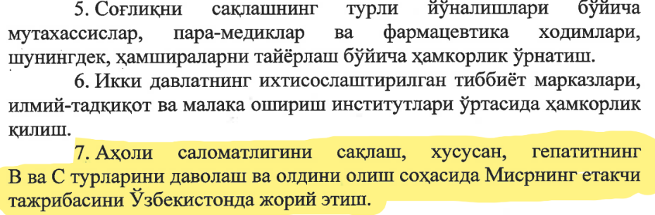
Memorandum of Understanding with the Ministry of Health of the Arab Republic of Egypt on the provision of humanitarian aid to Uzbekistan
2023-2024 - 400 thousand units of Sofosbuvir and 400 thousand units of Daclatasvir prepared for delivery.
Transfer of Egypt's leading experience to the Uzbek side in the field of public health initiatives, especially in the fight against hepatitis B and C.

Slide 14
Number of anti-HCV screening tests performed
and patients treated
(SOF+DAC, 3-6 months)

Slide 15

Patients with DAA failure in HCV
(Institute of Virology, 2016–2025)
From 2016 to 2022 - 16 patients;
In 2023 - 11 patients;
In 2024 - 29 patients was non-responded to treat SOF/DAC or SOF/LED or SOF/VEL.
Of these:
15 patients had genotype 1b,
9 had genotype 3a,
1 -genotype 1a,
5 cases the genotype could not be determined.
More information about DAA failure and virus mutation – in presentation by Evgeniya Kazakova
“When the Virus Doesn't Retreat: HCV Drug Resistance in a Real Case”.

Slide 16
Development and implementation of a 5-year program for screening HBsAg (+anti-HDV) and anti-HCV of the population of Uzbekistan (18+) and elimination of viral hepatitis C (Stage 3)
Approval of the National Program for the Elimination of Viral Hepatitis for 2026–2030.
Screening for HBV and HCV – 21 million adults and treating patients with hepatitis C;
Extension of the Memorandum between the Republic of Uzbekistan and the Arab Republic of Egypt for 2026–2030: antiviral drugs received for free;
Continuation of studies to identify non-responders to SOF/DAC therapy and introduction of new treatment regimens

Slide 17
Developmend support of the initiative to eliminate viral hepatitis in Uzbekistan
(Project of the Institute of Virology and CDC, 2025)

Slide 18
Development of a 5-year National Strategy for the Elimination of Viral Hepatitis for 2026-2030
(by WHO recommendations)
Prevention and control: Optimization of hepatitis B vaccination programs. Ensuring blood and injection safety.
Testing and diagnostics: Expanding access to testing for hepatitis B and C. Improving laboratory diagnostics.
Information and educational activities: Raising awareness among the population and health workers.
Surveillance and Data Management: Improving Epidemiological Surveillance Systems.
Treatment and care: Ensuring access to antiviral therapy. Integrating hepatitis services into primary care.
Resource mobilization and promotion.

Slide 19
Improving the capacity of laboratories and primary health care facilities to availability access to hepatitis screening, diagnosis and treatment services across Uzbekistan
Expansion of PCR testing in the regions.
Conducting external quality assessment (EQA) in PCR laboratories.
Development of panels for EQA in PCR laboratories.
Development of training materials and conducting trainings for regional laboratories.

Slide 20
HCV micro-elimination program in high-risk groups
Implementation of targeted screening, testing and treatment of HCV and HBV among patients in hemodialysis centers, patients in oncohematology departments.
Development of guidelines for the prevention, screening and management of HBV and HCV in hemodialysis centers and oncohematology departments.
Data collection and monitoring.
Preventive measures.
Training health care workers on new guidelines, screening protocols, and data collection.

Slide 21
Development of information campaign to improve knowledge about viral hepatitis
Objective: to raise public awareness of parenteral viral hepatitis, screening and treatment programs.
Development of educational materials in Uzbek, Karakalpak and Russian languages.
Implementation of educational initiatives to raise awareness of viral hepatitis and available treatment methods among the general population.

Slide 22
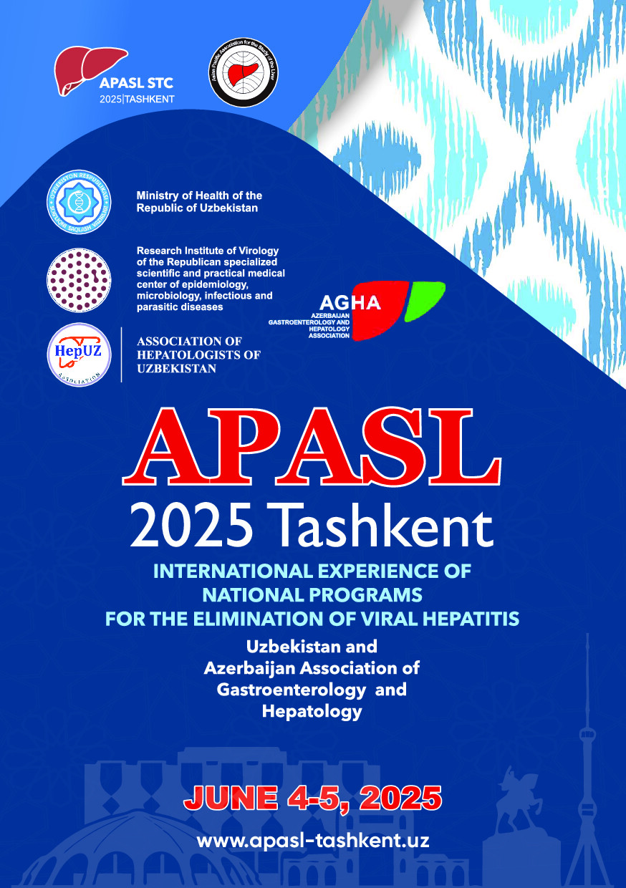
THANK YOU FOR YOUR ATTENTION

Slide 23

Questions for discussion
Is it necessary to perform quantitative determination of the HBV viral load before starting antiviral therapy? Quantitative HBsAg might be enough?
Is it necessary to perform HCV PCR determination after anti-HCV positive screening before antiviral treatment?
Is it possible to achieve best practices the WHO 2030 viral hepatitis elimination targets:
Reduce new cases of chronic infection by 90%.
Reduce hepatitis-related deaths by 65%.
Treat 80% of all treatable patients?

