Slide 1

Hepatitis B Elimination Program in Türkiye
Prof. A.Kadir Dökmeci
Emeritus Professor, Ankara University
Past President of APASL
APASL STC 2025, 4-5 June 2025 Tashkent, Uzbekistan

Slide 2
Disclosure of Conflict of Interest
I have nothing to declare for this study

Slide 3
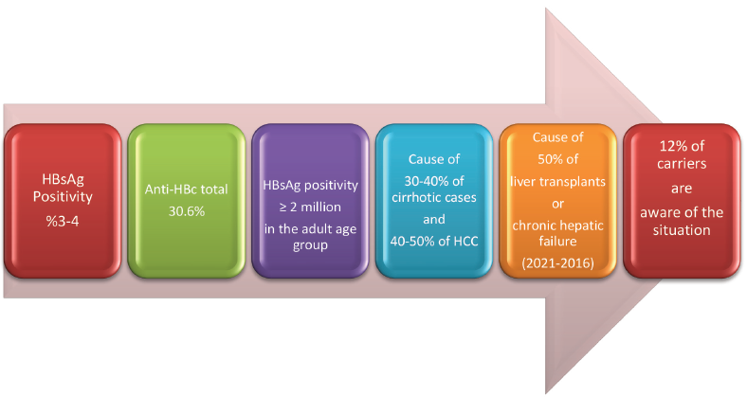
Epidemiologic Features of HBV Infection in Türkiye
Akarca et al. Viral Hepatitis Journal 2022;28(2):47-54

Slide 4
(WHO-2016) Targets to Eliminate Viral Hepatitis as a Public Health Risk by 2030
Reduction in the risk of new infections ; 90%
Reduction in the number of hepatitis patients that can be treated; 80%
Reduction in hepatitis-related mortality; 65%
To reach undiagnosed patients (elligible treatable) 88%

Slide 5
Development of Strategy in Türkiye
Declaration Global Health Sector Strategy on Viral Hepatitis by the WHO in 2016
Turkish Goverment ; National strategy prevention and control program covering 2018-2023 to reach goals by 2030
Road maps projects were carried out for prevention of hepatitis B, together with hepatitis associations

Slide 6
The aims of Turkish Viral Hepatitis Prevention and Control Program for HBV
To raise awareness throughout Turkish society,
particularly among those groups who are most at risk
Intention of preventing disease transmission
Vaccination
Early diagnoses
Appropriate guidance for the treatment plans, to the prevention of cirrhosis and liver cancer
To reduce the negative socio-economic impact of HBV
Meşe EA, ..Akarca U,..Dokmeci AK, et al. Turkish viral hepatitis prevention and control program
(2018-2023). https://dosyahastane.saglik.gov.tr/Eklenti/62428,viral-hematit-onlemepdf.pdf?0
Turkish Viral Hepatitis Prevention and Control Program(2018-2023.
Ministry of Health Ed. No, Ankara, 2019, www.hsgm.saglik.gov.tr

Slide 7
Report of Coalition for Global Hepatitis Elimination for Türkiye
Persons living with HBV diagnosed ;14.24 (%)
Diagnosed persons receiving appropriate HBV treatment ; 28.33 (%)
HepB Newborn Vaccination Coverage of HepB birth dose ; 99 (%)
HBV-related death rate ; (per 100,000) 6.28
https://www.globalhep.org/data-profiles/countries/turkey, 2022 , Survey/reported
Notes:
ccination

Slide 8
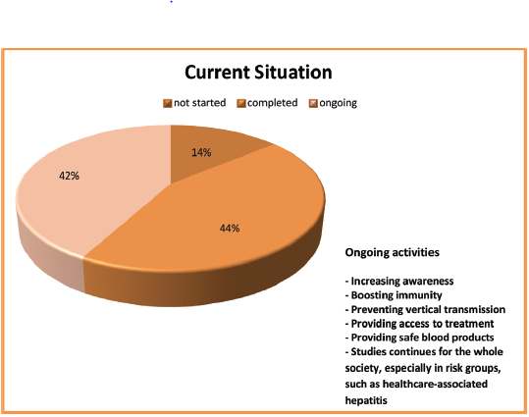
Turkish Viral Hepatitis Prevention and Control Program evaluation in 2021
(Activites)
Akarca et al. Viral Hepatitis Journal 2022;28(2):47-54

Slide 9
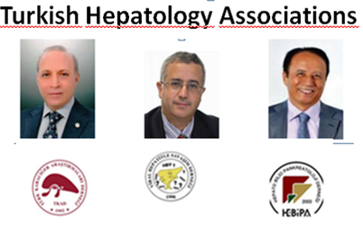
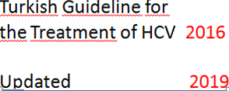
Contribution to Turkish National Action Plan for Viral Hepatitis Prevention and Control Program
National Hepatitis B
Elimination Roadmap 2022

Slide 10
National Hepatitis B Elimination Roadmap (The project process consisted of five stages)
Review of current hepatitis B strategies and plans,
Conducting preliminary interviews,
Conducting workshops,
Preparation of the Hepatitis B Elimination Roadmap within the scope of the National Hepatitis Elimination Program,
Evaluation of National Hepatitis B Elimination Roadmap projects.
Akarca et al. Viral Hepatitis Journal 2022;28(2):47-54

Slide 11
Recommendations for Progress of the Program (2022)
Priorition
Awareness and screening ; Firstly, by healthcare associate professionals
Face-to-face training activities
Learning efficacy after the training sessions
Integration of an obligatory follow-up for HBsAg(+)
Screening in all individuals above the age of 18 and in younger high risk individuals
Collection of ccurate and reliable surveillance data
Collection of the screening data
Having an electronic identity card

Slide 12
Basic Factors of Turkish National Hepatitis B Elimination Roadmap
Raising awareness
Increasing screening and surveillance programs
Reducing viral transmission
- Providing safe blood products
- Prevention of viral hepatitis transmisson among
people who inject or use drugs
- Prevention of healthcare-associated transmission
- Control of vertical transmission
Increasing immunization
Increasing access to treatment

Slide 13
Public Awareness of HB Infection in Türkiye
Status | N = 181 (%)
“Advanced” education levels | 91 (51%)
Knowledge about HBV infection and transmittance | 108 (60%)
Aware of the ill consequences of HBV infection | 130 (72%)
Vaccinated their family members | 120 (66%)
Promoting better awareness of HBV and endorsing mass educational interventions
may be useful strategies to prevent the spread of HBV infection
Gurakar A et al. Turk J Gastroenterol 2014; 25: 304-8

Slide 14
Activities for Training and Raising Awareness to Prevent HBV Infection
The Viral Hepatitis Educator Guide and educational slide sets were prepared and shared by the Ministry of Health in 20222
Family physicians have been training regularly.
Meetings were organized in various provinces to raise public awareness of hepatitis among the public, and posters were posted on billboards.
The National Haemovigilance Guide for safe blood transfusion was updated in 2022
The perception of “if the patient is a carrier, nothing is needed” should be changed by regular training.

Slide 15
Strategies of Turkish Hepatitis Prevention and Control Program
Raising awareness
Increasing screening and surveillance programs
Reducing viral transmission
- Providing safe blood products
- Prevention of viral hepatitis transmisson among
people who inject or use drugs
- Prevention of healthcare-associated transmission
- Control of vertical transmission
Increasing immunization
Increasing access to treatment

Slide 16
Strategies for Screening and Surveillance in Türkiye (1)
All voluntary blood donations for HBV since 1993
All registered sex workers are tested for hepatitis B every three months.
Couples who appeal for marriage, since 2002
Antenatal screening for HBsAg among pregnant women is not mandatory
Advertisements on visual and written media
Training programmes for physicians were implemented
A series of faceto-face training sessions will be organized with the participation of family physicians.
Screening and training of personnel working in
hospitals should be obligated
Turkish Viral Hepatitis Prevention and Control Program (2018-2023).
Ministry of Health Ed. No, Ankara, 2019, www.hsgm.saglik.gov.tr

Slide 17
Strategies for Screening and Surveillance in Türkiye (2)
Absolute screening of adults is recommended in regions with a prevalence of more than 0.1%
Surveillance data should be collected and handled by the Ministry of Health and used in national health policymaking
Hepatitis B screening data collecting activities should be centralized and confirmed carrier status could be transmitted to relevant professionals and institutions
An electronic identity card specific to the prevention of Hepatitis B could be designed
Turkish Viral Hepatitis Prevention and Control Program (2018-2023).
Ministry of Health Ed. No, Ankara, 2019, www.hsgm.saglik.gov.tr

Slide 18
Regional Differenses in Türkiye Regarding with Notification
Notification rates differed by geographical region
Highest rates identified in Istanbul, western Marmara, the Black Sea and middle Anatolia.
Residents of eastern, particularly south-eastern Anatolia have higher rates of HBsAg positivity
Toy et al. (meta-analysis) , 1999 and 2009 Highest rates in the eastern parts of Turkey
Ay P et al. Euro Surveill. 2013;18(47):pii=20636. http://www.eurosurveillance.org.

Slide 19
Strategies of Turkish Hepatitis Prevention and Control Program
Raising awareness
Increasing screening and surveillance programs
Reducing viral transmission
- Providing safe blood products
- Prevention of viral hepatitis transmisson among
people who inject or use drugs
- Prevention of healthcare-associated transmission
- Control of vertical transmission
Increasing immunization
Increasing access to treatment

Slide 20
90% of cases of chronic hepatitis B infection transmitted during the perinatal period Control of Vertical Transmission
Ensuring hospital delivery (The rate ; Western Türkiye > Eastern Türkiye)
Rigorous prenatal counseling
Standard management protocols
HBV vaccine and immunoglobulin to high-risk
babies at the time of birth ( 92-98%)

Slide 21
Strategies of Turkish Hepatitis Prevention and Control Program
Raising awareness
Increasing screening and surveillance programs
Reducing viral transmission
- Providing safe blood products
- Prevention of viral hepatitis transmisson among
people who inject or use drugs
- Prevention of healthcare-associated transmission
- Control of vertical transmission
Increasing immunization
Increasing access to treatment

Slide 22
Vaccination in Türkiye
National immunization programme ; 1998
First dose; - End of second month after birth 1998-2002
- At birth since 2003
Complete dose;
- At birth
- First month
- Sixth month
Catch-up vaccination
- Primary School; between 2005 and 2009
- High risk adults

Slide 23
Vaccination in Turkey
Vaccination is the most efficacious way to prevent HBV
Turkey’s vaccination rate has increased from 64% in 1994 to 98% in 2016.
Catch-up vaccination was administered to those who were in first or middle school between 2005 and 2009
Theoretically, most people born in 1991 or later have completed their primary vaccination.
Turkish Viral Hepatitis Prevention and Control Program(2018-2023. Ministry of Health Ed. No,
Ankara, 2019, www.hsgm.saglik.gov.tr

Slide 24
Hepatitis B Vaccine for Infants
Vaccination of newborn: in the first 24 hours
HBsAg-positive mothers: Vaccine + BHIG 0.5 within the 12 hours
Mother (HBsAg -) and newborns weigt <2.000 g,
the first dose of vaccine : 1-month of age
Mother (HBsAg +): Vaccine and + BHIG 0.5 within the 12 hours
Mother (HBsAg -) : No testing for Infants
Arısoy ES et al. J Pediatr Inf 2020;14(3):e160-e174

Slide 25
Vaccination Status Among Healthcare Students
Public health activities to control HBV infection have increased in the last three decades.
HBV vaccination rate among university students in the healthcare was high, but lower than the country targets
Susceptible students should be vaccinated against HBV.
Aciksoz A et al. Hum Vac & Immun. 2021, VOL. 17, NO. 11, 4595–4602

Slide 26
HB vaccination; Free of Charge
Children
Hemodialysis patients, solid organ or bone marrow transplantation candidates or recipients,
Intravenous drug users,
People who live with HBV carriers
Multiple sexual partners
Sex workers, bisexual men
People who have chronic liver disease
People who work in prison or detention centers and prisoners
Health-care staff
Barbers, manicurists, tattooist
Turkish Viral Hepatitis Prevention and Control Program(2018-2023. Ministry of Health Ed. No,
Ankara, 2019, www.hsgm.saglik.gov.tr

Slide 27
Changing of HBsAg-Positivity in Adukts According to Year Intervals in Istanbul
20-year period | HBsAg-positivity rate N= 20.001
1995-2002 | 5.3%
2003-2009 | 4.8%
2010-2015 | 3.1%
Furuncuoğlu Y et al. Viral Hepat J. 2016;22:88-91.
Notes:
A study of 26,001 adult patients comparing the change of HBsAg-positivity rate in 20-year period found that HBsAg positivity in 1995-2002, 2003-2009, and 2010-2015 was 5.3% to 4.8% and 3.1%, respectively.⁶ The results of this study showed that National Hepatitis Program achieved a reduction in incidence of HBV infection.

Slide 28
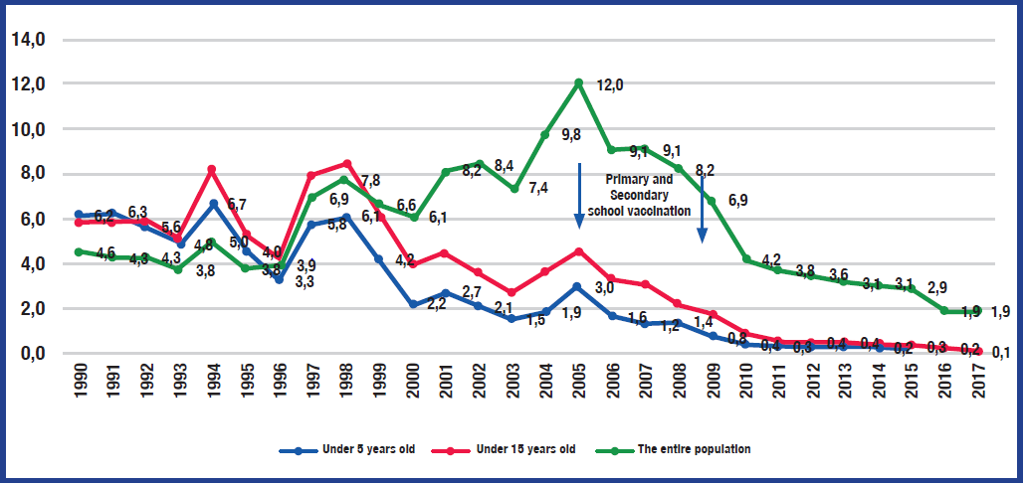
Acute Hepatitis B Incidence Based On Years and Age Groups,Türkiye, 1990-2017
(One Hundred Thousand
In Türkiye, acute hepatitis B incidence is gradually decreasing
Turkish Viral Hepatitis Prevention and Control Program(2018-2023. Ministry of Health Ed. No, Ankara, 2019, www.hsgm.saglik.gov.tr

Slide 29
Strategies of Turkish Hepatitis Prevention and Control Program
Raising awareness
Increasing screening and surveillance programs
Reducing viral transmission
- Providing safe blood products
- Prevention of viral hepatitis transmisson among
people who inject or use drugs
- Prevention of healthcare-associated transmission
Increasing immunization
Increasing access to treatment

Slide 30
Current Trends for the Traetment of HBV
Once daily oral ETV, TDF and TAF can suppress HBV DNA profoundly but have no direct action on cccDNA of the HBV-infected hepatocytes
In HBV-infected patients with certain charecteristics, treatment should be started without liver biopsy
The long-term goal of antiviral therapy has partly achieved by effectively reducing the incidence of HCC development
Existing antiviral therapy is still far from satisfactory now that new strategies and/or new drugs are emerging.

Slide 31
Future Trends for HBV
The incidence
- Widespread vaccine use in high-risk
groups
- High-risk behavior
- Effectiveness of antiviral drugs
Development of liver cirrhosis an HCC
Requiring liver transplant for advanced
hepatitis B
Notes:
Hepatitis B virus (HBV) is the most common cause of acute hepatitis virus infection and is estimated to account for about a third of clinically apparent cases of acute hepatitis
The incidence has declined over the last three decades probably as a result of widespread vaccine use in high-risk groups and reduction in high-risk behavior
Age-adjusted mortality and the number of patients requiring liver transplant for advanced hepatitis B are declining, which are likely attributable to the availability and effectiveness of antiviral drugs

Slide 32
Conclusion
The Turkish Viral Hepatitis Prevention and Control Program were announced by The Ministry of Health in 2018
After evaluation of the current status in 2020, the “National Hepatitis B Elimination Roadmap” was created in cooperation with Hepatology Associations in 2022.
National immunisation programme was started in1998
The actual rate of three doses of HBV vaccination in infants is 98%
Vaccination is free of charge to new born and high risk groups
Also, goverment covers for the treatment of hepatiits B infection

Slide 33








APASL 2026
Thank you for your attention
Thank you for your attention

