Slide 1
Two years of experience in early liver cancer screening as part of the national virus hepatitis elimination program in Uzbekistan Successes and disappointments
Erkin Musabaev, Aziza Raxmanova
Institute of Virology of the Ministry of Health of the Republic of Uzbekistan

Slide 2
HСС Risk Groups according to the 2023 AASLD Guidelines.
Group of population | HCC morbidity
Sufficient risk to guarantee surveillance
Child-Pugh A-B liver cirrhosis of any etiology Hepatitis B Hepatitis C (viremic or post-VVO) Alcoholic cirrhosis Non-alcoholic steatohepatitis Other etiologies | ≥1,0% в год | ≥1,0% in year
Child-Pugh C liver cirrhosis, transplantation candidate
Non-cirrhotic chronic hepatitis B Man from endemic country > 40 years old Woman from endemic country > 50 years old A man from Africa at an earlier age b Family history of HCC on PAGE-B ≥ 10 c scale | ≥0,2% в год | ≥0,2% in year
Insufficient risk and need for risk stratification models/biomarkers
Hepatitis C and fibrosis stage 3 Non-cirrhotic NAFLD | < 0,2% в год | < 0,2% in year
a Endemic country, as defined in the AASLD guideline for hepatitis B virus b. Observation can be started as early as the third decade of life, considering the average age at the time of diagnosis of HCC - 46 years. c It is possible to consider the possibility of using other risk calculators, although PAGE-B has been tested in Western populations receiving antiviral therapy.

Slide 3
AFP AND PIVKA II AS DIAGNOSTIC MARKERS OF HCC IN PATIENTS WITH LC 300 patients
Data from the Research Institute of Virology
Notes:
15 patients (5%) had both markers elevated; lesions were confirmed in all (12 by ultrasound, 3 by MSCT).
17 patients (5.5%) had isolated PIVKA II elevation; 9 had lesions on ultrasound, 8 on MSCT.
10 patients (3.3%) had isolated AFP elevation; 2 had lesions on ultrasound, 3 had none on MSCT, and 5 declined further testing.
In total, 34 patients (11%) had confirmed liver lesions (22 by ultrasound, 12 by MSCT).
During HCC screening of 90 patients with chronic viral hepatitis, 1.8% (2 patients) showed elevated PIVKA II levels, with liver lesions subsequently confirmed by instrumental research methods.

Slide 4
PIVKA II AS A DIAGNOSTIC MARKER OF HCC IN PATIENTS WITH CHRONIC VIRAL HEPATITIS
During screening for HCC among 90 patients with chronic viral hepatitis, 1.8% had elevated PIVKA II levels, and the formation was subsequently detected using instrumental research methods.

Slide 5
International experience
All of Japan is ahead of the planet.
Japan has achieved very favorable results in the treatment of hepatocellular carcinoma (HC). This achievement was facilitated by several factors. One such factor is the creation of a nationwide liver cancer screening program, developed in the 1980s and involving institutions across Japan. Japan was the world's first country to develop and implement diagnostic ultrasound systems for liver cancer screening. In addition to the already established tumor marker α-fetoprotein (AFP), other markers such as PIVKA-II and AFP-L3 were developed in Japan. These two tumor markers were included in screening tests covered by health insurance in 1989 and 1994, respectively. Japan is the only country in the world where these three oncomarkers are included in routine monitoring within the framework of national health insurance without restrictions.
Kudo, Masatoshi. "Management of hepatocellular carcinoma in Japan as a world-leading model." Liver Cancer 7.2 (2018): 134-147.

Slide 6
The Global Cancer Observatory - All Rights Reserved - March 2021.

Slide 8
DIAGNOSTICS OF HCC
СТ/МRI
histology
Ultrasound + oncomarkers

Slide 9
Actions for the early diagnosis of hepatocarcinoma, CARRIED OUT WITHIN THE FRAMEWORK OF THE NATIONAL PROGRAM FOR THE ELIMINATION OF VIRAL HEPATITIS
Implementation of new technologies for the early diagnosis of liver fibrosis and hepatocellular carcinoma after viral hepatitis | 1. Purchase of AFP and PIVKA-II kits for early diagnosis of liver fibrosis and hepatocellular carcinoma in 90,000 people for the Virology Research Institute and 14 regional hepatology centers; 2. Acquisition of a total of 46,000 test kits for the quantitative determination of HBsAg (virus antigen) in patients with hepatitis B. | 2022–2025 y. | $1,06 million $136000
Notes:
Читается слайд Далее…
There is a clause in the resolution that allows us to change the survey and funding figures in 2023. We plan to increase screening from 2024 to 2 million people and treatment of patients with hepatitis C to 30 thousand per year. Only in this case can we achieve WHO goals by 2030.
Pay attention to the 4 points on which we plan to start early screening for liver cancer in our country.

Slide 10
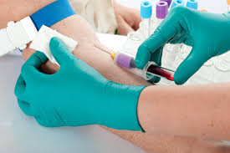
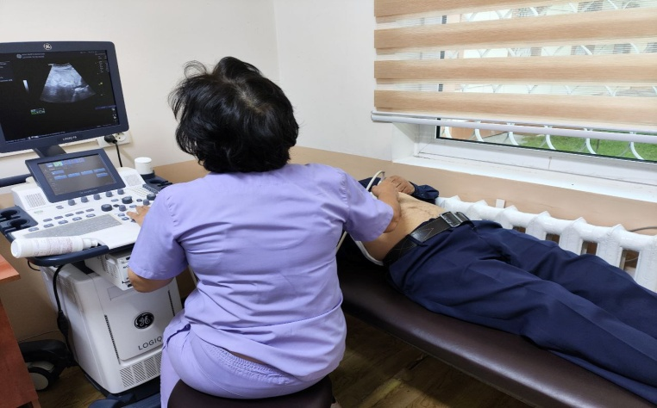
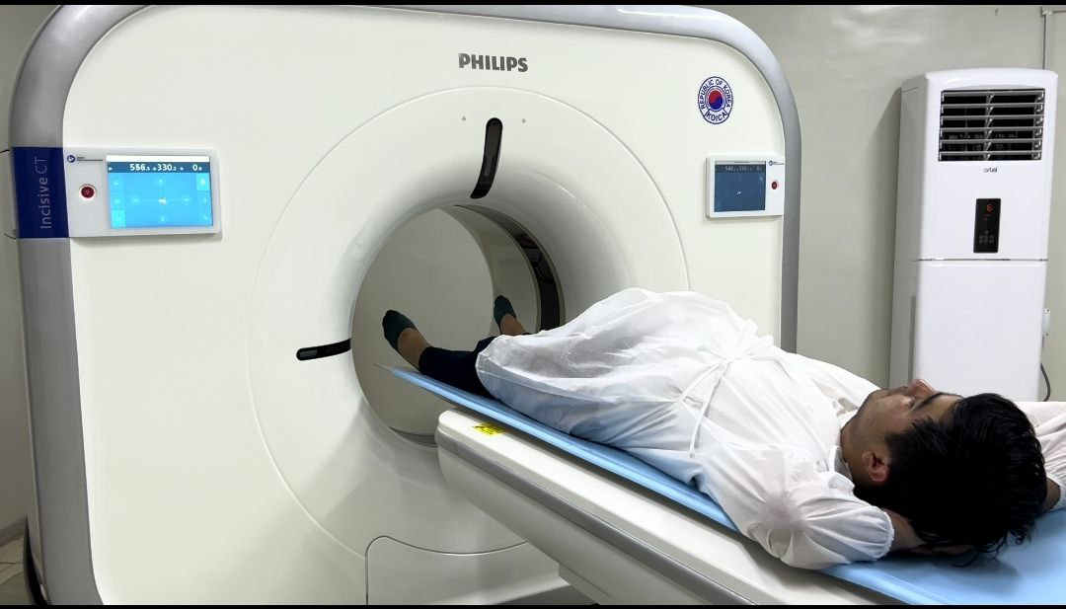
Number of individuals examined for AFP at the Virology Research Institute
Total number of those examined in the AFP |  | 3742 (100%)
Among them | AFP 0-14 IU/ml | 3381 (90,5%)
 | AFP 15-100 IU/ml | 223 (5,9%)
 | AFP 100-200 IU/ml | 51 (1,3%)
 | AFP above 200 IU/ml | 87 (2,3%)
Ultrasound and contrast MSCT examination results among patients diagnosed with viral hepatitis "B" and "C" and an elevated AFP level above 100 ng/ml.
Patients with higher APF 100 ng/ml | 138 (100%)
Visualization methods | 138 (100%)
Number of detected formations on ultrasound | 40 (29%)
Number of detected formations on MSCT | 84 (61%)

Slide 11
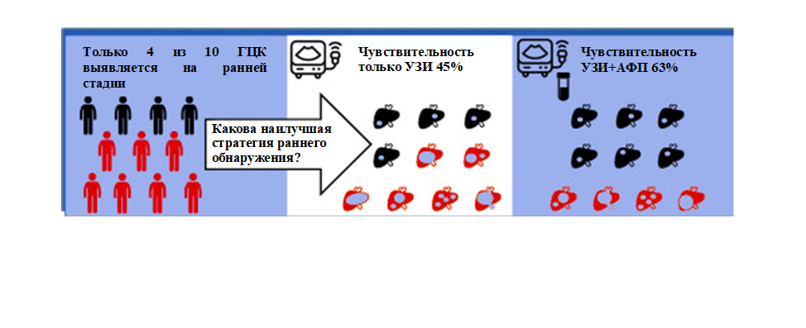
Ultrasound and alpha-fetoprotein for early detection of hepatocellular carcinoma in liver cirrhosis: meta-analysis
Авторы: Tzartzeva, Obi, Rich, Parikh, Marrero, Yopp, Waljee, Singal Gastroenterology 2018

Slide 12
Ultrasound is not an ideal independent observation instrument.
Depends on the operator/tool¹
Less accurate in patients with obesity²
Insufficient accuracy in patients with severe cirrhosis of the liver³
Small (less than 2 cm) lesions are difficult to detect³
A recent study has shown that more than half of the patients participating in monitoring programs receive ultrasound examinations of inadequate quality.⁴
Excellent 13 out of 154 (8.4%)
Good 44/154 (28.6%)
Satisfactory 44/154 (28.6%)
Poorly 53/154 (34.4%)
1. Bruix J et al. Hepatology. 2005;42:1208-36
2. Bruix J et al. Hepatology. 2011;53:1020-2
3. Bennett GL et al. AJR 2002;179:75–80.
4. Joshi et al. Dig Dis Sci 2014 JUL 16, In Print
Notes:
Slide 8- Why Ultrasound should be starting point for surveillance & survey data
The AASLD guideline recommended imaging modality of ultrasound is highly variable.
The quality of the ultrasound is operator and equipment dependent. Ultrasound quality and accuracy rapidly diminishes with obese patients and highly cirrhotic livers.
The ability to detect small (<2cm) lesions is poor.
To this point, a recent study conducted at the University of California San Diego found that almost 2/3 of patients that are in surveillance programs received fair or poor quality Ultrasound imaging.

Slide 13
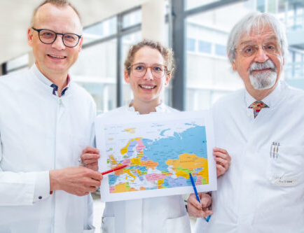
The Hannover Medical School, under the auspices of GIZ, has entered into clinical partnership with Uzbekistan and provides support in the training program for ultrasound diagnostics of hepatocellular carcinoma (HC).
PLUTHO Project (Prophylaxis of viral liver cancer in Uzbekistan: Tashkent-Hannover-Liver Network (HRC)).
HCC can be very well treated if we detect them early enough using sonography." However, this requires not only modern equipment but also qualified personnel.
https://biermann-medizin.de/mit-ultraschall-gegen-leberkrebs-partnerschaft-zwischen-der-mhh-und-usbekischer-klinik/

Slide 14
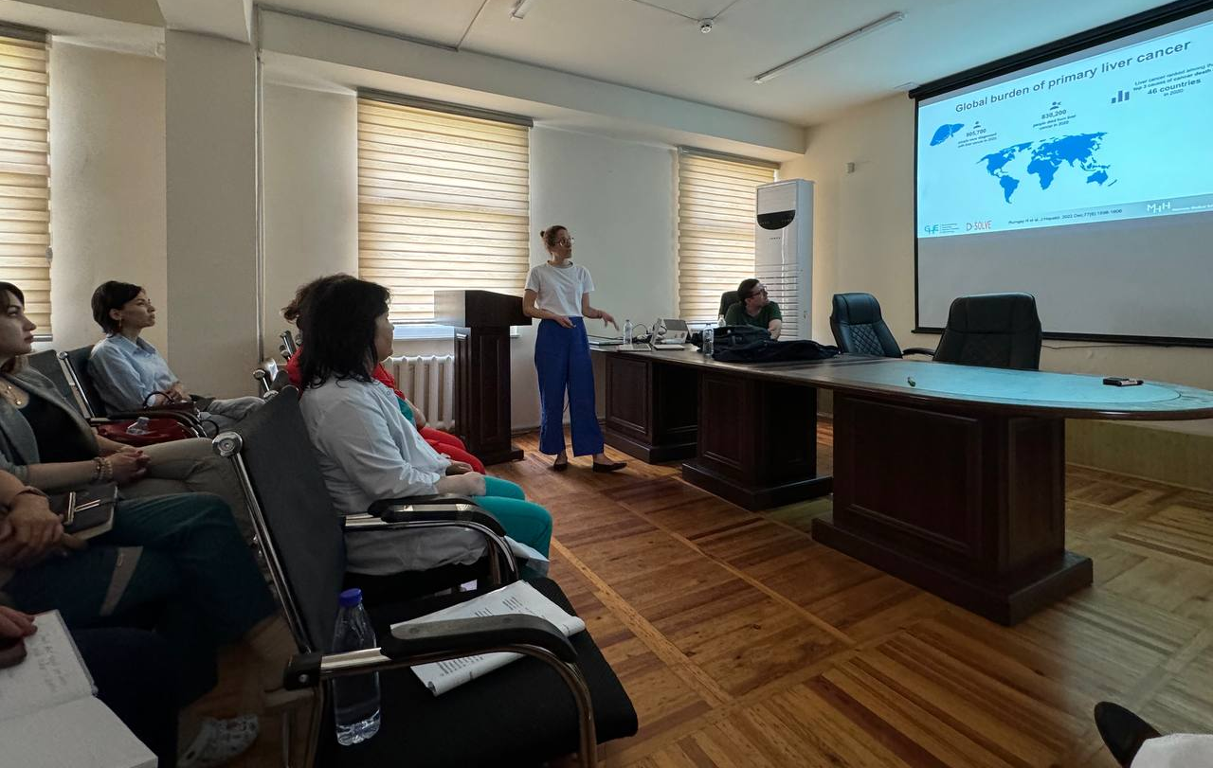
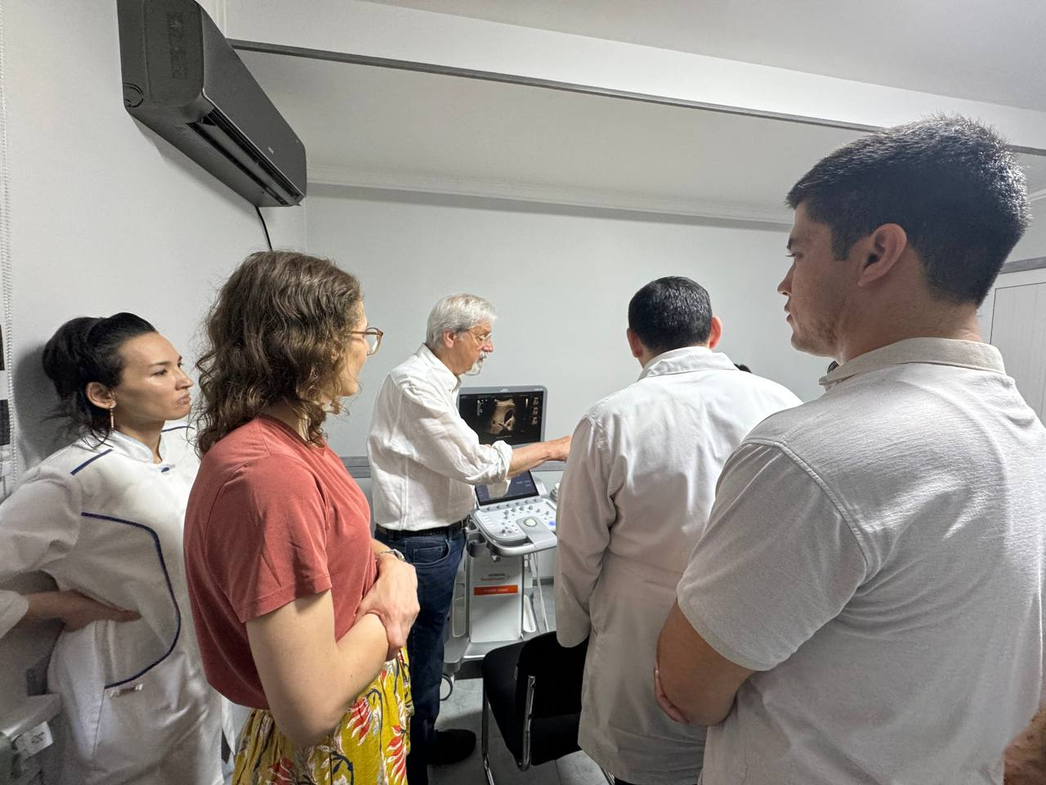
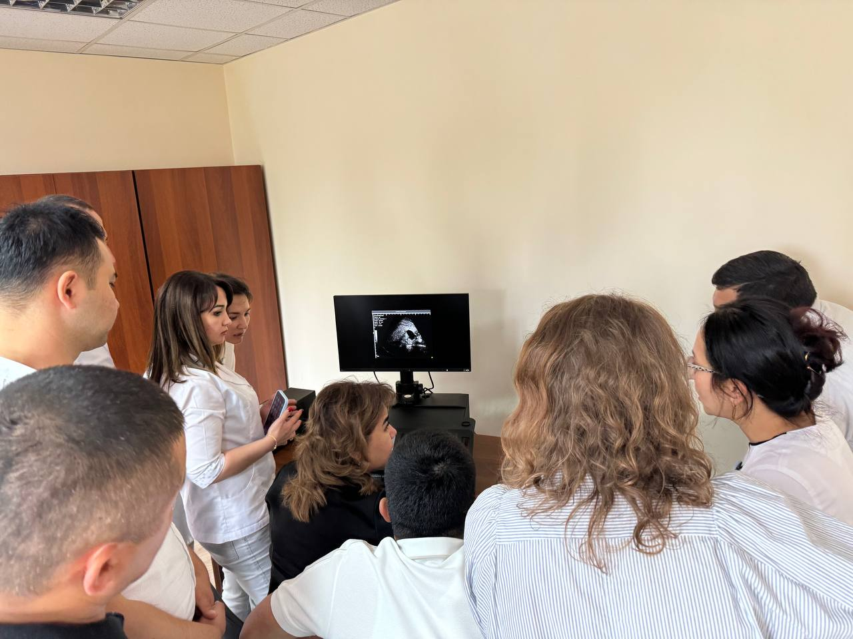
Four courses on the early diagnosis of HCC have already been conducted at the Virology Research Institute.

Slide 15
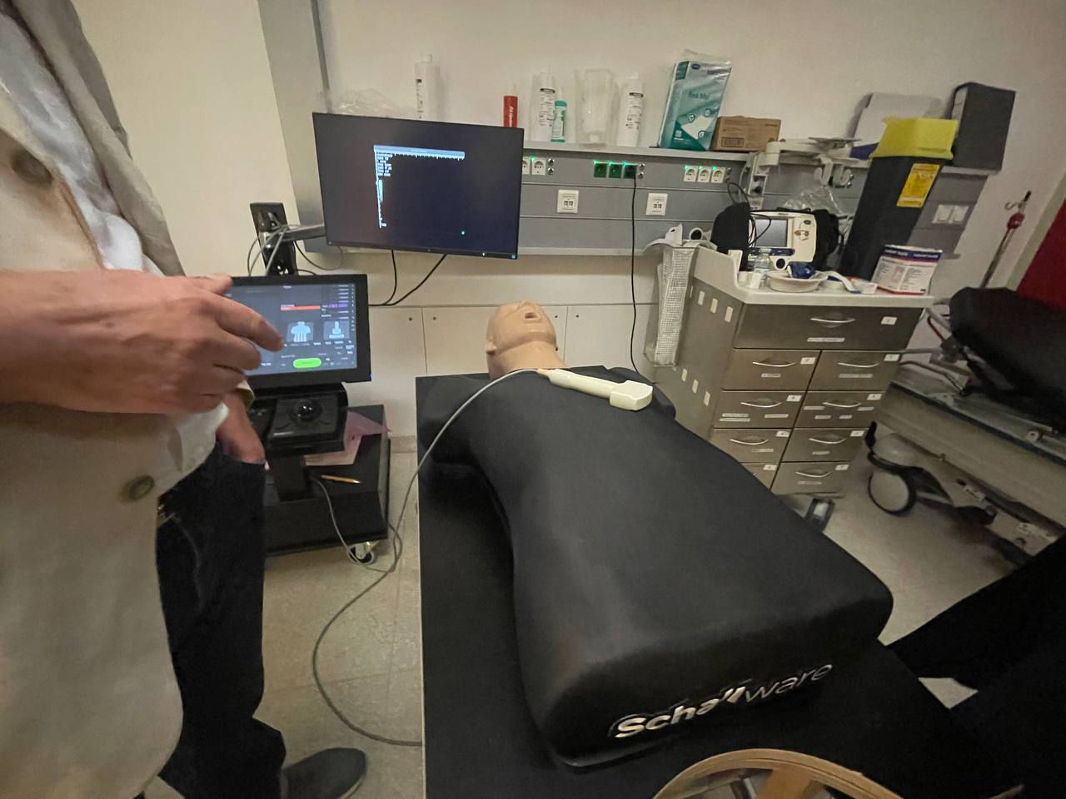
Ultrasound Specialist Training Simulation Center

Slide 16
Test results of the first of the 4 courses.

Slide 17
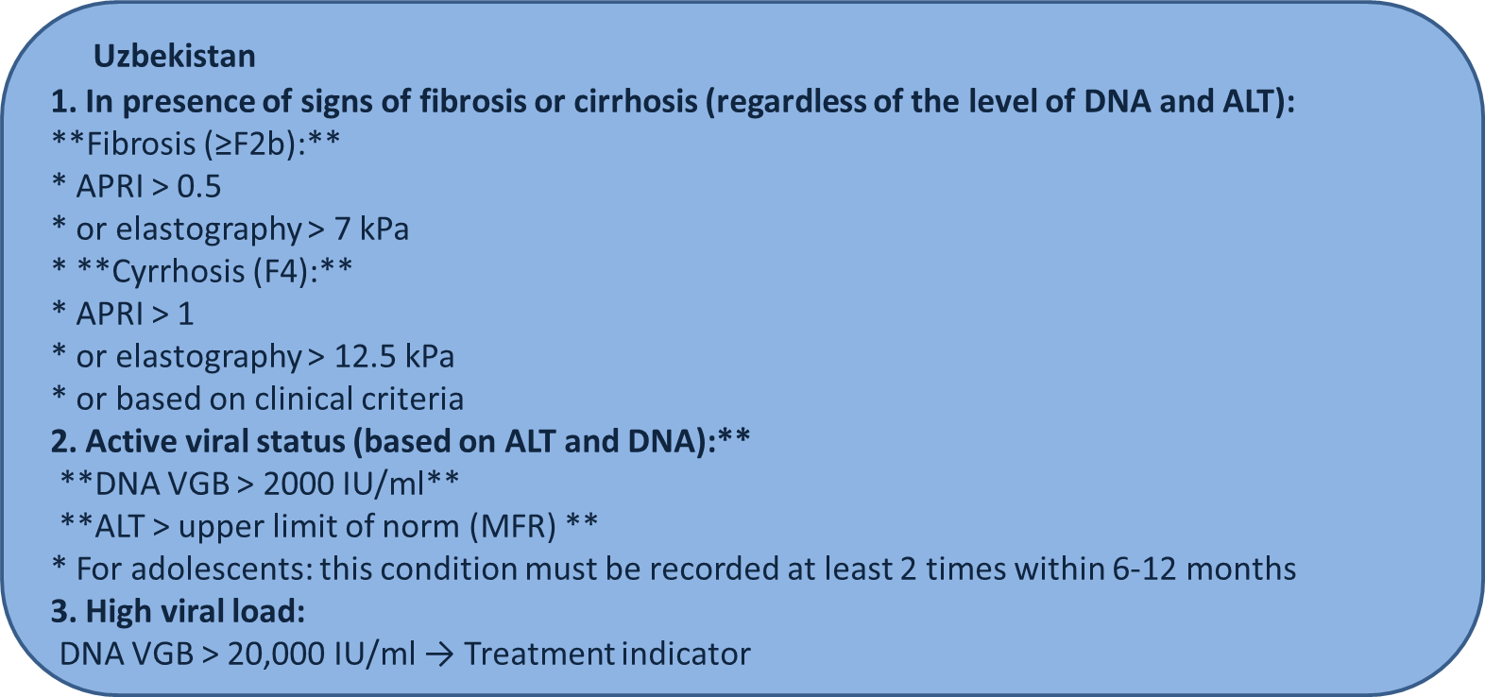
Treatment recommendations
EASL
- HBeAg positive or HBeAg negative:
HBV/DNK > 2000 UI/ml and ALT > XULN and / or
at least moderate necroinflammation
- HBV/DNK > 20,000 UI/ml and ALT > 2 XULN
- Treatment indicated regardless of fibrosis degree
- ULN : 40 U/L
AASLD
HBeAg positive:
HBV/DNK > 20,000 UI/ml and ALT > 2 XULN
HBeAg negative:
HBV/DNK > 2000 UI/ml and ALT > 2 XULN
ULN : 35 U/L for males 25 U/L for females
WHO
Evidance of fibrosis (F2) or cirrhosis (F4)
and/or
HBV DNA >2000 UI/mL and ALT> ULN
and/or
- Additional details forthcoming

Slide 18
HBsAg and HBV DNA level in chronic hepatitis B naïve patients (n=127 RIV)
HBV DNA
qHBsAg
Notes:
Among the 127 newly diagnosed CHB naïve patients, the majority of 107 (84.5%) patients were patients with a HBV DNA level <2000 IU/ml. Such patients are usually identified as inactive or low-risk HBV patients. Data from continuous studies showed that the annual rate of HCC development in these subjects is 0.06%. Of the 107 inactive patients, 78 (72.9%) had qHBsAg more than 1000 IU/ml - that is, they were in the risk group for the development of HCC. Their average age was 36.7 years.

Slide 19
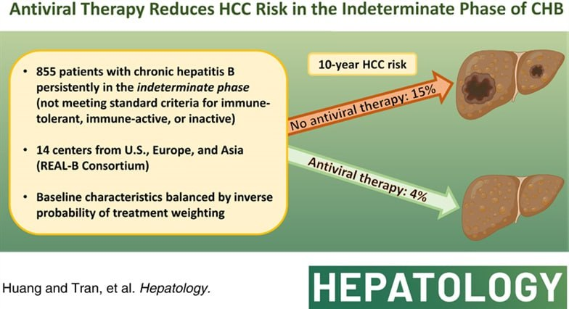
Assessment of patients with a natural course and chronic HBV infection by HBV markers (n=127 RIV patients)
HBeAg positive |  | HBeAg negative |  | Grey zone (indeterminate phase)
HBeAg positive infection | HBeAg positive hepatitis | HBeAg negative infection | HBeAg negative hepatitis
0 | 4 (3%) | 67 (52,7%) | 3 (2,3%) | 53 (41,7%)
Notes:
The "gray zone" of hepatitis B is an unofficial term used to describe a condition in which the results of laboratory and clinical studies do not allow the patient to be unambiguously assigned to one of the standard categories of chronic hepatitis B (CHB). Characteristics of the "gray zone"
Mismatch between virus markers and biochemistry.

Slide 20
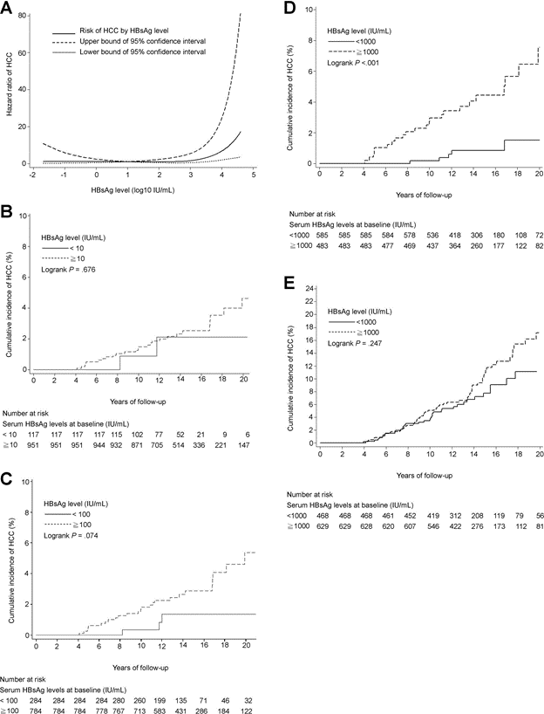
Could HBsAg levels be a risk factor for HCC in HBeAg-negative patients with low viral load?
Patients with HBV DNA <2000 IU/mL who had a similar risk of HCC, HBsAg levels ≥1000 IU/mL have been identified as a new independent risk factor for HCC.
These data suggest that HBsAg levels may complement HBV DNA levels in predicting the development of HCC, especially in low-viraemic HBV carriers.
Thus, in a cohort of 2688 patients among HBeAg-negative patients with low viral load, age, baseline levels and dynamic changes in HBsAg and ALT are predictors of the development of HCC.
Conclusion: The combination of HBV DNA level <2000 IU/mL and HBsAg level <1000 IU/mL can be considered as a mandatory criterion for identifying HBV carriers with minimal risk.
High Levels of Hepatitis B Surface Antigen Increase Risk of Hepatocellular Carcinoma in Patients With Low HBV Load Tseng, Tai–Chung et al. Gastroenterology, Volume 142, Issue 5, 1140 - 1149.e3
Notes:
Известно, что существует положительная корреляция между уровнями HBsAg и ДНК HBV.¹²
, ¹³
, ³⁴
Было показано, что корреляция выше в HBeAg-положительной фазе, ниже в HBeAg-негативной фазе и самая низкая в низкорепликативной фазе, что согласуется с нашими результатами. Это несоответствие между уровнями HBsAg и ДНК HBV в низкорепликативной фазе может быть вызвано накоплением интегрированных последовательностей вирусной оболочки в инфицированных гепатоцитах. HBsAg в основном происходит из интегрированной формы ДНК HBV, а не из эписомальной формы.¹³
, ³⁵
Другими словами, у пациентов с низкой виремией и высоким уровнем HBsAg может быть больше гепатоцитов с интеграцией HBV, чем у пациентов с низким уровнем HBsAg. Таким образом, более высокий риск ГЦК у бывших пациентов можно объяснить повышенной нестабильностью генома в результате интегрирования вирусных последовательностей, играющих важную роль в гепатоканцерогенезе.³⁶
Другим возможным объяснением положительной корреляции между риском ГЦК и уровнем HBsAg, но не уровнем ДНК HBV, является узкий диапазон ДНК HBV. У носителей ВГВ с уровнем ДНК ВГВ <2000 МЕ/мл динамический диапазон HBsAg шире, чем уровень ДНК ВГВ (0,05–>10 000 МЕ/мл против 15–2000 МЕ/мл). Фактор широкого диапазона, как правило, обеспечивает большую мощность для дифференциации пациентов с разным риском.

Slide 21
Question is…
Should we make changes to the monitoring and treatment of patients with hepatitis B?

Slide 22
THANK YOU FOR ATTENTIONS !!!

