Slide 1
Test and treat early to prevent cancer
Hepatitis B and Hepatitis C
APASL STC – Tashkent – June 4, 2025
Francesco Negro
Emeritus Professor
Formerly at the Departments of Medicine and of Pathology and Immunology Faculty of Medicine, University of Geneva, Switzerland

Slide 2
Disclosures
I have nothing to disclose

Slide 3
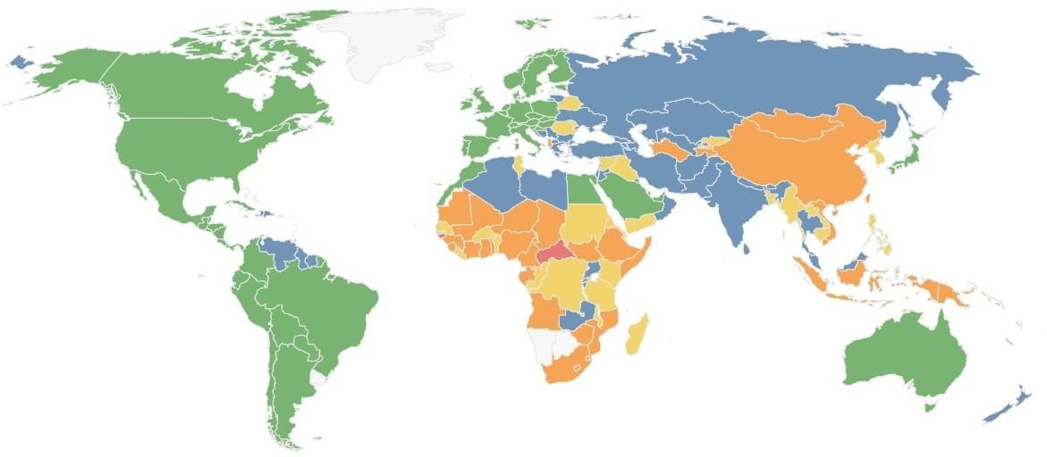
Global burden of hepatitis B
HBsAg prevalence: 3%, or 248 million infected
https://cdafound.org/polaris/dashboard/

Slide 4
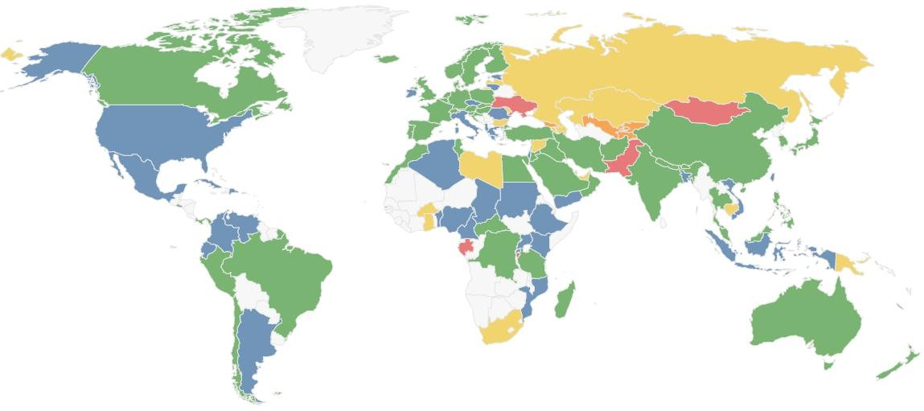
Global burden of hepatitis C
HCV RNA prevalence: ~1%, or 51.3 million infected
https://cdafound.org/polaris/dashboard/

Slide 5


1,373,000
1,286,600
90% of global viral hepatitis deaths
are due to end-stage
liver-related complications of hepatitis B and C
~1/3 of them are due to liver cancer
cirrhosis
1,059,000
HCV 399,400
HCC
cirrhosis
HBV 887,200
440,000
HCC
acute
WHO 2017 Global Hepatitis Report

Slide 6
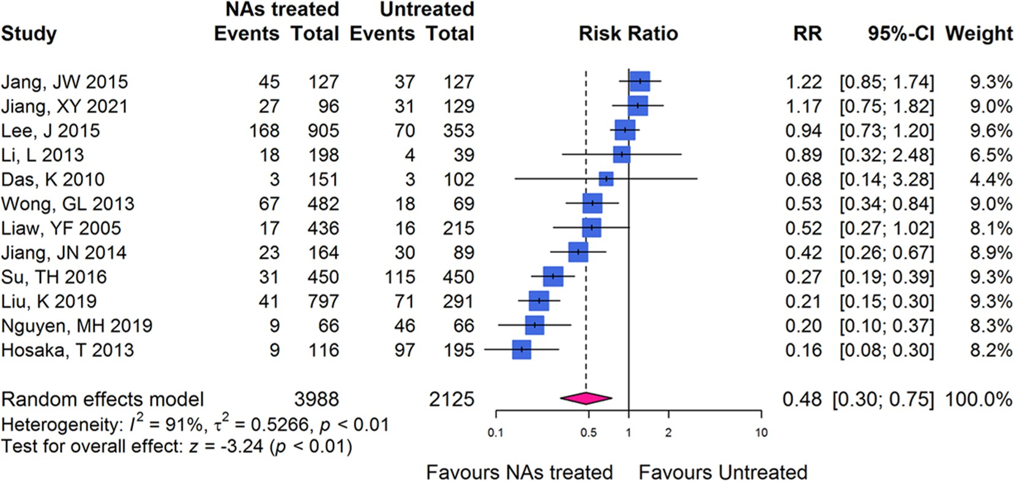
HCC incidence in nucleos(t)ide analogue-treated vs untreated hepatitis B
A meta-analysis on 12 studies
Kong Y, et al. Hepatol Int 2022;16:1052–1063

Slide 7
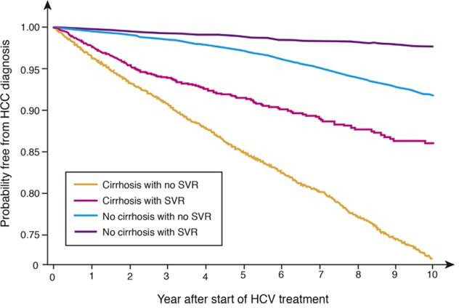
Residual risk of HCC after HCV eradication (SVR)
in 25,424 Veterans treated with direct-acting antivirals, by cirrhosis status
No cirrhosis, SVR
No cirrhosis, no SVR Cirrhosis, SVR
Cirrhosis, no SVR
DAA-induced SVR is associated with a 71% reduction in HCC risk
Ioannou GN, Feld JJ. Gastroenterology 201G;156:446-460.e2

Slide 8
The European Code Against Cancer (ECAC) #4
In 2012, the International Agency for Research on Cancer (IARC) (an authoritative intergovernmental agency belonging to the WHO) classified HBV and HCV as class 1 carcinogens¹
In 2014, IARC emitted recommendations to prevent HPV-associated cervical cancer and HBV-associated liver cancer through vaccination (ECAC4)²
Current ECAC4 do not include preventive or treatment measures for hepatitis C
IARC. List of Classifications: Agents classified by the IARC Monographs. Available from: https://monographs.iarc.who.int/list-of-classifications
IARC: European Code Against Cancer (2014). Available from: https://cancer-code-europe.iarc.fr/index.php/en/

Slide 9
The European Code Against Cancer (ECAC) #4
The role of testing to prevent chronic HBV infection and its long-term sequelae was not considered in the recommendations, although the Discussion section mentioned that persons at risk of chronic HBV should seek medical advice about testing and treated if indicated¹
HBV risk factors were based on international guidelines:²⁻⁴
  People born or brought up in a country with an intermediate or high prevalence (≥2%) of chronic hepatitis B
  Babies born to mothers who are HBV carriers
  People who have ever injected drugs
  Men who have sex with men
  Anyone who has ever had unprotected sex
  Anyone (especially babies and children under the age of 10) subject to close contacts with carriers (i.e., where there is a risk of transmitting the infection through blood or body fluids, including family members, close friends, household contacts or sexual partners
  Healthcare workers
Villain P, et al. European Code against Cancer 4th Edition: Infections and Cancer. Cancer Epidemiol 2015;3G Suppl 1:S120-38
Hepatitis B and C Testing: People at Risk of Infection, NICE Guidelines: https://www.nice.org.uk/guidance/ph43
EASL clinical practice guidelines: management of chronic hepatitis B virus infection. J Hepatol 2012;57:167-185
M.L. LeFevre. Screening for hepatitis B virus infection in nonpregnant adolescents and adults: USPSTF recommendation statement. Ann Int Med 2014;161:58-66

Slide 10
What about testing for HCV?
International recommendations have traditionally promoted three screening strategies:
  Risk-based^{1,2}
    Typically, all those at risk of blood borne infections
    High-risk sexual activities
    Newborns of anti-HCV-positive mothers
    People born in HCV endemic countries
  Birth cohort-based³⁻⁶
    US: baby boomer “birth cohort” of individuals born 1945-1965, covering ~75% of HCV infections in the USA despite representing only 27% of the general population (irrespective of symptoms or risk factors)
  Opportunistic screening (e.g., colonoscopy, ED)⁶
1. https://iris.who.int/; 2. https://www.ecdc.europa.eu/
3. Smith BD, et al. Ann Intern Med 2012;157:817–822; 4. Smith BD, et al. MMWR Recomm Rep 2012;61:1–32
5. Moyer VA, et al. Ann Intern Med 2013;15G:34G–357; 6. Tsay CJ, Lim JK. J Clin Transl Hepatol 2020;8:25-41

Slide 11
Hepatitis B Cascade of Care, per WHO Region: Prevalence, Diagnosis and Immunization Rates (2022)
WHO Region | Modelled prevalence | HBsAg+ population | Diagnosed | Prevalence of HBsAg+ in children (<5 yrs) | Timely birth dose | 3 doses <1 year of age
Africa | 5·4% | 64 778 000 | 2 610 000 (4%) | 1·7% | 14% | 82%
Eastern Mediterranean | 1·6% | 15 200 000 | 2 332 000 (15%) | 0·4% | 35% | 87%
Europe | 1·2% | 11 554 000 | 2 263 000 (20%) | <0·1% | 57% | 61%
Americas | 0·5% | 5 101 000 | 1 066 000 (21%) | <0·1% | 54% | 80%
Southeast Asia | 3·0% | 61 361 000 | 1 678 000 (3%) | 0·6% | 65% | 83%
Western Pacific | 5·1% | 66 464 000 | 26 062 000 (26%) | 0·3% | 80% | 60%
Globally: ~14%
Polaris Observatory Collaborators. Lancet Gastroenterol Hepatol 2023;8(10):87G-G07

Slide 12
Hepatitis C Cascade of Care, per WHO Region: Prevalence and Diagnosis Rate (2023)
WHO Region | Prevalence | Anti-HCV+ | Diagnosed
AFRO | 1% | 8 722 641 | G%
EMRO | 2% | 12 073 671 | 25%
EURO | 1% | 8 714 800 | 24%
SEARO | <1% | 6 366 606 | G%
PAHO | 1% | 5 383 703 | 22%
WPRO | <1% | 7 050 173 | 40%
Global diagnosis rate: ~21%
https://cdafound.org/polaris/dashboard/

Slide 13
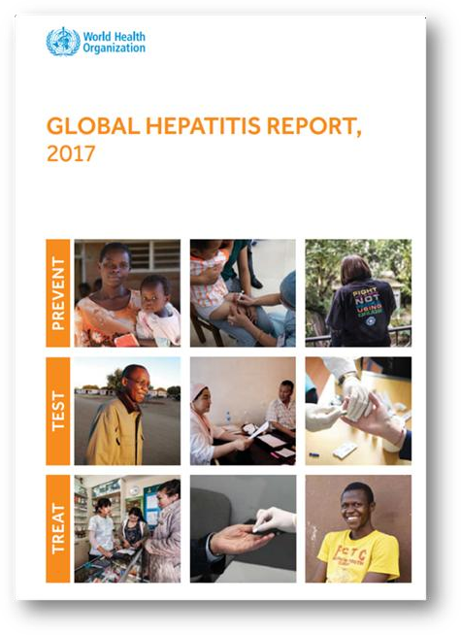
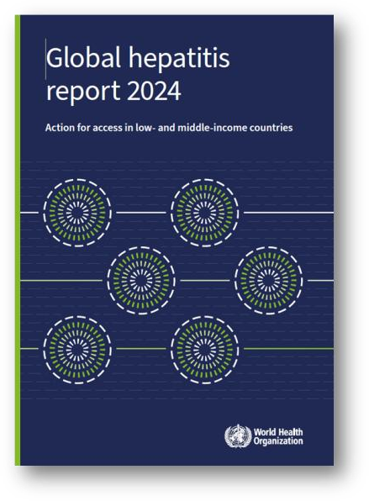
Interim progress towards global viral hepatitis targets (2022)
Indicator | 2015 | 2020 | 2022 | 2025 target | 2030 target
New HBV infections, py | N/A | 1,500,000 | 1,230,000 | 850,000 | 170,000
New HCV infections, py | 1,750,000 | 1,030,000 | 980,000 | 670,000 | 240,000
HBV deaths, py | 904,000 | 820,000 | 1,100,000 | 530,000 | 310,000
HCV deaths, py | 390,000 | 290,000 | 244,000 | 170,000 | 100,000
Global hepatitis report 2024. Geneva: WHO 2024

Slide 14
Viral hepatitis: finding the missing ones to prevent liver cancer
Risk-based strategies have failed to identify most chronic hepatitis B and C patients, even in high income countries
Most chronic HBV infections are established at birth or during the first 5 years of life, thus excluding birth cohort screening strategies for HBV
Birth cohort screening strategies for HCV have identified most infected persons only in specific settings
Given the current efficacy and safety of antiviral therapies, is universal screening a feasible, alternative strategy?

Slide 15
The evidence from Cost-Effectiveness Analyses

Slide 16

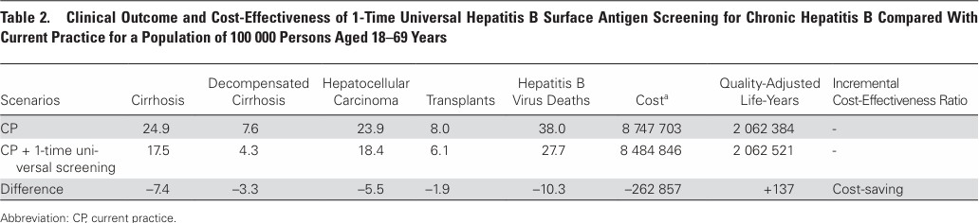
At an estimated 0.24% prevalence of undiagnosed chronic hepatitis B, universal HBsAg screening in US adults aged 18-66 years is cost-saving
(Markov model, compared to current practice, with a treatment drug costs <864 USD/year)
The US CDC has recommended
to screen for hepatitis B at least once during a lifetime all adults aged ≥18 years
Toy M, et al. Clin Infect Dis 2022;74:210–7 Testing for Hepatitis B Virus Infection: CDC Recommendations - US, 2023. MMWR Recomm Rep 2023;72:1-25

Slide 17

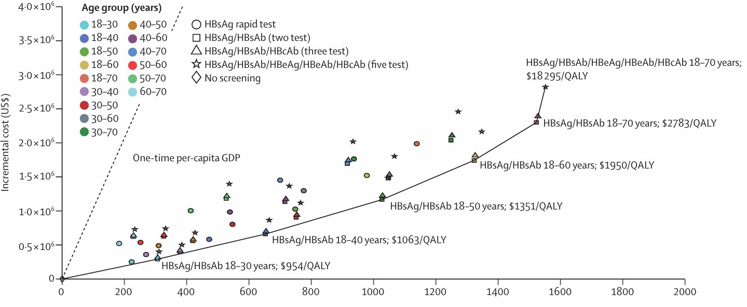
Based on a 5.1% prevalence, universal HBV screening in people aged 18-70 years during the next 10 years, is cost-effective
(Markov model, compared to status quo, WTP 3xGDP per capita = 30 828 USD)
CSH/CSM/CSID: HBsAg screening should be performed in the general population,
especially in those at high-risk and women of pregnancy or childbearing age
Su S, et al. Lancet Glob Health 2022;10:e278-e287 You H, et al, Chinese Society of Hepatology, Chinese Medical Association; Chinese Society of Infectious Diseases, Chinese Medical
Association. J Clin Transl Hepatol 2023;11:1425-1442

Slide 18

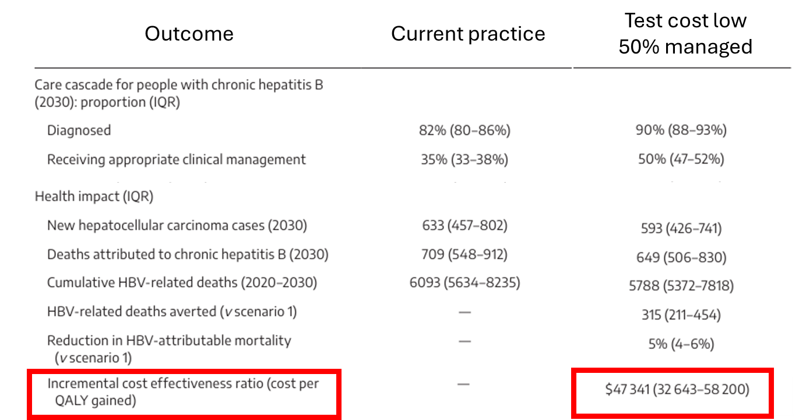
Universal screening for HBV is cost-effective, provided that the cost of testing is low and that >50% of patients are properly managed
(Markov model, compared to current practice)
Xiao Y, et al. Med J Aust 2023;218:168-173

Slide 19
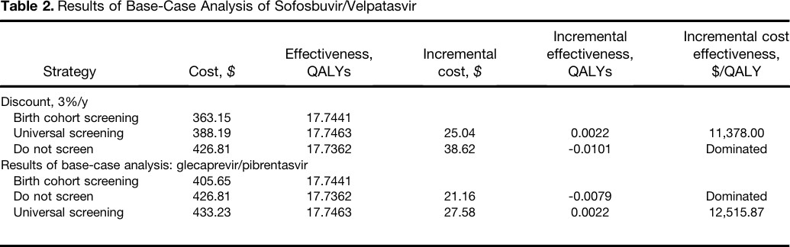
In the US, universal screening for HCV followed by DAA treatment is cost-effective (at a prevalence of 0.07%)
Cost of anti-HCV 19.57 USD; HCV RNA 58.76 USD; SOF/VEL 3 mos. = 24,270 USD; GLE/PIB 3 mos. = 29,490 USD
The US CDC has recommended to screen for hepatitis C at least once during a lifetime all adults and all those who request it (irrespectively of risk factors)
Eckman MH, et al. Clin Gastroenterol Hepatol 201G;17:G30-G3G.eG

Slide 20
Can we spin universal HBV and HCV screening?
Playing in favor | Playing against
Cost-effective, based on Markov models Effective treatments (and future medicines for HBV may lead to functional cure) People do not like to share stigmatizing behaviors (risk factors for HBV and HCV) Tests are simple and can be easily integrated in other screening strategies | Lack of empirical evidence Sensitive to prevalence, cost of diagnostics and antivirals, and treatment uptake Hyperbolic discounting bias (significant upfront costs vs uncertain benefits in the distant future) Unaccounted costs: awareness campaigns and GP education for proper counseling Inefficient testing program yields in low-risk population segments

Slide 21
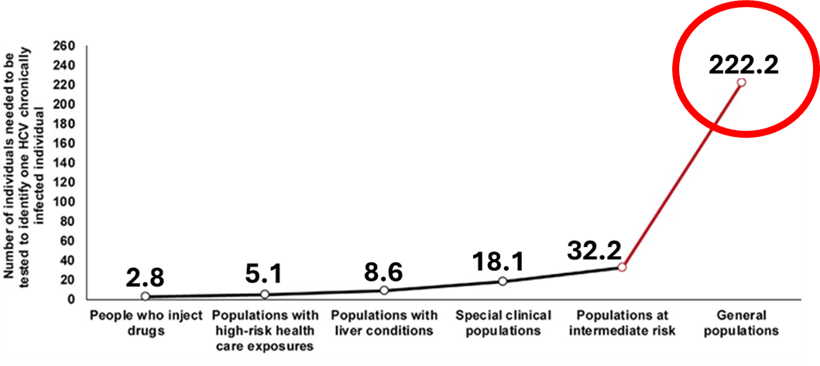
In low prevalence countries (e.g., <3%), the Number Needed To Test (testing yield) may be TOO HIGH to find all HCV-infected patients
Chemaitelly H, et al. Hepatol Commun 201G;3:325-33G

Slide 22
OK about testing, and then?

Slide 23
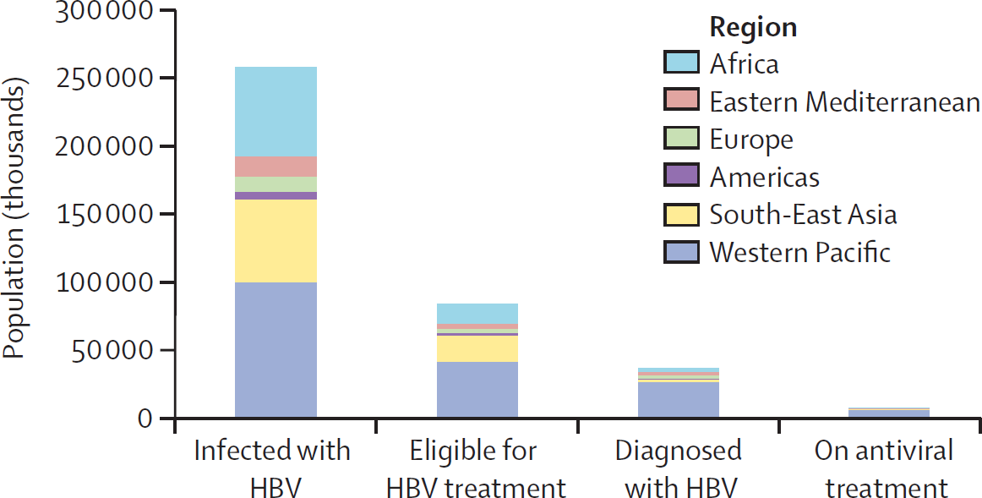
Global and regional HBV infection cascade of care, 2022
~8% of those eligible
Polaris Observatory Collaborators. Lancet Gastroenterol Hepatol 2023;8(10):879-907

Slide 24
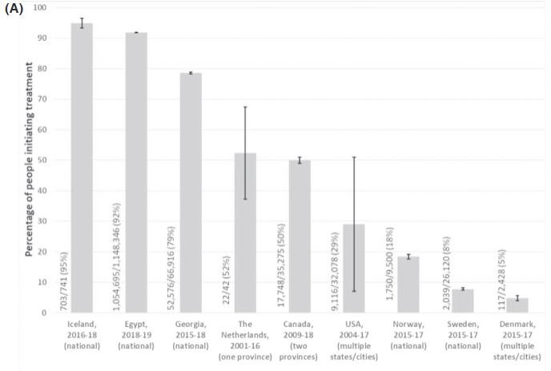
The continuum-of-care conundrum
Proportion of individuals diagnosed with HCV who received DAA treatment among the general population
Yousafzai MT, et al. J Viral Hepat 2021;28:1340-1354

Slide 25
What about alternative test-and-treat models?
Four-phase program among migrants
Coppola N, et al. Infect Dis Poverty 2024;13:3G
One-site one-visit, test-and-treat community program for HBV and HCV
Shiha G, et al. J Viral Hepat 2020;27:5G3-601
Same day test-and-treat for HCV among high-risk settings (PWID, prison inmates, homeless, HIV+ MSM)
Suan MAM, et al. BMC Public Health 2025;25:1152; Rajkumar N, et al. Harm Reduct J 2024;21:G8 Morris MD, et al. JAMA Netw Open 2023;6:e23387G2; Grebely J, et al. Int J Drug Policy 2023;114:103G82
Forns X, et al. J Viral Hepat 2022;2G:227-230; Supanan R, et al. J Acquir Immune Defic Syndr 2021;88:465-46G

Slide 26
Strong political will at work: the case of Egypt
HCV elimination plan launched in 2014¹
  Awareness campaign
  Comprehensive national program to screen the entire adult population (~62.5 million) and teenage school-children in middle and high schools (~12 million)
  WHO pre-qualified rapid assay for anti-HCV (USD 0.56/assay) on capillary blood
  Locally produced, low cost generic DAAs
HCV prevalence decreased from 6% (2015) to 0.5% in 2021²
HCC attributable to HCV from ~4,800 py (2018) to 2,200 py (2024)³
Mortality attributable to HCV from ~27,000 py (2018) to ~11,000 py (2025)³
Waked I. Antivir Ther 2022;27:13596535211067592
Gomaa A, et al. Pathogens 2024;13(8):681
Hassany M. EASL/WHO/ECDC Symposium, Amsterdam, May 8, 2025 (easl.eu)

Slide 27
In a high prevalence country, treatment initiation is sub-optimal and may impact elimination programs
HepFreePak observational study, n=25,000, free SOF/DAC plus incentives to attend visits
Site | Model | Tested | HCV RNA+ | Started therapy | Came to check SVR | Achieved SVR
Malir | Door-to-door case finding | 14,612 | 930 (6.4%) | 713 (77%) | 633 (89%) | 563 (89%) (60.5% of HCV+)
Karachi | Urban clinic and community testing events | 2,828 | 242 (8.6%) | 227 (94%) | 157 (69%) | 151 (96%) (62.4% of HCV+)
Gujranwala | Community camp test-and-treat | 3,609 | 246 (6.8%) | 178 (72%) | 76 (42%) | 72 (95%) (2G.3% of HCV+)
Hasnain A, et al. EASL 2025, J Hepatol 2025;82(S1):S687
Reinfection rate 12 months after SVR12: 1/530 (0.18%), 3/18G (1.6%), 8/G4 (8.5%)
Niaz S, et al. EASL 2025, J Hepatol 2025;82(S1):S708

Slide 28
WHAT IS TO BE DONE?
Risk-based strategies have failed to identify the majority of chronic hepatitis B and C patients globally
The availability of low-cost diagnostics and very effective antivirals should
prompt more aggressive screening strategies
CEAs (but not empirical evidence) support the extension of screening to all adults, irrespective of risk factors, to prevent HCC
Low prevalence, poor testing yield, and high costs of diagnostics and
treatments are playing against policy
Integrated screening may be more efficient and acceptable
The cascade of care remains a challenge

