Slide 1

Management of HDV infection: From Textbook to Real Life Treatment as Art!
APASL STC: International Experience of National Programs for the Elimination of Viral Hepatitis;
June 4-5, 2025 Tashkent
Yusif Alkhazov, MD, “EuroMed” Private Medical Center, Baku, Azerbaijan

Slide 2
Disclosures
I've nothing to disclose

Slide 3

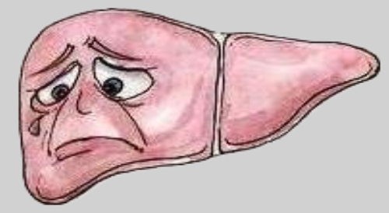
HDV infection is the most severe form of viral hepatitis.

Slide 4
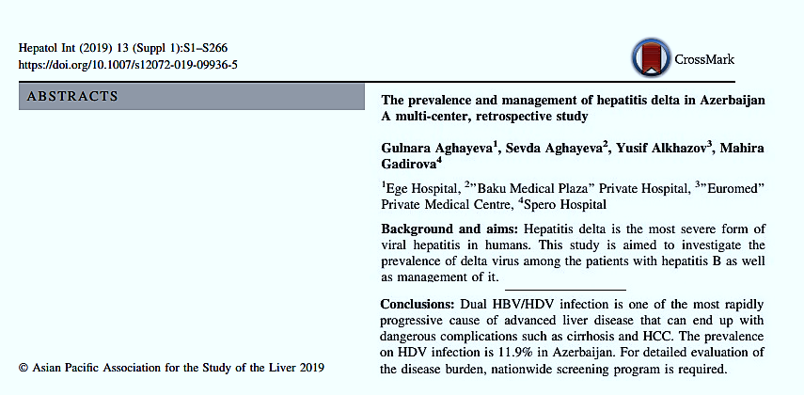
HDV infection in Azerbaijan
The prevalence on HDV infection is 11.9%
in Azerbaijan.
258 out of 2169 HBsAg+ patients
were also HDV+.
Data from 4 private hospitals in Baku.
Males – 159 (61.3%), females – 99 (38.7%). The mean age was 38.6 years. At the first admission, 42% of the patients presented with advanced liver disease, 27% with 1 or more episode of hepatic decompensation and 2.3% with HCC.
Y. Alkhazov, «EuroMed» - 2005 – to date
Aghayeva G, Aghayeva S, Alkhazov Y, Gadirova M, Hepatol Int (2019) 13 (Suppl 1):S106,
Abstract #359
Notes:
According to summarized data of 4 private medical centers,
HBV/HDV co-infection made up almost 12% of HBV infected patients.

Slide 5

HDV-infected patients

Slide 6
A case report: HBeAg (+) HBV/HDV infection Patient profile
Patient G., Fem., 1987, BMI-21,1 kg/m2, no alcohol consumption, no smoking. Married, has 2 children.
03.07.2009
HBsAg (+)
HBV DNA – 3,05*10³ IU/ml
ALT – 20 U/l
No tested for HBeAg
No tested for HDV Ab
30.04.2012
HBV DNA – 3,01*10³ IU/ml
ALT – 24 U/l
No tested for HBeAg
No tested for HDV Ab
22.03.2013
HBV DNA – 5,5*10³ IU/ml
No tested for HBeAg
No tested for HDV Ab
19.11.2014
HBV DNA – 1,59*10³ IU/ml
ALT – 23 U/l
No tested for HBeAg
HDV Ab – positive
No tested for HDV RNA
16.02.2016
No tested for HDV RNA
HBeAg (–), HBeAb (+)
PLT – 246 000 mm³
ALT – 42 U/l
Elastometry – 6,0 kPa
06.07.2019
HBV DNA – 1,58*10² IU/ml
HDV RNA – 4,161*10³ IU/ml
PLT – 163 000 mm³
ALT – 49 U/l
Elastometry – 10,5 kPa
No treatment prescribed!
Y. Alkhazov, «EuroMed» - Internal data

Slide 7
A case report: HBeAg (+) HBV/HDV infection Patient profile (cont.)
Patient G., Fem., 1987, BMI-21,1 kg/m2, no alcohol consumption, no smoking. Married, has 2 children.
05.09.2019
HBV DNA – 6,4*10² IU/ml
HDV RNA – 5,2*10⁴ IU/ml
ALT – 53 U/l
No treatment prescribed!
31.05.2021
HBV DNA – 5,3*10² IU/ml
HDV RNA – 3,2*10⁴ IU/ml
ALT – 64 U/l
No treatment prescribed!
05.11.2022
HBV DNA – 6,2*10² IU/ml
HDV RNA – 3,2*10⁴ IU/ml
ALT – 57 U/l
No treatment prescribed!
27.01.2023
HBV DNA – 6,2*10² IU/ml
HDV RNA – 3,2*10⁴ IU/ml
qHBsAg – 49296 IU/ml
HBeAg (+) ?!
Hb – 11,7 g/dl
WBC – 3450 n/mm³
ANC – 1630 mm³
PLT – 150 000 mm³
ALT – 57 U/l
Elastometry – 16,8 kPa
14 years without treatment
(2009 – 2023)
F1 (6,0 kPa) > F4 (16,8 kPa)
Y. Alkhazov, «EuroMed» - Internal data

Slide 8

A case report №5: HBeAg (+) HBV/HDV infection Patient profile (cont.)
3050 > 580 640 > 430 > 530 > 620
n/a > n/a > 25000 > 36000 > 32000 > 32000
HDVAb
Pos (+)
HBeAg
Neg (-)
HBeAg
Pos (+)
HBeAg
Pos (+)
Elastometry
7,0 kPa
Elastometry
10,5 kPa
Elastometry
16,8 kPa
LLoQ *
ALT (U/L)
20 42 53 36 64 57 58
LLoD #
HDV RNA
* LLoQ = 27 IU/ml
# LLoD = 12.3 IU/ml
HBV DNA
* LLoQ = 20 IU/ml
# LLoD = 12 IU/ml
Y. Alkhazov, «EuroMed» - Internal data

Slide 9
Treatment options for HDV
Before 2020:
In the United States and much of the world, the only available therapy for chronic HDV (CHD) infection is pegylated interferon α (PEG-IFNα)
However, treatment success is low, and the rates of viral relapse are high
After 2020:
Bulevirtide (BLV) was licensed by the European Medicines Agency in 2020 to treat CHD, based on data from 2 key clinical trials showing efficacy
Preliminary real-world data indicate effectiveness of BLV as monotherapy or with PEG-IFNα, including those with cirrhosis

Slide 10
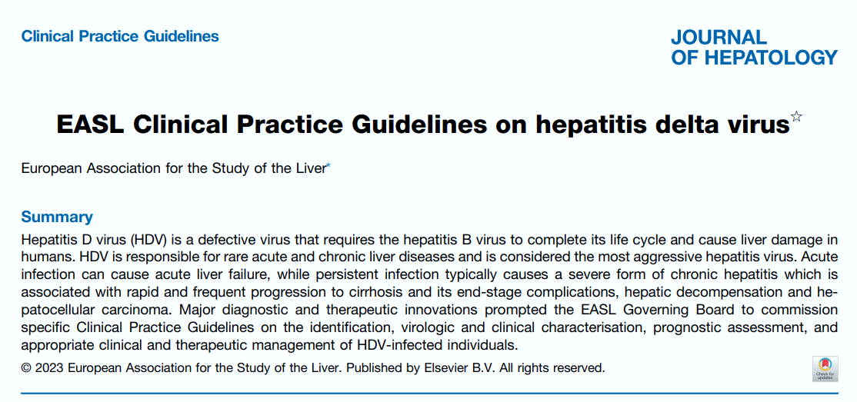

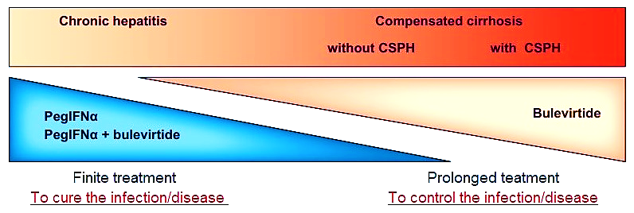
Management of antiviral treatment in patients with CHD
CSPH – clinically significant portal hypertension
Additional factors influencing the treatment schedule
Phase of HBV infection (HBeAg/anti-HBe status; HBV DNA and HBsAg levels)
IFNα contraindication, tolerability
Patient’s will and compliance to treatment
EASL Clinical Practice Guidelines on hepatitis delta virus, J. of Hepatology, July 2023

Slide 11
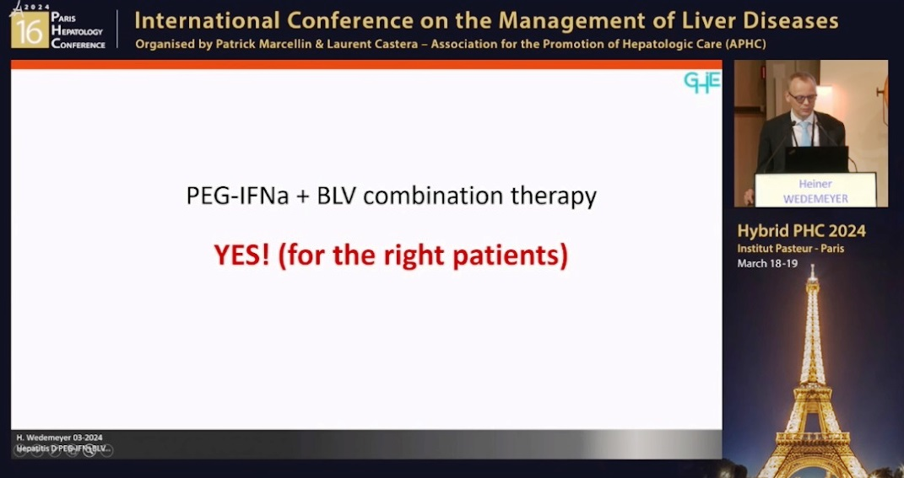
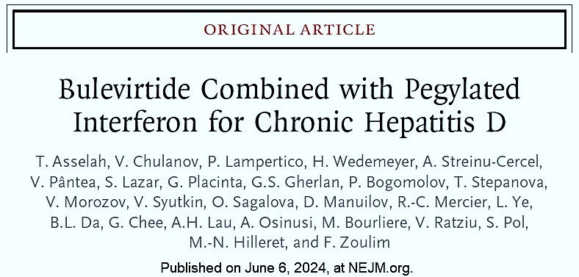
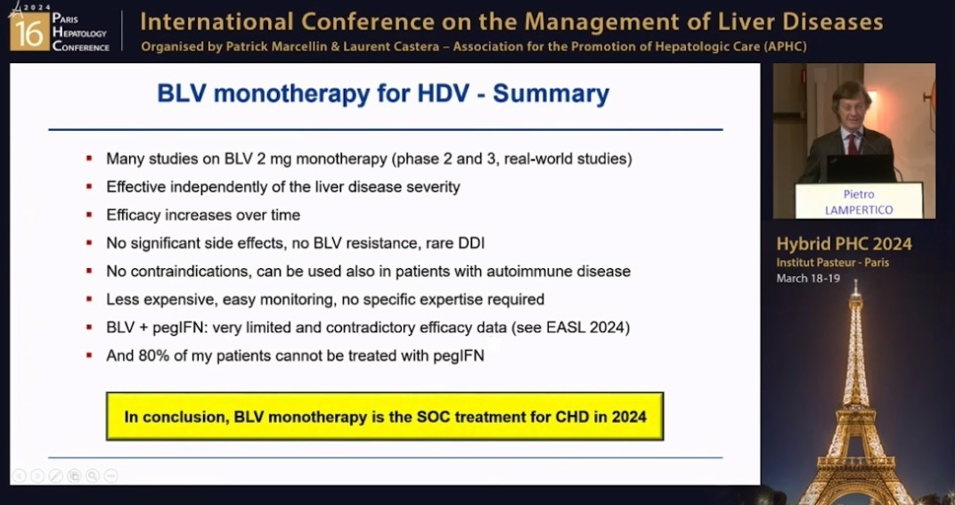
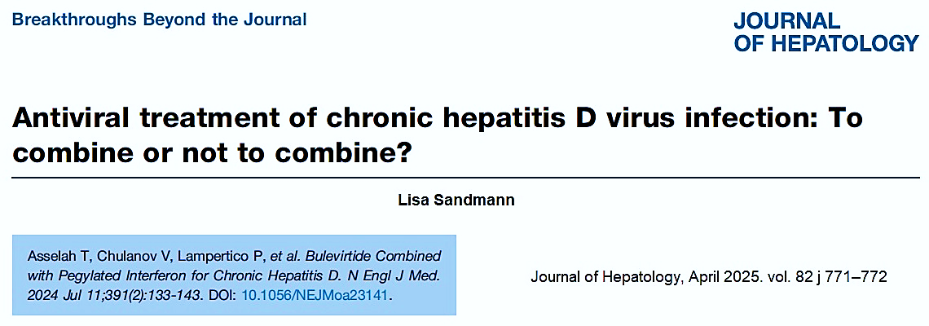
Hepatitis Delta – Optimal treatment: Bulevirtide - Combine or not to PEG IFN?
Yes: Heiner Wedemeyer
No: Pietro Lampertico
PHC-2024, March 18-19, Paris, France

Slide 12
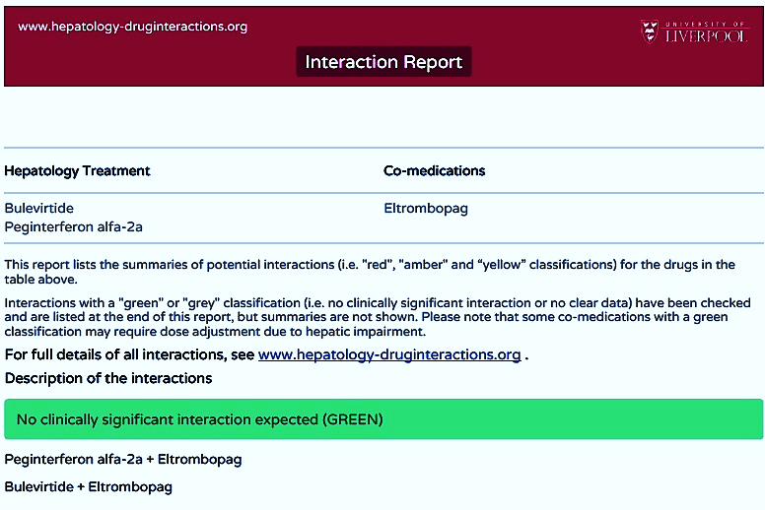
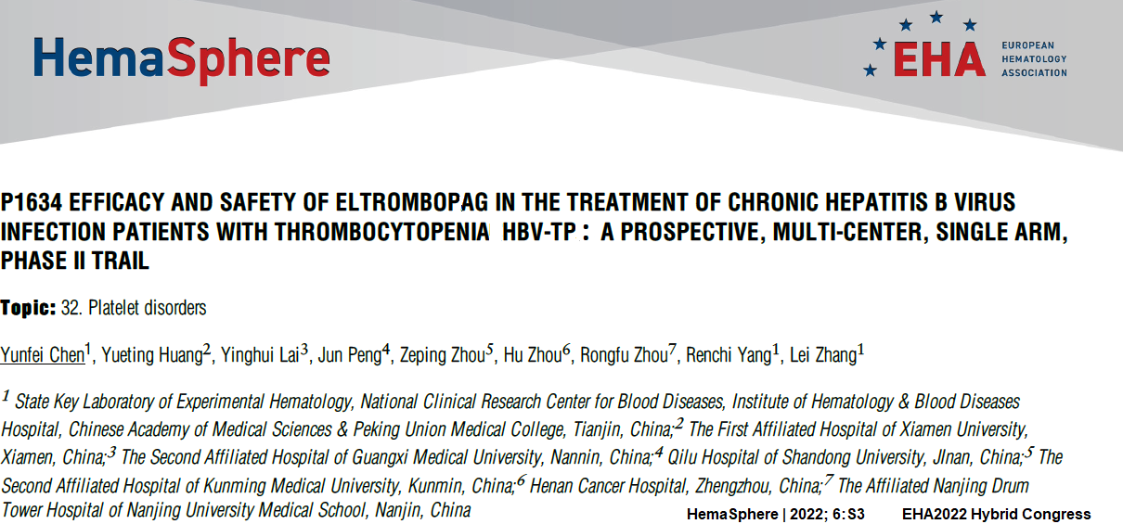
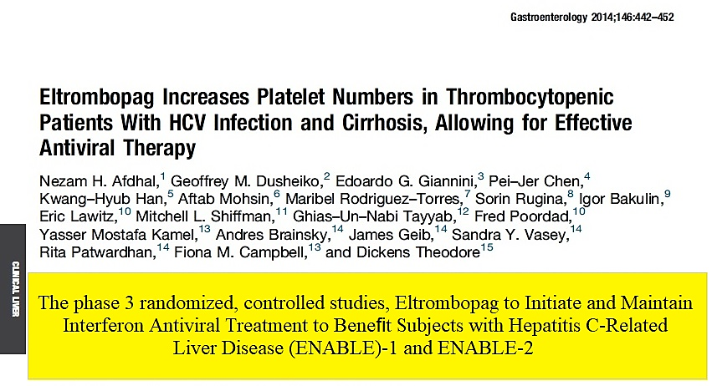

A case report (cont.): HBeAg (+) HBV/HDV infection with cirrhosis on PegIFN+BLV / BLV+TAF-based treatment
HBeAg
Pos (+)
32000 > 25
620 > Neg
Stop İFN?
Reduce İFN dose?
Something else?
PLT (n/mm³)
150 000 > 32 000
Elastometry
16,8 kPa
PegIFN α-2a – 180 μg/w
BLV 2 mg/d
Summary/Conclusion:
Eltrombopag is effective in chronic hepatitis B virus infection with thrombocytopenia, and adverse reactions are tolerable.
It is necessary to monitor platelet counts and liver function during eltrombopag treatment to manage the risk of thrombosis.
LLoQ *
LLoD #
HDV RNA
* LLoQ = 27 IU/ml
# LLoD = 12.3 IU/ml
HBV DNA
* LLoQ = 20 IU/ml
# LLoD = 12 IU/ml

Slide 13
A case report (cont.): HBeAg (+) HBV/HDV infection with cirrhosis on PegIFN+BLV / BLV+TAF-based treatment
HBeAg
Pos (+)
HBeAg
Pos (+)
32000 > 25 > 67 > Neg > Neg > Neg > Neg > Neg > Neg > Neg >
620 > Neg > Neg > Neg > 113 > Neg > Neg > Neg > Neg > Neg > n/a
202
PLT (n/mm³)
150 000 > 32 000 >
Elastometry
W-11 – 16,8 kPa
59 000 > 71 000 > 60 000 > 86 000 > 67 000 > 87 000 > 72 000 > 102 000
Thrombopoietin (Eltrombopag) - 25 mg every other day
(Off label !!!)
Elastometry
W89 – 10,3 kPa
LLoQ *
LLoD #
PegIFN α-2a – 180 μg/w + BLV 2 mg/d
BLV up to W104
HDV RNA
* LLoQ = 27 IU/ml
# LLoD = 12.3 IU/ml
HBV DNA
* LLoQ = 20 IU/ml
# LLoD = 12 IU/ml
TAF – 25 mg/d
Y. Alkhazov, «EuroMed» - Internal data (05.11.2022 – to date)

Slide 14
A case report (cont.): ALT dynamics on PegIFN+BLV / BLV+TAF-based treatment
HBeAg
Pos (+)
HBeAg
Pos (+)
PegIFN α-2a – 180 μg/w + BLV 2 mg/d
BLV up to W104
TAF – 25 mg/d
Y. Alkhazov, «EuroMed» - Internal data (05.08.2023 – to date)

Slide 15
A case report (cont.): HBeAg (+) HBV/HDV infection with cirrhosis on PegIFN + BVL-based treatment
HBeAg
Pos (+)
HBeAg
Pos (+)
49296 > 57944 > 52108 > 3566 > 39765 > 24817 > 25232 > 35641 > 30891 > 29575
TAF – 25 mg/d
PegIFN α-2a – 180 μg/w + BLV 2 mg/d
BLV up to W104
Negative < 0.05
Y. Alkhazov, «EuroMed» - Internal data (05.11.2022 – to date)

Slide 16
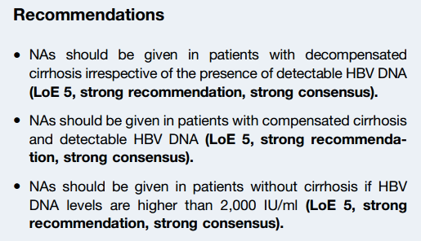
NAs in patients with CHD
EASL HDV Guidelines, Journal of Hepatology, August 2023. vol. 79 j 433–460

Slide 17
NAs in patients with CHD: My personal opinion
NAs should be given in all HBV/HDV patients with cirrhosis regardless
of HBV DNA level
NAs discontinuation is not recommended after stopping PegIFN/BLV
or BLV treatment in HBV/HDV patients with cirrhosis due to:
HBV remains transcriptionally active even when DNA is undetectable
HBsAg clearance is rare, making long-term viral suppression necessary
Cirrhotic patients remain at high HCC risk, requiring continuous
antiviral pressure

Slide 18
Conclusion: My view
NAs should be given in all HBV/HDV patients with cirrhosis regardless
of HBV DNA level
NAs discontinuation is not recommended after stopping PegIFN/BLV
or BLV treatment in HBV/HDV patients with cirrhosis
Eltrombopag can be used with caution in case of interferon-induced thrombocytopenia to ensure continuous PegIFN+BVL combination therapy to achieve an optimal virologic response

Slide 19




Treatment is Art!
Thank you for your attention!

