Slide 1
APASL Single Topic Conference 2025 Tashkent, 4-5 June "International Experience of National Programs for The Elimination of Viral Hepatitis" HDV medications: the revolution/… HDV elimination Robert G Gish MD Medical Director Hepatitis B Foundation robertgish.com

Slide 2
Disclosures see robertgish.com

Slide 3
HDV today and the future
Interferon: base of current therapy
limited supply
many Aes
expensive in some locations
MVR is 15% with or without nucs
new custom interferon is in development with IntegerBio: proposal much less AE with more AV effect
NAPS: MVR over 50%: see NATAP website for all details, only availability is compassionate use, risk of very high ALT, needs to be in combination with INF and Nucs No active Phase III studies
Lonafarnib and lambda interferon are alive and well: will be covered by Dr Glenn
NTCP: I: Bulevirtide: full approval in the EMA region and Russia, FDA US pending
monotherapy
combo with INF and Nuc
Oral NTCP receptor antagonist Heplatide with INF
HHH monoclonal antibody
Vir monoclonal antibody with iRNA, Nucs, Interferon
BlueJay: monoclonal with without nucs

Slide 4
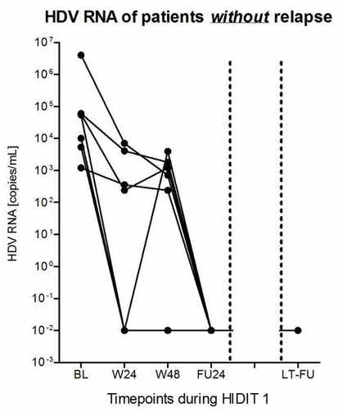
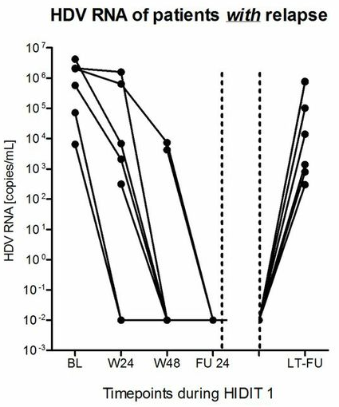
56% of patients with FU24 virological response in HIDIT1 became HDV RNA positive in the LTFU
Long Term Virological Response
Late Relapse
Therapy
Therapy
N= 58 with a median time of follow-up of 4.5 (0.5-5.5) years
Heidrich et al. Hepatology. 2014 Jul;60(1):87-97.

Slide 5
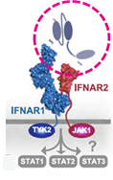
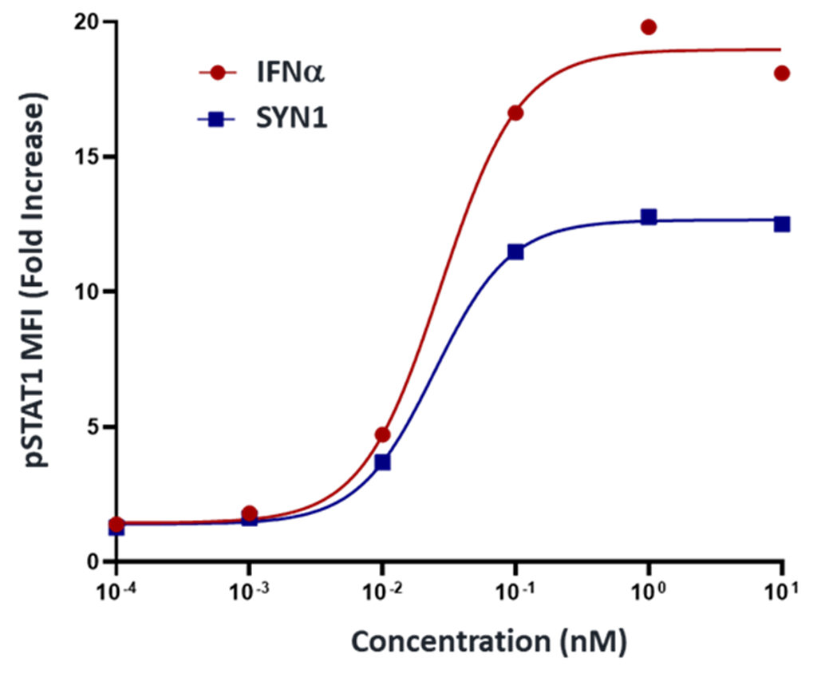
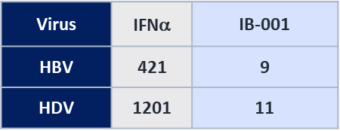
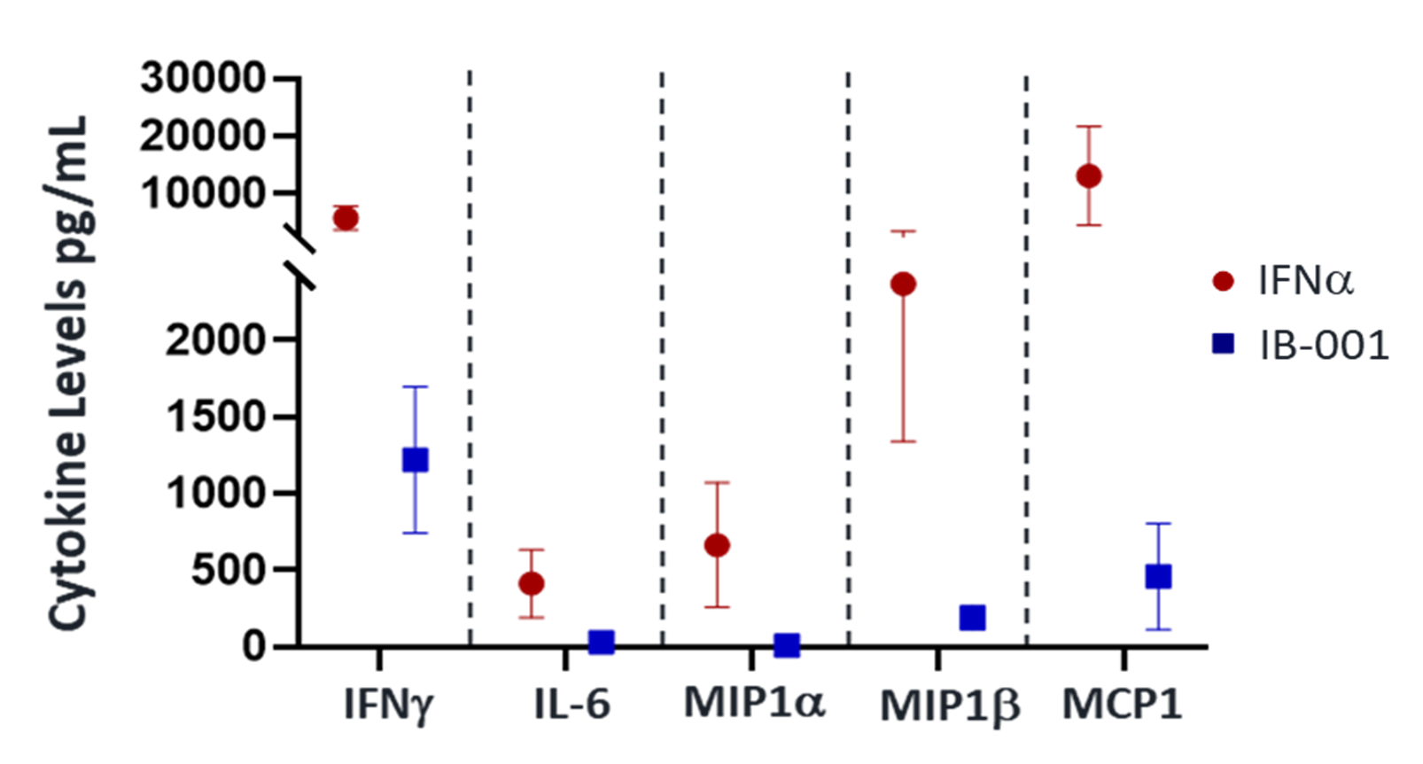
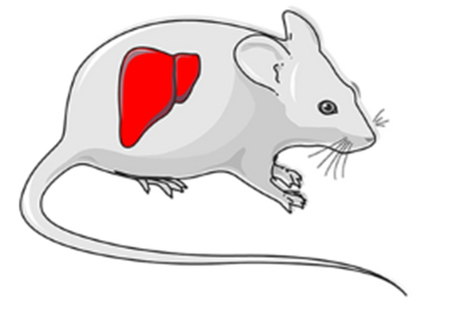
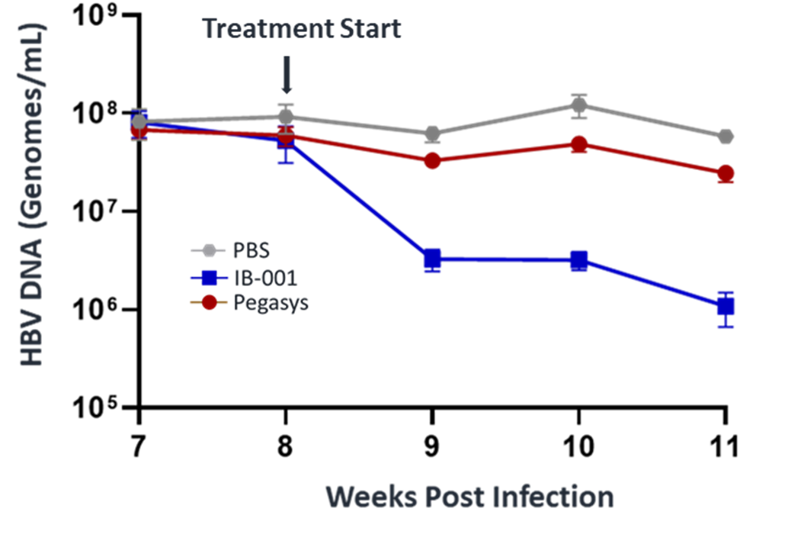
IB-001 Exhbits Potent Antiviral Activity Against HBV and HDV with the Potential for an Improved Safety Profile
IB-001 is a synthetic, partial agonist of the Type I IFN pathway that demonstrates potent antiviral activity with potential for improved safety compared to IFNα
Partial Agonist Profile
Potent Antiviral Activity
IC50 values (pM)
SYNFERONTM molecules (IB-001) are bispecific antibody-derived domains designed to bind IFNAR1/2 and activate the IFN pathway
Antiviral potency is as good as or better than natural interferon for HBV, HDV, and >10 other viruses tested in vitro
Shows reduced inflammatory cytokine activation and reduced anti-proliferative activity vs IFN in primary human cells
Demonstrates antiviral efficacy in 2 different in vivo models, including an HBV humanized mouse model
Demonstrates improved safety vs Peg-IFN in vivo
IB-001 = SYN1 fused to human serum albumin
Antiviral assays in primary human hepatocytes
Reduced Inflammatory Profile
Efficacy in HBV Mouse Model
Cytokine levels measured in human PBMCs
IB-001 represents a promising candidate for HBV and/or HDV cure regimens

Slide 6






OS-070 Achieving undetectable hepatitis delta virus RNA at end of therapy with bulevirtide 10 mg/day with or without with pegylated interferon alpha is strongly associated with post-treatment virologic response in chronic hepatitis delta
Background and Aims
Methods
Bulevirtide (BLV) 2 mg is approved in the European Economic Area, Great Britain, Switzerland, the Russian Federation, and Australia, for the treatment of compensated chronic hepatitis delta (CHD).
The clinical relevance of achieving undetectable HDV RNA (TND) vs detectable but low level viraemia (<LLOQ; TD) at the end of treatment (EOT) remains unclear.
Aim: To evaluate the association between EOT HDV RNA status (TND vs TD <LLOQ) and virologic response at posttreatment follow-up week (W) 48 (FU48).
Pooled data from the Phase 2 MYR204 and the Phase 3 MYR301
BLV 10 mg + PegIFNα (48W) BLV 10 mg alone (48W)
(n = 50)
BLV 10 mg for 96W
(n = 100)
BLV 10 mg for 144W (n = 50)
FU48 after EOT
Analysis
RT-qPCR
Virologic response
HDV RNA determined using RoboGene 2.0 LLOQ 50 IU/mL
limit of detection 6 IU/mL.
Response rate at FU48
undetectable HDV RNA vs HDV RNA <LLOQ, TD at EOT.
Notes:
Abbreviations: pIFN = Pegylated interferon; CHB = Chronic hepatitis B; HBsAG = hepatitis B surface antigen; NA = nucleos(t)ide analogue; pts =patients.
OS-070
Achieving undetectable hepatitis delta virus RNA at end of therapy with bulevirtide 10 mg/day with or without with pegylated interferon alpha is strongly associated with post-treatment virologic response in chronic hepatitis delta
Fabien Zoulim1, Tarik Asselah2, Soo Aleman3, Maurizia Brunetto4 5, Vladimir Chulanov6, Adrian Streinu-Cercel7 8, George Sebastian Gherlan9 10, Pavel Bogomolov11, Tatiana Stepanova12, Viacheslav Morozov13, Olga Sagalova14, Renee-Claude Mercier15, Lei Ye15
1Lyon Hepatology Institute, Lyon, France, 2Hôpital Beaujon APHP, Université de Paris-Cité, INSERM UMR1149, Clichy, France, 3Karolinska University Hospital/Karolinska Institutet, Department of Infectious Diseases, Stockholm, Sweden, 4Hepatology Unit, Reference Center of the Tuscany Region for Chronic Liver Disease and Cancer, University Hospital of Pisa, Pisa, Italy, 5Department of Clinical and Experimental Medicine, University of Pisa, Pisa, Italy, 6Sechenov University, Moscow, Russian Federation, 7Matei Bals National Institute of Infectious Diseases, Bucharest, Romania, 8“Carol Davila” University of Medicine and Pharmacy, Bucharest, Romania, 9"Carol Davila” University of Medicine and Pharmacy, Bucharest, Romania, 10Dr. Victor Babes Foundation, Bucharest, Romania, 11M.F. Vladimirsky Moscow Regional Research and Clinical Institute, Moscow, Russian Federation, 12LLC Clinic of Modern Medicine, Moscow, Russian Federation, 13LLC Medical Company “Hepatolog", Samara, Russian Federation, 14South Ural State Medical University, Chelyabinsk, Russian Federation, 15Gilead Sciences, Inc., Foster City, United States
Email: renee-claude.mercier@gilead.com
Background and Aims: Bulevirtide (BLV) 2 mg is approved for the treatment of chronic hepatitis delta (CHD) in Europe. In an integrated analysis of BLV 10 mg monotherapy or combined with pegylated interferon alpha (PegIFN), we aim to explore whether hepatitis delta virus (HDV) RNA levels undetectable (target not detected; TND) vs below the lower limit of quantification (< LLOQ; target detected [TD]) at end of treatment (EOT) affect post-treatment virologic response.
Method: A pooled analysis of data from patients who completed 2 or 3 years of BLV 10 mg/d with or without PegIFN in the Phase 2 study MYR204 (NCT03852433) and the Phase 3 study MYR301 (NCT03852719) was performed. Patients received (A) BLV 10 mg + PegIFN for 48 weeks (W) followed by 48W of monotherapy with BLV 10 mg (n = 50), (B) BLV 10 mg for 96W (n = 100), or (C) BLV 10 mg for 144W (n = 50). Patients were followed for up to 48W after EOT (FU-48). HDV RNA levels were determined by reverse transcription–quantitative polymerase chain reaction using RoboGene 2.0 (LLOQ 50 IU/mL, limit of detection 6 IU/mL). Virologic response rates at FU-48 were
compared between patients with undetectable HDV RNA and those with HDV RNA < LLOQ, TD at EOT.
Results: Demographics were generally similar across groups: male (65%), White (85%), and mean (SD) age 41 (8.2) years. Overall, 41% had compensated cirrhosis, and 53% had prior interferon experience. Mean (SD) HDV RNA, alanine aminotransferase, and liver stiffness were 5.1 (1.38)log10 IU/mL, 109 (88.2)U/L, and 14.0 (9.11)kPa, respectively. At EOT, 48.5% (97/200) overall achieved undetectable HDV RNA: (A) 70% (35/50), (B) 37% (37/100), and (C) 50% (25/50). Additionally, 24% (48/200) had < LLOQ, TD: (A) 16% (8/50), (B) 30% (30/100), and (C) 20% (10/50). At FU-48 in the whole population, undetectable HDV RNA was observed in 24.5% (49/200): 23/50 (46%) of those receiving combination therapy, 14% (14/100) of patients who received BLV monotherapy for 2 years, and 24% (12/50) of those who received 3 years of BLV monotherapy. Of the patients with undetectable HDV RNA at EOT, 46% (45/97) maintained undetectable HDV RNA at FU-48: (A) 60% (21/35), (B) 35% (13/37), and (C) 44% (11/25); 6% (6/97) had < LLOQ, TD at FU-48: (A) 6% (2/35), (B) 9% (3/37), and (C) 4% (1/25). Of those who had < LLOQ, TD at EOT, only 6% (3/48) had undetectable HDV RNA (1 in each group) and 4% (2/48) remained < LLOQ, TD at FU-48, while 71% (34/48) had HDV RNA > LLOQ: (A) 62.5% (5/8), (B) 80% (24/30), and (C) 50% (5/10); during the follow-up period, 9 discontinued the study early.
Conclusion: In patients with compensated CHD, achieving undetectable HDV RNA with TND at EOT is strongly associated with a virologic suppression at 48W post-treatment. Combination therapy with BLV 10 mg/d and PegIFN and longer treatment with BLV monotherapy were associated with higher rates of undetectable HDV RNA at EOT and FU-48. Patients with HDV RNA < LLOQ, TD at EOT are likely to have HDV RNA rebound off therapy.

Slide 7
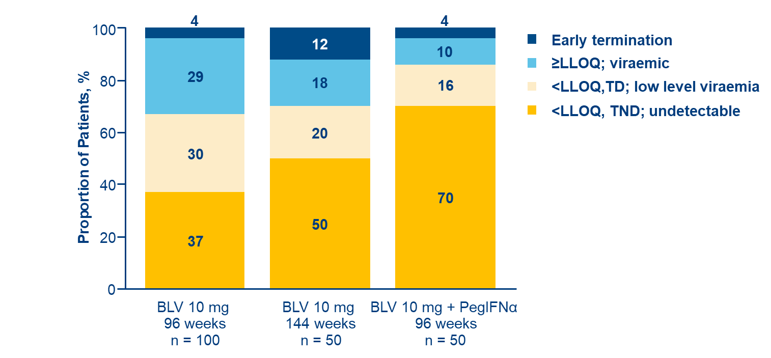
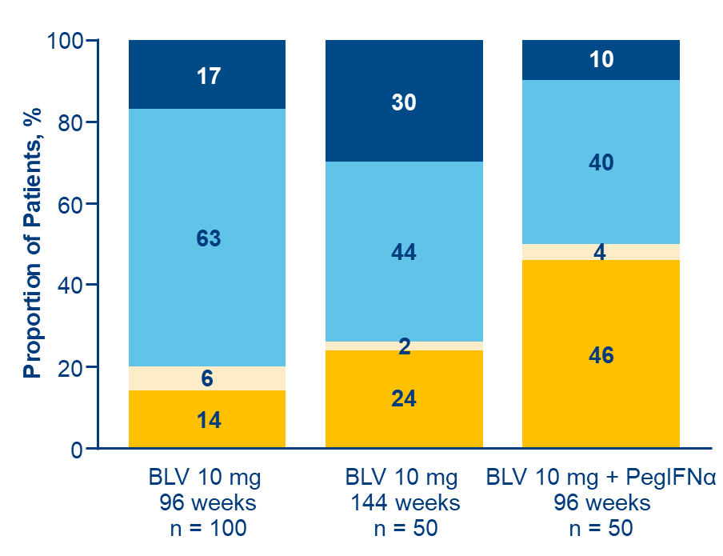
OS-070 Achieving undetectable hepatitis delta virus RNA at end of therapy with bulevirtide 10 mg/day with or without with pegylated interferon alpha is strongly associated with post-treatment virologic response in chronic hepatitis delta
Results
Virologic response
Baseline characteristics
Characteristic | Total (N = 200)
Male (%) | 65%
White (%) | 85%
Age, years, mean (SD) | 41 (±8.2)
Compensated cirrhosis (%) | 41%
Prior interferon use (%) | 53%
HDV RNA, log₁₀ IU/mL, mean (SD) | 5.1 (±1.38)
ALT, U/L, mean (SD) | 109 (±88.2)
Liver stiffness, kPa, mean (SD) | 14.0 (±9.11)
At EOT
At FU48
Conclusion
Among patients with compensated CHD, those with undetectable HDV RNA at FU48 were more likely to be those with undetectable HDV RNA, TND at EOT.
Combination therapy with BLV 10 mg/d and PegIFNα and longer treatment with BLV monotherapy were associated with higher rates of undetectable HDV RNA at EOT and FU48.
Patients with HDV RNA <LLOQ, TD at EOT were likely to have HDV RNA rebound off therapy.
Notes:
Abbreviations: BLV = Bulevirtide; CHD = Chronic hepatitis delta; EOT = End of treatment; TND = Target not detected; TD = Target detected; FU =Follow-up.
OS-070
Achieving undetectable hepatitis delta virus RNA at end of therapy with bulevirtide 10 mg/day with or without with pegylated interferon alpha is strongly associated with post-treatment virologic response in chronic hepatitis delta
Fabien Zoulim1, Tarik Asselah2, Soo Aleman3, Maurizia Brunetto4 5, Vladimir Chulanov6, Adrian Streinu-Cercel7 8, George Sebastian Gherlan9 10, Pavel Bogomolov11, Tatiana Stepanova12, Viacheslav Morozov13, Olga Sagalova14, Renee-Claude Mercier15, Lei Ye15
1Lyon Hepatology Institute, Lyon, France, 2Hôpital Beaujon APHP, Université de Paris-Cité, INSERM UMR1149, Clichy, France, 3Karolinska University Hospital/Karolinska Institutet, Department of Infectious Diseases, Stockholm, Sweden, 4Hepatology Unit, Reference Center of the Tuscany Region for Chronic Liver Disease and Cancer, University Hospital of Pisa, Pisa, Italy, 5Department of Clinical and Experimental Medicine, University of Pisa, Pisa, Italy, 6Sechenov University, Moscow, Russian Federation, 7Matei Bals National Institute of Infectious Diseases, Bucharest, Romania, 8“Carol Davila” University of Medicine and Pharmacy, Bucharest, Romania, 9"Carol Davila” University of Medicine and Pharmacy, Bucharest, Romania, 10Dr. Victor Babes Foundation, Bucharest, Romania, 11M.F. Vladimirsky Moscow Regional Research and Clinical Institute, Moscow, Russian Federation, 12LLC Clinic of Modern Medicine, Moscow, Russian Federation, 13LLC Medical Company “Hepatolog", Samara, Russian Federation, 14South Ural State Medical University, Chelyabinsk, Russian Federation, 15Gilead Sciences, Inc., Foster City, United States
Email: renee-claude.mercier@gilead.com
Background and Aims: Bulevirtide (BLV) 2 mg is approved for the treatment of chronic hepatitis delta (CHD) in Europe. In an integrated analysis of BLV 10 mg monotherapy or combined with pegylated interferon alpha (PegIFN), we aim to explore whether hepatitis delta virus (HDV) RNA levels undetectable (target not detected; TND) vs below the lower limit of quantification (< LLOQ; target detected [TD]) at end of treatment (EOT) affect post-treatment virologic response.
Method: A pooled analysis of data from patients who completed 2 or 3 years of BLV 10 mg/d with or without PegIFN in the Phase 2 study MYR204 (NCT03852433) and the Phase 3 study MYR301 (NCT03852719) was performed. Patients received (A) BLV 10 mg + PegIFN for 48 weeks (W) followed by 48W of monotherapy with BLV 10 mg (n = 50), (B) BLV 10 mg for 96W (n = 100), or (C) BLV 10 mg for 144W (n = 50). Patients were followed for up to 48W after EOT (FU-48). HDV RNA levels were determined by reverse transcription–quantitative polymerase chain reaction using RoboGene 2.0 (LLOQ 50 IU/mL, limit of detection 6 IU/mL). Virologic response rates at FU-48 were
compared between patients with undetectable HDV RNA and those with HDV RNA < LLOQ, TD at EOT.
Results: Demographics were generally similar across groups: male (65%), White (85%), and mean (SD) age 41 (8.2) years. Overall, 41% had compensated cirrhosis, and 53% had prior interferon experience. Mean (SD) HDV RNA, alanine aminotransferase, and liver stiffness were 5.1 (1.38)log10 IU/mL, 109 (88.2)U/L, and 14.0 (9.11)kPa, respectively. At EOT, 48.5% (97/200) overall achieved undetectable HDV RNA: (A) 70% (35/50), (B) 37% (37/100), and (C) 50% (25/50). Additionally, 24% (48/200) had < LLOQ, TD: (A) 16% (8/50), (B) 30% (30/100), and (C) 20% (10/50). At FU-48 in the whole population, undetectable HDV RNA was observed in 24.5% (49/200): 23/50 (46%) of those receiving combination therapy, 14% (14/100) of patients who received BLV monotherapy for 2 years, and 24% (12/50) of those who received 3 years of BLV monotherapy. Of the patients with undetectable HDV RNA at EOT, 46% (45/97) maintained undetectable HDV RNA at FU-48: (A) 60% (21/35), (B) 35% (13/37), and (C) 44% (11/25); 6% (6/97) had < LLOQ, TD at FU-48: (A) 6% (2/35), (B) 9% (3/37), and (C) 4% (1/25). Of those who had < LLOQ, TD at EOT, only 6% (3/48) had undetectable HDV RNA (1 in each group) and 4% (2/48) remained < LLOQ, TD at FU-48, while 71% (34/48) had HDV RNA > LLOQ: (A) 62.5% (5/8), (B) 80% (24/30), and (C) 50% (5/10); during the follow-up period, 9 discontinued the study early.
Conclusion: In patients with compensated CHD, achieving undetectable HDV RNA with TND at EOT is strongly associated with a virologic suppression at 48W post-treatment. Combination therapy with BLV 10 mg/d and PegIFN and longer treatment with BLV monotherapy were associated with higher rates of undetectable HDV RNA at EOT and FU-48. Patients with HDV RNA < LLOQ, TD at EOT are likely to have HDV RNA rebound off therapy.

Slide 8



OS-066 Predictors of undetectable hepatitis delta virus RNA at 48 weeks after end of treatment with bulevirtide monotherapy in the MYR 301 study
Background and Aims
Bulevirtide (BLV) is approved in the European Economic Area, Great Britain, Switzerland, the Russian Federation, and Australia for the treatment of compensated chronic hepatitis delta (CHD).
In MYR301 (Phase 3), long-term BLV monotherapy (2–3 years) led to hepatitis delta virus (HDV) RNA undetectability at the end of treatment (EOT) in a subset of patients, some of whom had continuous undetectability through 48 weeks of posttreatment follow-up (FU48).
Aim: To identify predictors of sustained HDV RNA undetectability through FU48 after long-term BLV treatment.
Methods
N = 150 randomised to:
Output
Delayed treatment 48 weeks no treatment then BLV 10 mg/day until 96 weeks
(n = 51)
Logistic regression (adjusted for treatment group) evaluated predictors of sustained HDV RNA undetectability at FU48 in patients with undetectable HDV RNA at EOT.
BLV
2 mg/day (n = 49)
BLV
10 mg/day
(n = 50)
Notes:
Abbreviations: IHC = Inactive HBsAG carriers; PegIFNα = peginterferon alpha; NA = Nucleos(t)ide analogues
OS-066
Predictors of undetectable hepatitis delta virus RNA at 48 weeks after end of treatment with bulevirtide monotherapy in the MYR 301 study
Soo Aleman1, Maurizia Brunetto2 3, Antje Blank4, Pietro Andreone5, Pavel Bogomolov6, Vladimir Chulanov7, Nina Mamonova8, Natalia Geyvandova9, Viacheslav Morozov10, Olga Sagalova11, Tatiana Stepanova12, Amos Lichtman13, Renee-Claude Mercier13, Dmitry Manuilov13, Sarah Arterburn13, Julian Schulze zur Wiesch14, Markus Cornberg15, Stefan Zeuzem16, Pietro Lampertico17 18, Heiner Wedemeyer15
1Department of Infectious Diseases, Karolinska University Hospital/Karolinska Institutet, Stockholm, Sweden, 2Hepatology Unit, Reference Center of the Tuscany Region for Chronic Liver Disease and Cancer, University Hospital of Pisa, Department of Clinical and Experimental Medicine, University of Pisa, Pisa, Italy, 3Department of Clinical and Experimental Medicine, University of Pisa, Pisa, Italy, 4Department of Clinical Pharmacology and Pharmacoepidemiology, Heidelberg University Hospital, Heidelberg, Germany, 5Division of Internal Medicine, University of Modena and Reggio Emilia, Baggiovara Hospital, Modena, Italy, 6M.F. Vladimirsky Moscow Regional Research and Clinical Institute, Moscow, Russian Federation, 7Sechenov University, Moscow, Russian Federation, 8FSBI National Research Medical Center for Phthisiopulmonology and Infectious Diseases of the Ministry of Health of the Russian Federation, Moscow, Russian Federation, 9Stavropol Regional Hospital, Stavropol, Russian Federation, 10LLC Medical Company Hepatolog, Samara, Russian Federation, 11South Ural State Medical University, Chelyabinsk, Russian Federation, 12LLC Clinic of Modern Medicine, Moscow, Russian Federation, 13Gilead Sciences, Inc., Foster City, United States, 14Hepatology Outpatient Medical Clinic, University Hospital Hamburg-Eppendorf, Hamburg, Germany, 15Clinic for Gastroenterology, Hepatology, Infectious Diseases, and Endocrinology, Hannover Medical School, Hannover, Germany, 16Department of Medicine, University Hospital Frankfurt, Frankfurt am Main, Germany, 17Division of Gastroenterology and Hepatology, Foundation IRCCS Ca’ Granda Ospedale Maggiore Policlinico, Milan, Italy, 18CRC “A. M. and A. Migliavacca” Center for Liver Disease, Department of Pathophysiology and Transplantation, University of Milan, Milan, Italy
Email: soo.aleman@ki.se
Background and Aims: Bulevirtide (BLV) is approved in Europe for the treatment of compensated chronic hepatitis delta (CHD). In MYR301, a Phase 3 study evaluating BLV monotherapy for 2–3 years, a subset of patients who achieved undetectable HDV RNA by end of treatment (EOT) maintained undetectable viraemia at 48 weeks (W) after EOT (FU48). Here, we present predictors of sustained HDV RNA undetectability through FU48 after 96W or 144W of BLV treatment.
Method: Data were analysed from 149 patients with CHD in MYR301 who were randomised to immediate treatment with BLV 2 or 10 mg/d for 144W, or to 48W of no treatment followed by BLV 10 mg/d for 96W (DT → 10 mg). All patients were to be followed through FU48. Logistic regression modelling (adjusted for treatment group) was performed to examine potential predictors of sustained HDV RNA undetectability (defined as less than the lower limit of quantitation [LLOQ; target not detected at follow-up in patients with available data]) through FU48 in those with undetectable viraemia at EOT.
Results: Baseline (BL) characteristics were similar between all treatment arms. Across all arms, 65/149 (44%) patients achieved HDV RNA undetectability at EOT, of whom 23/64 (36%) with available follow-up HDV RNA data had sustained undetectability through FU48. Rates of sustained undetectability were higher in the immediate treatment arms (2 mg: 7/14, 50%; 10 mg: 10/25, 40%) vs the delayed treatment arm (DT → 10 mg: 6/26, 23%). Undetectability rates at EOT were higher in patients who received BLV 10 mg, but the relapse rate was lower in the few patients with HDV RNA undetectable in the BLV 2 mg group. BL predictors of sustained undetectability posttreatment included BL HDV RNA less than a median of 4.5 log10 IU/mL (odds ratio [OR]: 6.2; 95% CI [1.9, 20.8]; p = .003) and lower BL hepatitis B surface antigen (HBsAg) level (OR: 0.3 per log10 IU/mL; 95% CI [0.1, 0.8]; p = .019). On-treatment predictors included greater duration of continuous undetectability at EOT (OR per additional week: 1.0; 95% CI [1.0, 1.1]; p < .0001), HBsAg loss or decrease by ≥ 1 log10 IU/mL (OR: 7.2; 95% CI [1.2, 42.3]; p = .030), and W144 antidrug antibody (ADA) incidence (OR: 10.2; 95% CI [1.9, 55.7]; p = .008). The proportion of patients with sustained posttreatment undetectability was 9/10 (90%) in those with ≥ 96W of undetectability at EOT, 11/22 (50%) in those with ≥ 48 to < 96W, and 3/32 (9%) in those with < 48W. Of patients with ADA incidence by W144, 8/10 (80%) had sustained undetectability vs 15/54 (28%) of those without. BL cirrhosis was not a predictor of sustained posttreatment undetectability; 13/32 (41%) with cirrhosis had sustained undetectability vs 10/32 (31%) without cirrhosis.
Conclusion: In patients with CHD treated with BLV monotherapy for 96W or 144W, early and sustained HDV RNA undetectability predicted sustained undetectability during follow-up. Note: PL and HW contributed equally.

Slide 9

LB25221 Final results of MYR301: a randomised phase 3 study evaluating the efficacy and safety of up to 144
weeks of bulevirtide monotherapy for chronic hepatitis delta and 96 weeks of posttreatment follow-up
Background and Aims
Methods
BLV 2 mg is s approved in the European Economic Area, Great Britain, Switzerland, the Russian Federation, and Australia for the treatment of compensated chronic hepatitis delta (CHD).
MYR301 was a Phase 3 study evaluating BLV monotherapy for 2 to 3 years during which BLV treatment was safe and effective through 144 weeks (W).
N = 150 randomised to:
BLV
2 mg/day 144 weeks
BLV
10 mg/day
144 weeks
Delayed treatment 48 weeks no treatment then BLV 10 mg/day for 96 weeks
96 weeks of posttreatment follow-up
Efficacy endpoints
Aim: To evaluate the long-term safety and efficacy through 96 weeks of posttreatment follow-up (FU96) following 96 or 144W BLV monotherapy for compensated CHD.
Virologic Response (VR)
Undetectable HDV RNA or ≥2 log₁₀ IU/mL decline from baseline.
Combined Response
VR and
ALT normalisation
ALT normalisation
≤31 U/L for females and ≤41 U/L for males (Russian sites).
≤34 U/L for females and ≤49 U/L for males (all other sites).
Undetectable HDV RNA
Primary analysis: Intention to treat. Missing data = failures.
Notes:
Abbreviations: ALT = Alanine aminotransferase; BLV = Bulevirtide; CHD = Chronic Hepatitis Delta; FU = Follow-up; EOT = End of treatment
LB25221
Final results of MYR301: a randomised phase 3 study evaluating the efficacy and safety of up to 144 weeks of bulevirtide monotherapy for chronic hepatitis delta and 96 weeks of posttreatment follow-up
Heiner Wedemeyer1, Soo Aleman2, Antje Blank3, Pietro Andreone4, Pavel Bogomolov5, Vladimir Chulanov6, Nina Mamonova7, Natalia Geyvandova8, Viacheslav Morozov9, Olga Sagalova10, Tatiana Stepanova11, Annemarie Berger12, Sandra Ciesek12, Amos Lichtman13, Dmitry Manuilov13, Renee-Claude Mercier13, Sarah Arterburn13, Florence Christian-Cox13, Steve Tseng13, Anu Osinusi13, Julian Schulze zur Wiesch14, Markus Cornberg1, Stefan Zeuzem15, Maurizia Brunetto16 17, Pietro Lampertico18 19
1Clinic for Gastroenterology, Hepatology, Infectious Diseases, and Endocrinology, Hannover Medical School, Hannover, Germany, 2Department of Infectious Diseases, Karolinska University Hospital/Karolinska Institutet, Stockholm, Sweden, 3Medical Faculty Heidelberg/Heidelberg University Hospital, Department of Clinical Pharmacology and Pharmacoepidemiology, Heidelberg, Germany, 4Department of Internal Medicine, Baggiovara Hospital, University of Modena and Reggio Emilia, Modena, Italy, 5M.F. Vladimirsky Moscow Regional Research and Clinical Institute, Moscow, Russian Federation, 6Sechenov University, Moscow, Russian Federation, 7FSBI National Research Medical Center for Phthisiopulmonology and Infectious Diseases of the Ministry of Health of the Russian Federation, Moscow, Russian Federation, 8Stavropol Regional Hospital, Stavropol, Russian Federation, 9LLC Medical Company “Hepatolog”, Samara, Russian Federation, 10South Ural State Medical University, Chelyabinsk, Russian Federation, 11LLC Clinic of Modern Medicine, Moscow, Russian Federation, 12External partner site Frankfurt, German Center for Infection Research (DZIF), Institute for Medical Virology, University Hospital Frankfurt, Goethe University Frankfurt, Frankfurt, Germany, 13Gilead Sciences, Inc., Foster City, United States, 14Hepatology Outpatient Medical Clinic, University Hospital Hamburg-Eppendorf, Hamburg, Germany, 15Department of Medicine, University Hospital, Goethe University Frankfurt, Frankfurt, Germany, 16Hepatology Unit, Reference Center of the Tuscany Region for Chronic Liver Disease and Cancer, University Hospital of Pisa, Pisa, Italy, 17Department of Clinical and Experimental Medicine, University of Pisa, Pisa, Italy, 18Division of Gastroenterology and Hepatology, Foundation IRCCS Ca’ Granda Ospedale Maggiore Policlinico, Milan, Italy, 19CRC “A. M. and A. Migliavacca” Center for Liver Disease, Department of Pathophysiology and Transplantation, University of Milan, Milan, Italy
Email: wedemeyer.heiner@mh-hannover.de
Background and Aims: Bulevirtide (BLV) 2 mg/day (d) is approved in Europe, Australia, and Russia for treatment of compensated chronic hepatitis delta (CHD). In MYR301, a Phase 3 study evaluating BLV monotherapy for 2 to 3 years, BLV treatment was safe and effective through 144 weeks (W). We present final MYR301 results through follow-up at 96W after end of treatment (EOT; FU96).
Method: Patients with CHD and compensated liver disease (N = 150) were randomised to immediate treatment with BLV 2 or 10 mg/d for 144W or to 48W of delayed treatment (DT) followed by BLV 10 mg/d for 96W (DT to 10 mg) and 96W posttreatment FU. Efficacy endpoints included virologic response (VR; undetectable hepatitis delta virus [HDV] RNA or ≥ 2 log10 IU/mL decline from baseline [BL]), combined response (CR; VR and alanine aminotransferase [ALT] normalisation), ALT normalisation, undetectable HDV RNA, and hepatitis B surface antigen (HBsAg) loss. The primary analysis was intention to treat, with missing data considered failures.
Results: BL characteristics were previously reported and similar across groups. Most patients (92%) remained in the study at EOT; 72% and 57% completed FU48 and FU96, respectively. CR rates in the 2, 10, and DT to 10 mg groups, respectively, declined from 57%, 54%, and 56% at EOT to 24% in each group at FU96. HDV RNA undetectability rates in these groups were 29%, 50%, and 52% at EOT and 20%, 22%, and 20% at FU96. Of the 64 patients across all groups with undetectable HDV RNA at EOT and available FU data, 23 (36%) had sustained undetectable HDV RNA through FU96, and 41 patients had viral relapse, which occurred in 38 (93%) by FU24 and none after FU48. Sustained posttreatment undetectable HDV RNA was more frequent in patients with longer on-treatment continuous HDV RNA undetectability at EOT: 9/10 (90%) for ≥ 96 weeks, 11/22 (50%) for ≥ 48 to < 96 weeks, and 3/32 (9%) for 0 to < 48 weeks. Posttreatment HBsAg loss occurred in 3 patients. In the posttreatment period, 14/142 (10%) patients had ALT > 10 × the upper limit of normal (ULN), which occurred by FU24 in most (10/14, 71%). Posttreatment hepatic serious adverse events (SAEs) were reported in 20/142 (14%) patients: 7 had ALT > 10 × ULN, 15 had HDV rebound (HDV RNA increased ≥ 2 log10 IU/mL from EOT), and 4 had liver-related hospitalisation (including 1 case of oesophageal varices haemorrhage); 1 additional patient experienced nonserious ascites. The hepatic SAEs resolved in 17/20 (85%) patients, ≥ 16 of whom restarted BLV.
Conclusion: In patients with CHD treated with BLV monotherapy for 96W or 144W, response rates decreased after treatment discontinuation. However, a subset of patients maintained undetectable HDV RNA for 2 years posttreatment, which was associated with longer duration of continuous on-treatment undetectability. Posttreatment viral relapse occurred only in the first year after EOT and may be associated with hepatitis flares.

Slide 10
LB25221 Final results of MYR301: a randomised phase 3 study evaluating the efficacy and safety of up to 144
weeks of bulevirtide monotherapy for chronic hepatitis delta and 96 weeks of posttreatment follow-up
Results
Conclusion
HDV Undetectability
Combined response (CR)
In patients with CHD treated with BLV monotherapy for 96 or 144 weeks, response rates declined after EOT; viral rebound in the posttreatment period may be associated with ALT flares.
Among patients who achieved undetectable HDV RNA at the EOT, a subset sustained undetectable HDV RNA for 2 years posttreatment.
No relapses occurred in the second year of follow-up and patients with on-treatment undetectability of at least 2 years prior to stopping BLV were highly unlikely to relapse.
 | EOT | FU96
BLV 2 mg | 29% | 20%
BLV 10 mg | 50% | 22%
DT to BLV 10 mg | 52% | 20%
 | EOT | FU96
BLV 2 mg | 57% | 24%
BLV 10 mg | 54% | 24%
DT to BLV 10 mg | 56% | 24%
36% (23/64) maintained sustained undetectability with no relapses during follow-up.
Longer duration of on-treatment undetectability at EOT = better durability.
CR rates dropped from EOT to FU96
ALT and hepatic safety
≥96W: 90%
48–96W: 50%
<48W: 9%
10% (14/142) had ALT >10 × ULN (most occurred by FU24)
14% (20/142) had hepatic SAEs
7 with ALT >10 × ULN
15 with HDV rebound
4 had liver-related hospitalisations
Hepatic SAEs resolved in 85% (17/20) of patients, of whom ≥16 restarted BLV
Duration of undetectable HDV RNA at EOT: Proportion with sustained undetectability throughout follow-up
92% of patients remained in study at EOT, 72% completed FU48, and 57% completed FU96.
Of the 64 patients across all groups with undetectable HDV RNA at EOT, 41 (64%) had posttreatment viral relapse.
Relapse occurred in 38 (93%) by FU24, and none after FU48
Notes:
Abbreviations: ALT = Alanine aminotransferase; BLV = Bulevirtide; CHD = Chronic Hepatitis Delta; FU = Follow-up; EOT = End of treatment
of treatment
LB25221
Final results of MYR301: a randomised phase 3 study evaluating the efficacy and safety of up to 144 weeks of bulevirtide monotherapy for chronic hepatitis delta and 96 weeks of posttreatment follow-up
Heiner Wedemeyer1, Soo Aleman2, Antje Blank3, Pietro Andreone4, Pavel Bogomolov5, Vladimir Chulanov6, Nina Mamonova7, Natalia Geyvandova8, Viacheslav Morozov9, Olga Sagalova10, Tatiana Stepanova11, Annemarie Berger12, Sandra Ciesek12, Amos Lichtman13, Dmitry Manuilov13, Renee-Claude Mercier13, Sarah Arterburn13, Florence Christian-Cox13, Steve Tseng13, Anu Osinusi13, Julian Schulze zur Wiesch14, Markus Cornberg1, Stefan Zeuzem15, Maurizia Brunetto16 17, Pietro Lampertico18 19
1Clinic for Gastroenterology, Hepatology, Infectious Diseases, and Endocrinology, Hannover Medical School, Hannover, Germany, 2Department of Infectious Diseases, Karolinska University Hospital/Karolinska Institutet, Stockholm, Sweden, 3Medical Faculty Heidelberg/Heidelberg University Hospital, Department of Clinical Pharmacology and Pharmacoepidemiology, Heidelberg, Germany, 4Department of Internal Medicine, Baggiovara Hospital, University of Modena and Reggio Emilia, Modena, Italy, 5M.F. Vladimirsky Moscow Regional Research and Clinical Institute, Moscow, Russian Federation, 6Sechenov University, Moscow, Russian Federation, 7FSBI National Research Medical Center for Phthisiopulmonology and Infectious Diseases of the Ministry of Health of the Russian Federation, Moscow, Russian Federation, 8Stavropol Regional Hospital, Stavropol, Russian Federation, 9LLC Medical Company “Hepatolog”, Samara, Russian Federation, 10South Ural State Medical University, Chelyabinsk, Russian Federation, 11LLC Clinic of Modern Medicine, Moscow, Russian Federation, 12External partner site Frankfurt, German Center for Infection Research (DZIF), Institute for Medical Virology, University Hospital Frankfurt, Goethe University Frankfurt, Frankfurt, Germany, 13Gilead Sciences, Inc., Foster City, United States, 14Hepatology Outpatient Medical Clinic, University Hospital Hamburg-Eppendorf, Hamburg, Germany, 15Department of Medicine, University Hospital, Goethe University Frankfurt, Frankfurt, Germany, 16Hepatology Unit, Reference Center of the Tuscany Region for Chronic Liver Disease and Cancer, University Hospital of Pisa, Pisa, Italy, 17Department of Clinical and Experimental Medicine, University of Pisa, Pisa, Italy, 18Division of Gastroenterology and Hepatology, Foundation IRCCS Ca’ Granda Ospedale Maggiore Policlinico, Milan, Italy, 19CRC “A. M. and A. Migliavacca” Center for Liver Disease, Department of Pathophysiology and Transplantation, University of Milan, Milan, Italy
Email: wedemeyer.heiner@mh-hannover.de
Background and Aims: Bulevirtide (BLV) 2 mg/day (d) is approved in Europe, Australia, and Russia for treatment of compensated chronic hepatitis delta (CHD). In MYR301, a Phase 3 study evaluating BLV monotherapy for 2 to 3 years, BLV treatment was safe and effective through 144 weeks (W). We present final MYR301 results through follow-up at 96W after end of treatment (EOT; FU96).
Method: Patients with CHD and compensated liver disease (N = 150) were randomised to immediate treatment with BLV 2 or 10 mg/d for 144W or to 48W of delayed treatment (DT) followed by BLV 10 mg/d for 96W (DT to 10 mg) and 96W posttreatment FU. Efficacy endpoints included virologic response (VR; undetectable hepatitis delta virus [HDV] RNA or ≥ 2 log10 IU/mL decline from baseline [BL]), combined response (CR; VR and alanine aminotransferase [ALT] normalisation), ALT normalisation, undetectable HDV RNA, and hepatitis B surface antigen (HBsAg) loss. The primary analysis was intention to treat, with missing data considered failures.
Results: BL characteristics were previously reported and similar across groups. Most patients (92%) remained in the study at EOT; 72% and 57% completed FU48 and FU96, respectively. CR rates in the 2, 10, and DT to 10 mg groups, respectively, declined from 57%, 54%, and 56% at EOT to 24% in each group at FU96. HDV RNA undetectability rates in these groups were 29%, 50%, and 52% at EOT and 20%, 22%, and 20% at FU96. Of the 64 patients across all groups with undetectable HDV RNA at EOT and available FU data, 23 (36%) had sustained undetectable HDV RNA through FU96, and 41 patients had viral relapse, which occurred in 38 (93%) by FU24 and none after FU48. Sustained posttreatment undetectable HDV RNA was more frequent in patients with longer on-treatment continuous HDV RNA undetectability at EOT: 9/10 (90%) for ≥ 96 weeks, 11/22 (50%) for ≥ 48 to < 96 weeks, and 3/32 (9%) for 0 to < 48 weeks. Posttreatment HBsAg loss occurred in 3 patients. In the posttreatment period, 14/142 (10%) patients had ALT > 10 × the upper limit of normal (ULN), which occurred by FU24 in most (10/14, 71%). Posttreatment hepatic serious adverse events (SAEs) were reported in 20/142 (14%) patients: 7 had ALT > 10 × ULN, 15 had HDV rebound (HDV RNA increased ≥ 2 log10 IU/mL from EOT), and 4 had liver-related hospitalisation (including 1 case of oesophageal varices haemorrhage); 1 additional patient experienced nonserious ascites. The hepatic SAEs resolved in 17/20 (85%) patients, ≥ 16 of whom restarted BLV.
Conclusion: In patients with CHD treated with BLV monotherapy for 96W or 144W, response rates decreased after treatment discontinuation. However, a subset of patients maintained undetectable HDV RNA for 2 years posttreatment, which was associated with longer duration of continuous on-treatment undetectability. Posttreatment viral relapse occurred only in the first year after EOT and may be associated with hepatitis flares.

Slide 11
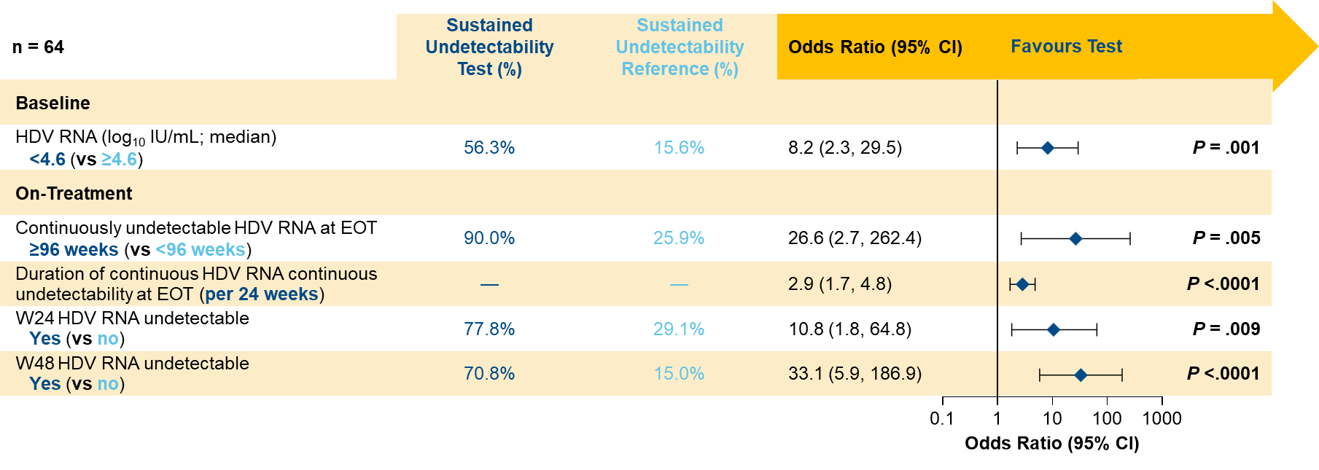
OS-066 Predictors of undetectable hepatitis delta virus RNA at 48 weeks after end of treatment with bulevirtide monotherapy in the MYR 301 study
Results
Sustained undetectability
Predictors of sustained undetectability at FU48
150 patients
65/150 (43%) undetectable at EOT
23/64 (36%)
sustained at FU48
Undetectability rates at EOT were higher in patients on BLV 10 mg.
Sustained undetectable HDV RNA through FU48 was more common in patients who received 3 years of treatment vs 2 years.
The duration of on-treatment undetectable HDV RNA at EOT was the strongest predictor of achieving sustained posttreatment undetectable HDV RNA through 48 weeks after treatment
BLV 2mg (n = 14) | BLV 10mg (n = 25) | Delayed Treatment (n = 26)
50% | 40% | 23%
By treatment arm
Conclusion
In patients with CHD treated with BLV monotherapy for 96W or 144W, achieving undetectable HDV RNA early during treatment and a longer duration of on-treatment HDV RNA undetectability were key predictors of sustained undetectability through 48 weeks of follow-up after treatment discontinuation.
Notes:
Abbreviations: IHC = Inactive HBsAG carriers; PegIFNα = peginterferon alpha; NA = Nucleos(t)ide analogues
OS-066
Predictors of undetectable hepatitis delta virus RNA at 48 weeks after end of treatment with bulevirtide monotherapy in the MYR 301 study
Soo Aleman1, Maurizia Brunetto2 3, Antje Blank4, Pietro Andreone5, Pavel Bogomolov6, Vladimir Chulanov7, Nina Mamonova8, Natalia Geyvandova9, Viacheslav Morozov10, Olga Sagalova11, Tatiana Stepanova12, Amos Lichtman13, Renee-Claude Mercier13, Dmitry Manuilov13, Sarah Arterburn13, Julian Schulze zur Wiesch14, Markus Cornberg15, Stefan Zeuzem16, Pietro Lampertico17 18, Heiner Wedemeyer15
1Department of Infectious Diseases, Karolinska University Hospital/Karolinska Institutet, Stockholm, Sweden, 2Hepatology Unit, Reference Center of the Tuscany Region for Chronic Liver Disease and Cancer, University Hospital of Pisa, Department of Clinical and Experimental Medicine, University of Pisa, Pisa, Italy, 3Department of Clinical and Experimental Medicine, University of Pisa, Pisa, Italy, 4Department of Clinical Pharmacology and Pharmacoepidemiology, Heidelberg University Hospital, Heidelberg, Germany, 5Division of Internal Medicine, University of Modena and Reggio Emilia, Baggiovara Hospital, Modena, Italy, 6M.F. Vladimirsky Moscow Regional Research and Clinical Institute, Moscow, Russian Federation, 7Sechenov University, Moscow, Russian Federation, 8FSBI National Research Medical Center for Phthisiopulmonology and Infectious Diseases of the Ministry of Health of the Russian Federation, Moscow, Russian Federation, 9Stavropol Regional Hospital, Stavropol, Russian Federation, 10LLC Medical Company Hepatolog, Samara, Russian Federation, 11South Ural State Medical University, Chelyabinsk, Russian Federation, 12LLC Clinic of Modern Medicine, Moscow, Russian Federation, 13Gilead Sciences, Inc., Foster City, United States, 14Hepatology Outpatient Medical Clinic, University Hospital Hamburg-Eppendorf, Hamburg, Germany, 15Clinic for Gastroenterology, Hepatology, Infectious Diseases, and Endocrinology, Hannover Medical School, Hannover, Germany, 16Department of Medicine, University Hospital Frankfurt, Frankfurt am Main, Germany, 17Division of Gastroenterology and Hepatology, Foundation IRCCS Ca’ Granda Ospedale Maggiore Policlinico, Milan, Italy, 18CRC “A. M. and A. Migliavacca” Center for Liver Disease, Department of Pathophysiology and Transplantation, University of Milan, Milan, Italy
Email: soo.aleman@ki.se
Background and Aims: Bulevirtide (BLV) is approved in Europe for the treatment of compensated chronic hepatitis delta (CHD). In MYR301, a Phase 3 study evaluating BLV monotherapy for 2–3 years, a subset of patients who achieved undetectable HDV RNA by end of treatment (EOT) maintained undetectable viraemia at 48 weeks (W) after EOT (FU48). Here, we present predictors of sustained HDV RNA undetectability through FU48 after 96W or 144W of BLV treatment.
Method: Data were analysed from 149 patients with CHD in MYR301 who were randomised to immediate treatment with BLV 2 or 10 mg/d for 144W, or to 48W of no treatment followed by BLV 10 mg/d for 96W (DT → 10 mg). All patients were to be followed through FU48. Logistic regression modelling (adjusted for treatment group) was performed to examine potential predictors of sustained HDV RNA undetectability (defined as less than the lower limit of quantitation [LLOQ; target not detected at follow-up in patients with available data]) through FU48 in those with undetectable viraemia at EOT.
Results: Baseline (BL) characteristics were similar between all treatment arms. Across all arms, 65/149 (44%) patients achieved HDV RNA undetectability at EOT, of whom 23/64 (36%) with available follow-up HDV RNA data had sustained undetectability through FU48. Rates of sustained undetectability were higher in the immediate treatment arms (2 mg: 7/14, 50%; 10 mg: 10/25, 40%) vs the delayed treatment arm (DT → 10 mg: 6/26, 23%). Undetectability rates at EOT were higher in patients who received BLV 10 mg, but the relapse rate was lower in the few patients with HDV RNA undetectable in the BLV 2 mg group. BL predictors of sustained undetectability posttreatment included BL HDV RNA less than a median of 4.5 log10 IU/mL (odds ratio [OR]: 6.2; 95% CI [1.9, 20.8]; p = .003) and lower BL hepatitis B surface antigen (HBsAg) level (OR: 0.3 per log10 IU/mL; 95% CI [0.1, 0.8]; p = .019). On-treatment predictors included greater duration of continuous undetectability at EOT (OR per additional week: 1.0; 95% CI [1.0, 1.1]; p < .0001), HBsAg loss or decrease by ≥ 1 log10 IU/mL (OR: 7.2; 95% CI [1.2, 42.3]; p = .030), and W144 antidrug antibody (ADA) incidence (OR: 10.2; 95% CI [1.9, 55.7]; p = .008). The proportion of patients with sustained posttreatment undetectability was 9/10 (90%) in those with ≥ 96W of undetectability at EOT, 11/22 (50%) in those with ≥ 48 to < 96W, and 3/32 (9%) in those with < 48W. Of patients with ADA incidence by W144, 8/10 (80%) had sustained undetectability vs 15/54 (28%) of those without. BL cirrhosis was not a predictor of sustained posttreatment undetectability; 13/32 (41%) with cirrhosis had sustained undetectability vs 10/32 (31%) without cirrhosis.
Conclusion: In patients with CHD treated with BLV monotherapy for 96W or 144W, early and sustained HDV RNA undetectability predicted sustained undetectability during follow-up. Note: PL and HW contributed equally.

Slide 12
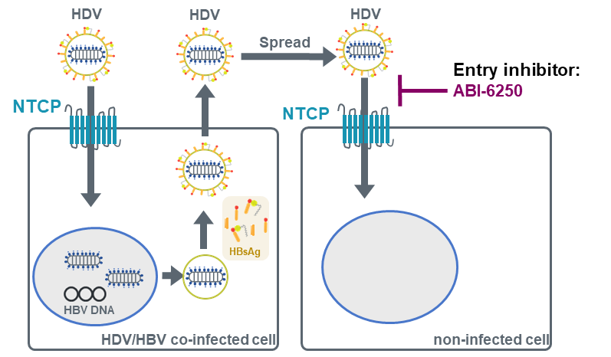
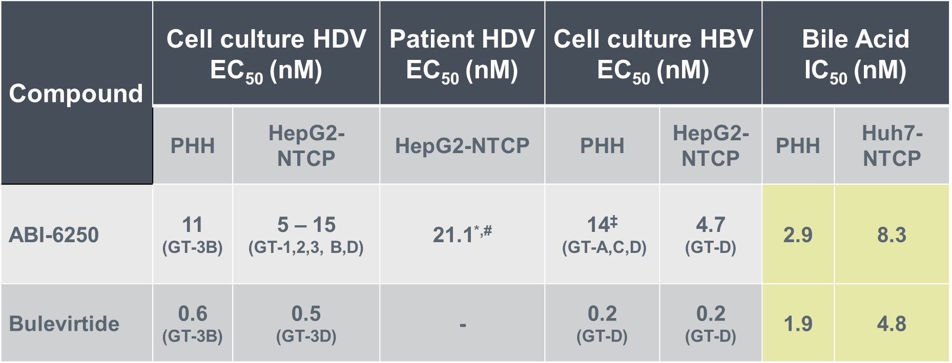
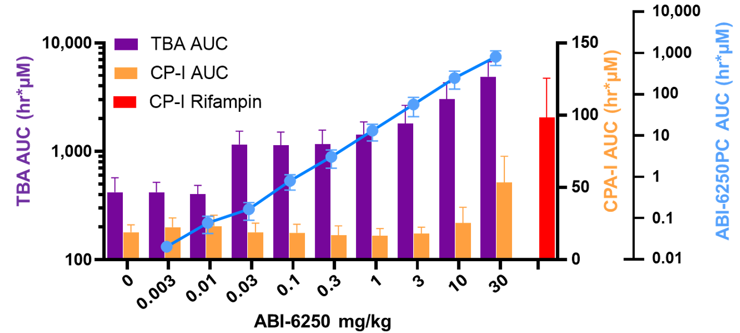

Preclinical Profiling of ABI-6250, a Novel Small-Molecule Orally Bioavailable Drug Candidate for the Treatment of Chronic Hepatitis D Virus Infections
LBP-001 LB252
Figure 1. ABI-6250 is an HDV/HBV entry inhibitor
Figure 2. ABI-6250 inhibits HDV/HBV entry & NTCP-mediated bile acid uptake
Figure 3. ABI-6250 elevates bile acids in cynomolgus monkeys
Conclusion
ABI-6250 is a highly potent, specific, orally bioavailable HDV/HBV entry inhibitor
At projected clinically relevant concentrations, ABI-6250 elevates total bile acid levels in vivo without increasing coproporphyrin-I plasma levels, a biomarker for OATP1B inhibition, indicating specific target engagement
ABI-6250s PK profile supports low once-daily dosing in patients with chronic HDV
A Phase 1a clinical trial with ABI-6250 is currently ongoing

Slide 13


OS-073 Entry inhibitor Hepalatide combined with pegylated interferon-alpha 2a therapy resulted in cccDNA clearance in CHB patients: a phase II randomised, double-blind, placebo-controlled trial
Background and Aims
HLT is a peptide designed to block the HBV entry receptor NTCP.
Aim
To evaluate the efficacy and safety of HLT in combination with pegylated interferon-alpha 2a (PEG-IFN) in patients with chronic hepatitis B (CHB).
Methods
Phase II multicentre, randomised, double-blind, placebo-controlled trial (NCT 04426968)
Number of Patients | 96
Age | 18-60 Years
HBV DNA | HBeAg-positive (≥ 20,000 IU/mL ) or HBeAg-negative (≥ 2,000 IU/mL)
Cirrhosis | None
IFN | Naïve
Placebo
(n = 24)
2.1 mg HLT (n = 24)
Primary endpoint (24-weeks):
Safety
HBV DNA loss (cut-off: 20 IU/mL)
HBsAg, Pg RNA, cccDNA and histological response in liver biopsy were also assessed at the end of the 24-week treatment.
24-week
treatment*
4.2 mg HLT (n = 24)
6.3 mg HLT (n =2 4)
*All subjects received PEG-IFN (180 μg/week) concomitantly for 48 weeks.
Notes:
Abbreviations: HLT = Hepalatide; NTCP = sodium-bile acid cotransporter; Aes = Adverse Events.
OS-073
Entry inhibitor Hepalatide combined with pegylated interferon-alpha 2a therapy resulted in cccDNA clearance in CHB patients: a phase II randomised, double-blind, placebo-controlled trial
Junliang Fu, Qing Mao1, Qinglong Jin2, Hui Chen3, Yongqian Cheng4, Xiaolu Tang5, Hongli Liu5, Fu-Sheng Wang
1Department of Infectious Diseases, Southwest Hospital, Army Medical University, Chongqing, China, 2Department of Hepatology, The First Hospital of Jilin University, Jilin University, Changchun, China, 3Department of hepatitis, Hepatobiliary hospital of Jilin, Changchun, China, 4Senior Department of Infectious Diseases, The Fifth Medical Center of Chinese PLA General Hospital, National Clinical Research Center for Infectious Diseases, Beijing, China, 5Shanghai HEP Pharma Co. Ltd., Shanghai, China
Email: fswang302@163.com
Background and Aims: Hepalatide (HLT) is a peptide designed to block the HBV entry receptor sodium-bile acid cotransporter (NTCP). This study aimed to evaluate the efficacy and safety of HLT in combination with pegylated interferon-alpha 2a (PEG-IFN) in patients with chronic hepatitis B (CHB).
Method: This Phase II multicentre, randomised, double-blind, placebo-controlled trial enrolled 96 patients aged 18–60 years with HBV DNA ≥ 20,000 IU/mL (HBeAg-positive) or ≥ 2,000 IU/mL (HBeAg-negative), no cirrhosis, and naïve to interferon treatment (NCT 04426968). Participants were randomly assigned to receive 2.1mg, 4.2mg, 6.3 mg of HLT treatment, or placebo for 24 weeks in a 1:1:1:1 ratio. All subjects received PEG-IFN (180μg/week) foundational treatment for 48 weeks. The primary endpoint was safety and HBV DNA loss (cut-off: 20 IU/mL) at 24 weeks of treatment. HBsAg, Pg RNA, cccDNA and histological response in liver biopsy were also assessed at the end of the 24-week treatment.
Results: A total of 96 subjects (77 HBeAg-positive and 19 HBeAg-negative) were included in the trial, with 24 patients in each group. Two patients withdrew due to interferon-related AEs. A total of 1281 AEs ranging from grade 1 to 3 were recorded, and mainly interferon-related. Only 26 AEs were related to HLT, and all AEs were graded 1 or 2. The proportion of patients with virological response (HBV DNA < 20 IU/mL or a decrease from baseline ≥ 2 log10) at the end of the 24-week HLT treatment in the 2.1 mg, 4.2 mg, or 6.3 mg and placebo group were 78.3%, 87.5%, 70.8% and 58.3%, respectively. The virological response rate in the 4.2mg group was significantly higher than that in placebo group (p = 0.0248). At baseline and the end of 24-week HLT treatment, 21 and 14 liver biopsies were obtained, respectively. All four groups had positive baseline biopsies cccDNA of 3.463 ± 1.03, 2.383 ± 0.97, 3.850 ± 1.08, and 3.018 ± 0.76 log10 copies/μL, respectively. Surprisingly, cccDNA became undetectable (< 5 copies/μL by verified PCR assay) in 33.3% (1/3) and 40.0% (2/5) of samples from the 4.2mg and 6.3mg groups at the end of the 24-week HLT treatment, while all samples from 2.1mg and placebo groups remained cccDNA positive. The three subjects with cccDNA clearance remained HBsAg-positive at the end of HLT treatment. Pg RNA levels and HBsAg levels were progressively reduced in all groups during the treatment. The fact that all indicates that this HBsAg may be expressed from integrated HBV DNA.
Conclusion: The combination therapy in the present trial may alter the balance of the HBV reservoir by blocking cccDNA replenishment through inhibiting HBV entry via HLT and accelerating cccDNA
decay via PEG-IFN. This strategy provides great potential to achieve a sterilising cure for patients with CHB.

Slide 14
OS-073 Entry inhibitor Hepalatide combined with pegylated interferon-alpha 2a therapy resulted in cccDNA clearance in CHB patients: a phase II randomised, double-blind, placebo-controlled trial
Results
Conclusion
Adverse Events
Virological Response
The combination therapy in the present trial may alter the balance of the HBV reservoir by blocking cccDNA replenishment through inhibiting HBV entry via HLT and accelerating cccDNA decay via PEG-IFN.
This strategy provides great potential to achieve a sterilising cure for patients with CHB.
Two patients withdrew due to interferon-related AEs.
1281 AEs → mostly PEG-IFN-related. Only 26 HLT-related (Grade 1-2).
 | 2.1 mg HLT | 4.2 mg HLT | 6.3 mg HLT | Placebo
Virological response* | 78.30% | 87.50% | 70.80% | 58.30%
(HBV DNA < 20 IU/mL or decrease from baseline ≥ 2 log10)
*Virological response rate in the 4.2mg group was significantly higher than that in placebo group (p = 0.0248)
cccDNA
 | 2.1 mg HLT | 4.2 mg HLT | 6.3 mg HLT | Placebo
Baseline ccccDNA (log10 copies/μL) | 3.463 ± 1.03 | 2.383 ± 0.97 | 3.850 ± 1.08 | 3.018 ± 0.76
24-week ccDNA | All samples cccDNA positive | Undetectable* in 33.3% of samples | Undetectable* in 40.0% of samples | All samples cccDNA positive
The three subjects with cccDNA clearance remained HBsAg-positive at the end of HLT treatment.
*< 5 copies/μL by verified PCR assay
Notes:
Abbreviations: HLT = Hepalatide; NTCP = sodium-bile acid cotransporter; Aes = Adverse Events.
OS-073
Entry inhibitor Hepalatide combined with pegylated interferon-alpha 2a therapy resulted in cccDNA clearance in CHB patients: a phase II randomised, double-blind, placebo-controlled trial
Junliang Fu, Qing Mao1, Qinglong Jin2, Hui Chen3, Yongqian Cheng4, Xiaolu Tang5, Hongli Liu5, Fu-Sheng Wang
1Department of Infectious Diseases, Southwest Hospital, Army Medical University, Chongqing, China, 2Department of Hepatology, The First Hospital of Jilin University, Jilin University, Changchun, China, 3Department of hepatitis, Hepatobiliary hospital of Jilin, Changchun, China, 4Senior Department of Infectious Diseases, The Fifth Medical Center of Chinese PLA General Hospital, National Clinical Research Center for Infectious Diseases, Beijing, China, 5Shanghai HEP Pharma Co. Ltd., Shanghai, China
Email: fswang302@163.com
Background and Aims: Hepalatide (HLT) is a peptide designed to block the HBV entry receptor sodium-bile acid cotransporter (NTCP). This study aimed to evaluate the efficacy and safety of HLT in combination with pegylated interferon-alpha 2a (PEG-IFN) in patients with chronic hepatitis B (CHB).
Method: This Phase II multicentre, randomised, double-blind, placebo-controlled trial enrolled 96 patients aged 18–60 years with HBV DNA ≥ 20,000 IU/mL (HBeAg-positive) or ≥ 2,000 IU/mL (HBeAg-negative), no cirrhosis, and naïve to interferon treatment (NCT 04426968). Participants were randomly assigned to receive 2.1mg, 4.2mg, 6.3 mg of HLT treatment, or placebo for 24 weeks in a 1:1:1:1 ratio. All subjects received PEG-IFN (180μg/week) foundational treatment for 48 weeks. The primary endpoint was safety and HBV DNA loss (cut-off: 20 IU/mL) at 24 weeks of treatment. HBsAg, Pg RNA, cccDNA and histological response in liver biopsy were also assessed at the end of the 24-week treatment.
Results: A total of 96 subjects (77 HBeAg-positive and 19 HBeAg-negative) were included in the trial, with 24 patients in each group. Two patients withdrew due to interferon-related AEs. A total of 1281 AEs ranging from grade 1 to 3 were recorded, and mainly interferon-related. Only 26 AEs were related to HLT, and all AEs were graded 1 or 2. The proportion of patients with virological response (HBV DNA < 20 IU/mL or a decrease from baseline ≥ 2 log10) at the end of the 24-week HLT treatment in the 2.1 mg, 4.2 mg, or 6.3 mg and placebo group were 78.3%, 87.5%, 70.8% and 58.3%, respectively. The virological response rate in the 4.2mg group was significantly higher than that in placebo group (p = 0.0248). At baseline and the end of 24-week HLT treatment, 21 and 14 liver biopsies were obtained, respectively. All four groups had positive baseline biopsies cccDNA of 3.463 ± 1.03, 2.383 ± 0.97, 3.850 ± 1.08, and 3.018 ± 0.76 log10 copies/μL, respectively. Surprisingly, cccDNA became undetectable (< 5 copies/μL by verified PCR assay) in 33.3% (1/3) and 40.0% (2/5) of samples from the 4.2mg and 6.3mg groups at the end of the 24-week HLT treatment, while all samples from 2.1mg and placebo groups remained cccDNA positive. The three subjects with cccDNA clearance remained HBsAg-positive at the end of HLT treatment. Pg RNA levels and HBsAg levels were progressively reduced in all groups during the treatment. The fact that all indicates that this HBsAg may be expressed from integrated HBV DNA.
Conclusion: The combination therapy in the present trial may alter the balance of the HBV reservoir by blocking cccDNA replenishment through inhibiting HBV entry via HLT and accelerating cccDNA
decay via PEG-IFN. This strategy provides great potential to achieve a sterilising cure for patients with CHB.

Slide 15
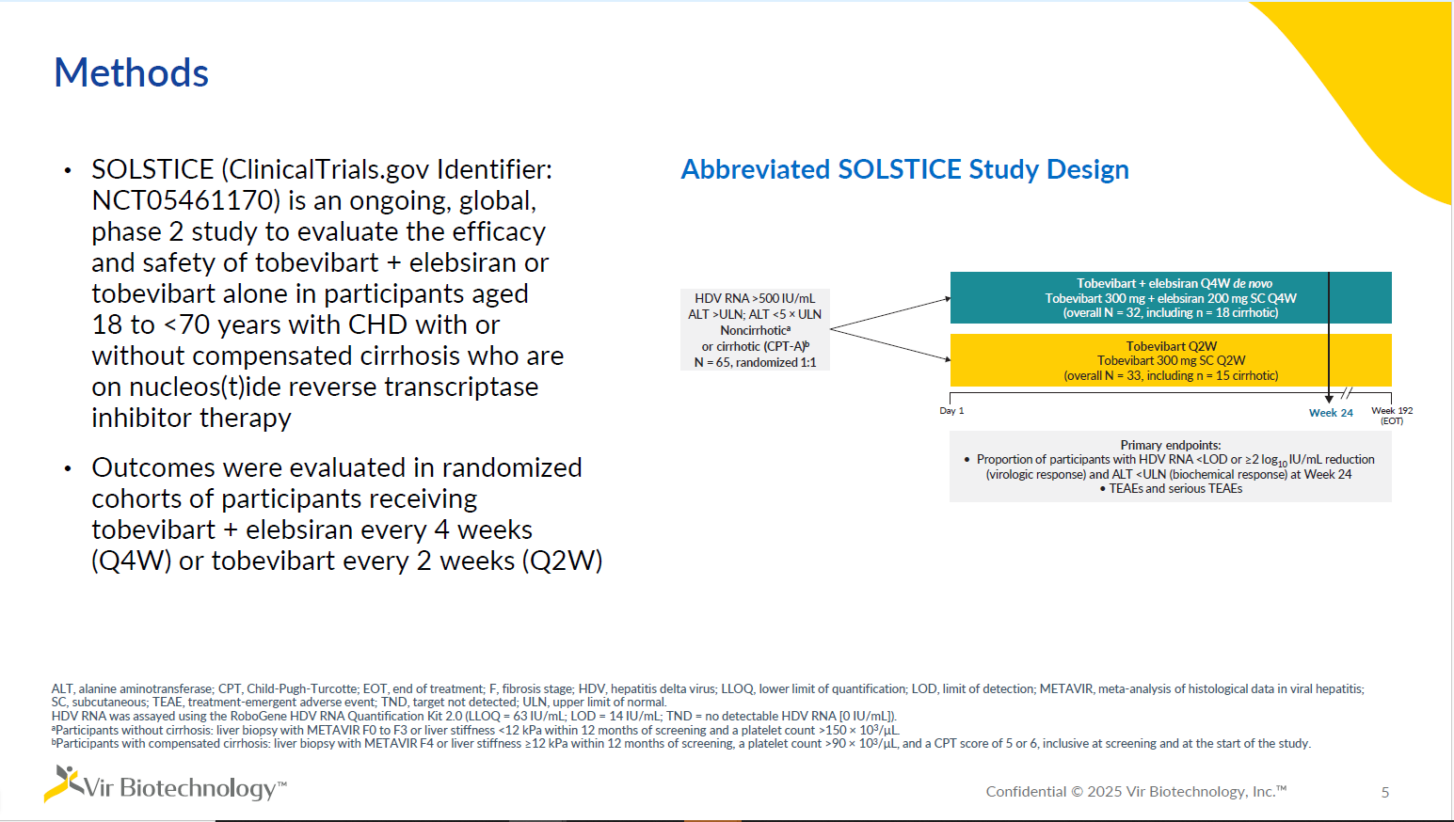

Slide 16
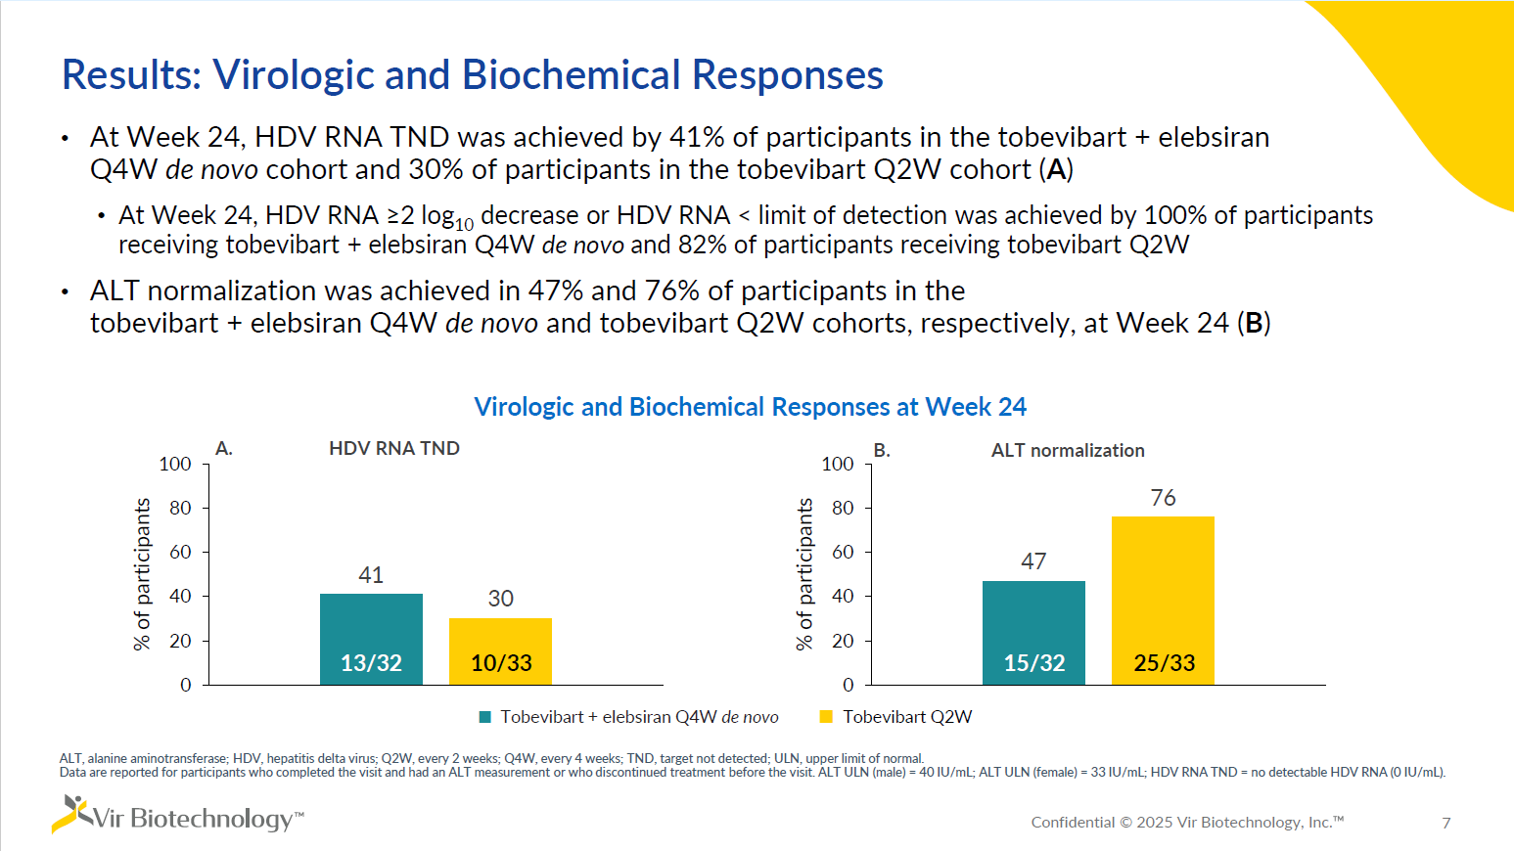

Slide 17
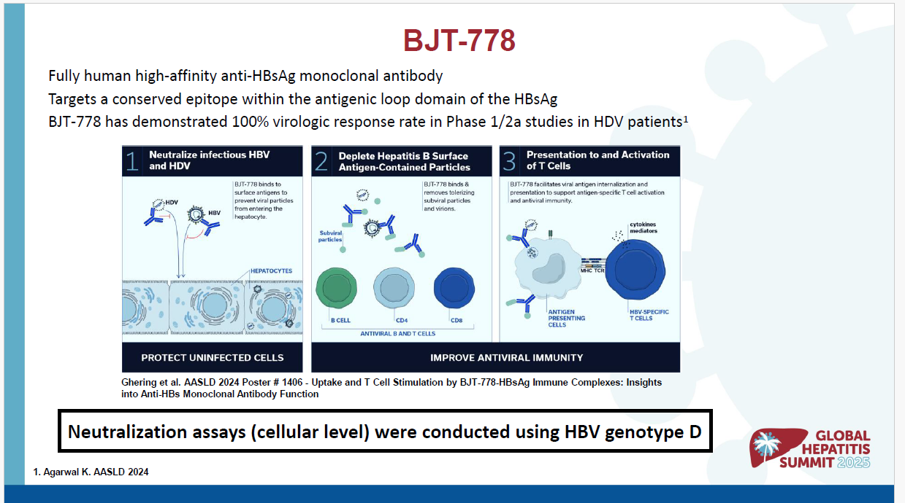

Slide 18
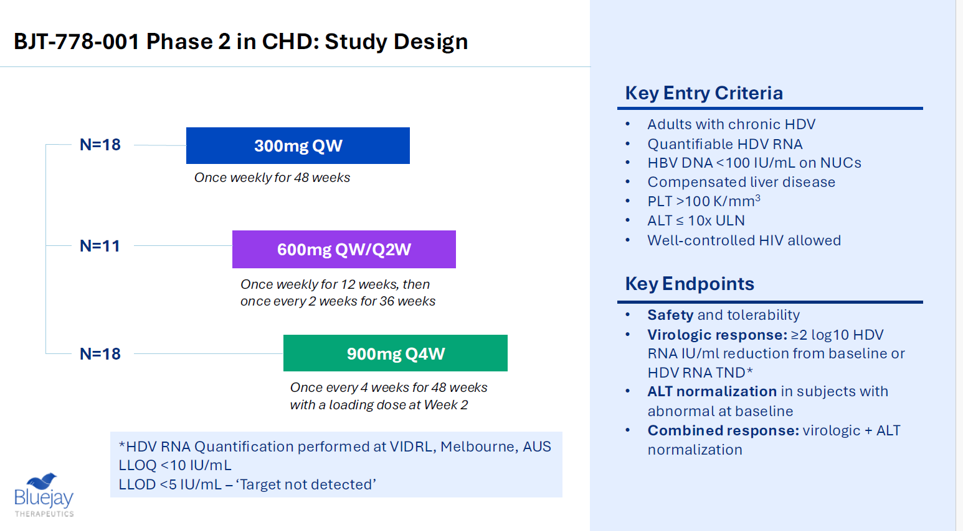

Slide 19
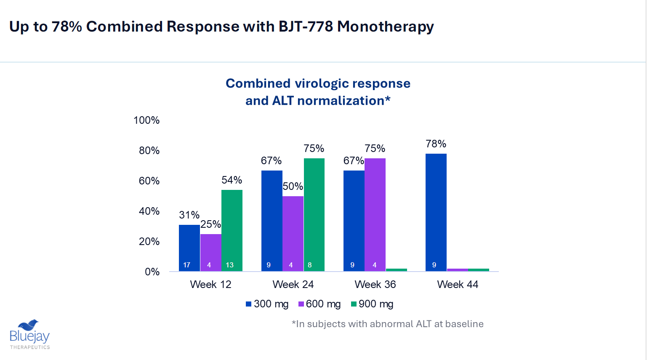

Slide 20
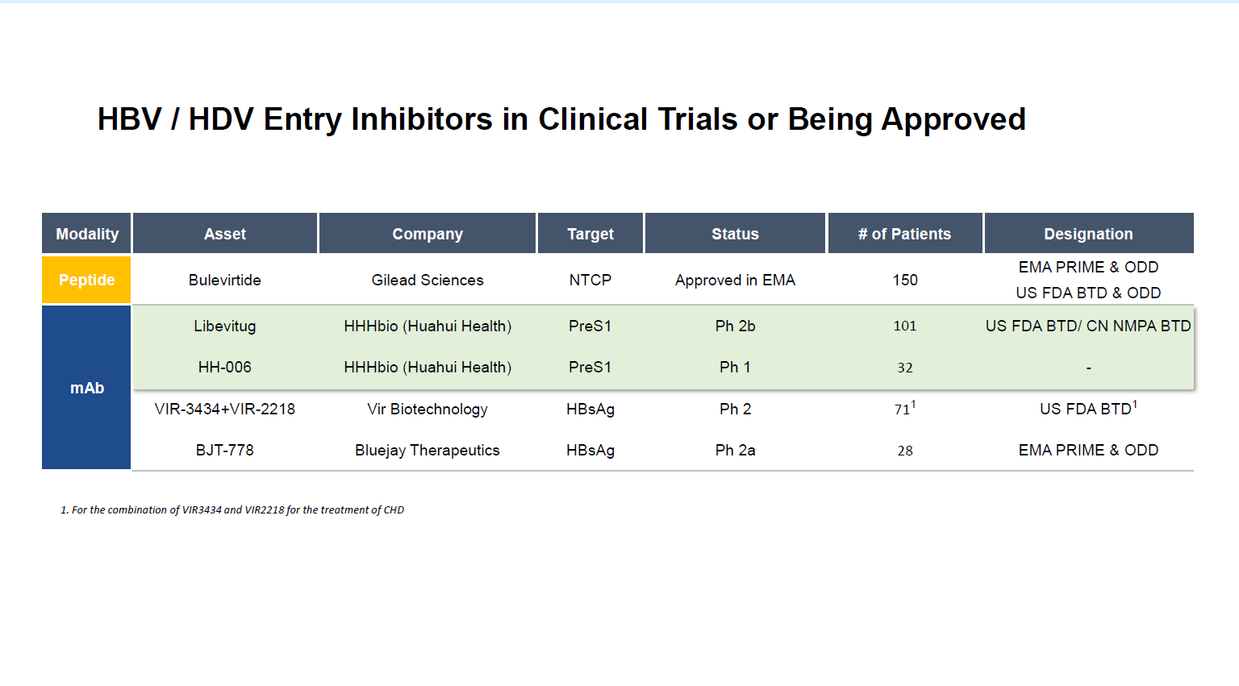

Slide 21
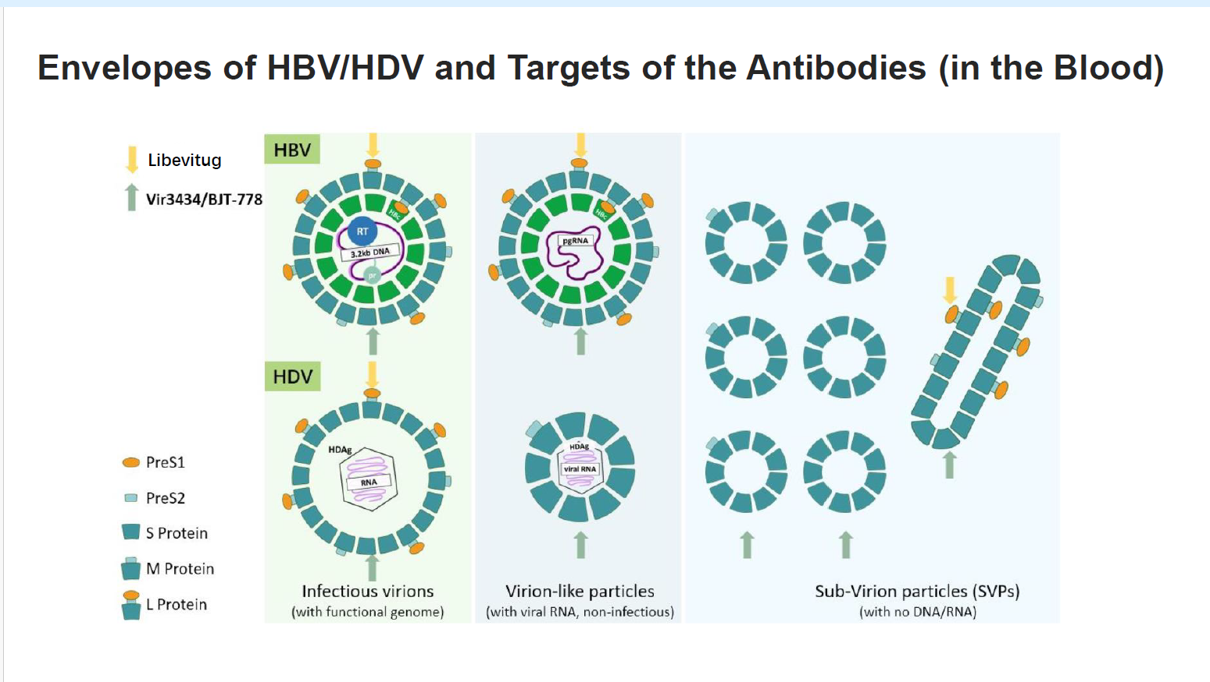

Slide 22
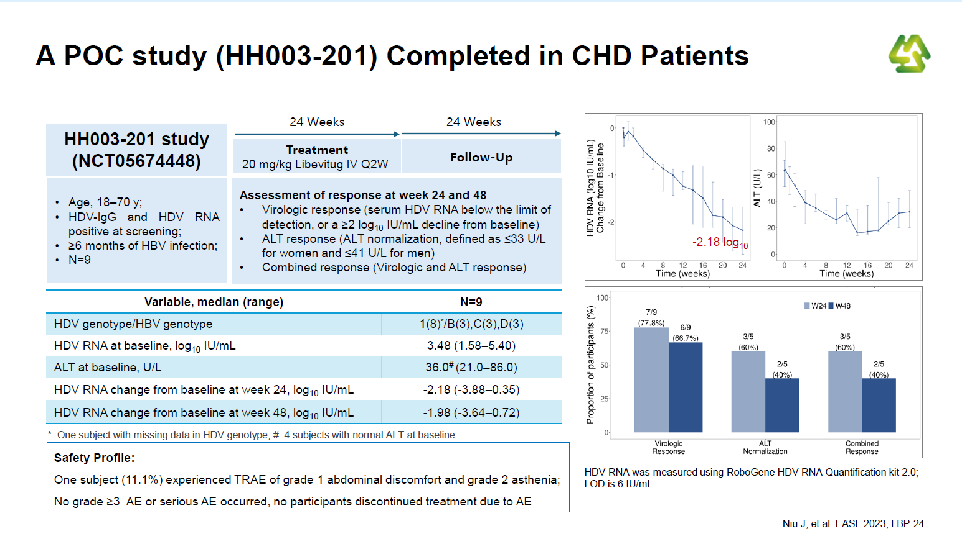

Slide 23
In summary:
We have many new technologies moving forward to cure HDV even in the absence of an HBV Cure
Antibody technology is dominating this space currently with NTCP receptors and co-dominant
DAA against HBV may superscede these new HDV treatment paradigms, but that roadmap is not established
We hope the path for oral NTCP receptors can move forward to replace injectables in 5 years
A partnership with lonafarnib and lambda interferon is also on the horizon

Slide 24
Thank you to the organizers of the STC Taskent APASL meeting
And my thanks to
HHH
Vir
Gilead
Bluejay
For their work in the HDV space and the patients and families, the Pis, and the institutions and also the investors !

