Slide 1
Libevitug: Revolutionizing Chronic Hepatitis Delta (CHD) Treatment with a First-in-Class Anti-PreS1 Monoclonal Antibody
Bin Chen, Ph.D.
Huahui Health
June 2025

Slide 2


Huahui Health (HHHbio) at A Glance
Pioneer in innovative therapeutics to address significant unmet medical needs in chronic hepatitis B and D (CHB and CHD)
  First-in-class MoA with proven superior safety and efficacy profiles with 300+ subjects
  The flagship asset, Libevitug, is globally the first one granted Breakthrough Therapy Designation (BTD) for CHD by both the US FDA and China NMPA
1
Led by award winner and sophisticated executives with proven track record in executing clinical development
  The founder, Wenhui Li, is the Prize Winner of 2021 Baruch S. Blumberg, the Hepatitis B Foundation's highest honor
  Experienced management team with decades of leadership experience across multinational pharma and local biotech organizations
2
Focused and effective execution of clinical trials with promising results
  With only $200m funding to date, HHHbio has effectively brought Libevitug to Phase III ready stage for CHD with various designations, and Phase IIb ready stage for CHB
  Backed by season investors such as CBC Group, Hillhouse, Matrix Partners China and Superstring
3
Clear near-term commercialization opportunity with huge global potential
  Libevitug has filed China NDA for CHD in Nov 2024 and expects to launch by Q4 2025; US, EU and rest of the world R&D and commercialization plan on track
  Libevitug has also demonstrated promising results in anti-HBV, which affects ~300m people globally
4
Founded in 2015, HHHbio was established by top-tier scientists with exceptional scientific expertise in Hepatitis B virus (HBV) and Hepatitis D virus (HDV), hepatology, and protein engineering
HHHbio is managed by an executive team with extensive R&D experience in both the US and China, and is financially supported by seasonal investors such as CBC Group, Hillhouse, Matrix, and Superstring
HHHbio possesses integrated R&D capabilities and is dedicated to developing innovative therapeutics to address significant unmet medical needs in chronic hepatitis B and D (CHB and CHD), as well as other liver diseases
HHHbio’s flagship asset, Libevitug (HH-003), has been granted Breakthrough Therapy Designation (BTD) for CHD by both the US FDA and China NMPA, based on its first-in-class mechanism of action (MoA) and its proven efficacy and safety profiles in one of the largest Phase 2 datasets of CHD patients
Libevitug has a clear near-term commercialization opportunity with global potential

Slide 3



Our Pipeline – Virology and Oncology
An innovative pipeline with global IP rights
 | Asset | Target | Modality | Route of Administration | Indication | Worldwide Rights | Pre-clinical | IND | Phase 1 | Phase 2 | Phase 3 | Next Milestone
Virology | Libevitug (HH-003) | PreS1 | mAb | IV | CHD | ✓ |  |  |  |  |  | H2 2025: CN NDA approval
 |  |  |  |  |  |  |  |  |  |  |  | Q1 2025: EOP2 H2 2025: US Ph3 initiation
 |  |  |  |  | CHB | ✓ |  |  |  |  |  | H2 2025: Ph2b initiation
 | HH-006 | PreS1 w/ enhanced Fc | mAb | SC | CHB/CHD | ✓ |  |  |  |  |  | Q4 2025: Ph2 initiation
 | HH-1270 | NTCP | Small molecule | Oral | CHB/CHD | ✓ |  |  |  |  |  | Q4 2025: IND approval
Oncology | HH-009 | FGF19 | mAb | IV | HCC | ✓ |  |  |  |  |  | Q1 2025: Ph1a completion
 | HH-018 | CD98 | mAb and ADC¹ | IV | CRC, OC, HNSCC | ✓ |  |  |  |  |  | H2 2025: IND approval
 | Others² | TIGIT, CD112R,TfR1 | mAb | IV or SC | Tumors | ✓ |  |  |  |  |  | To bring promising molecules to the clinical stage
 |  | CD3/LILRB4 | BsAb
 |  | PD-1/CTLA4/VEGF | TsAb
China NMPA BTD granted in Apr 2023;
NDA submitted in Nov 2024
US FDA BTD granted in Nov 2024
US/China IND
Australia CTA/China IND/US IND
US/China IND; US ODD
1. ADC In collaboration with Genmab
2. Lead optimization stage except for TIGIT at the end of Phase 1a and CD112R under an approved China IND
ADC: antibody-drug conjugate; BsAb: bispecific antibody; BTD: breakthrough therapy; CRC: colorectal cancer; CTA: clinical trial application; CHB: chronic HBV infection; CHD: chronic HDV infection; FDA: food & drug administration; HBV: hepatitis B virus; HCC: hepatocellular carcinoma; HDV: hepatitis delta virus; HNSCC: head and neck squamous cell carcinoma; IND: investigational new drug; IP: intellectual property; IV: intravenous; mAb: monoclonal antibody; NMPA: National Medical Products Administration; OC: ovarian cancer; ODD: orphan drug designation; SC: subcutaneous; TsAb: tri-specific antibody

Slide 4
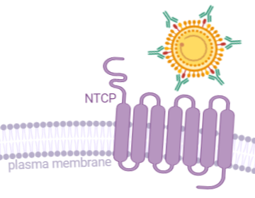
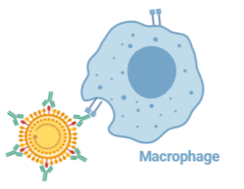
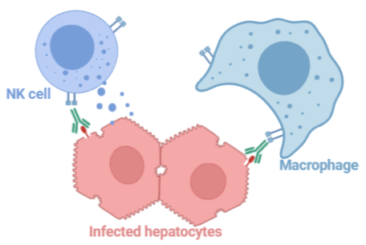
Libevitug Has Triple Anti-HBV/HDV Mechanism of Actions (MoAs)
Growing scientific consensus recognizes the importance of entry inhibitor in achieving functional cure
Blockage of Viral Entry
By binding to PreS1, Libevitug can block the viral entry of HBV/HDV to hepatocyte, further inhibit de novo infection and re-infection
Fab
HBV binding
Fc
Fc effector function
Clearance of Virions
By binding to PreS1, Libevitug could clear the free HBV/HDV virions via Fc functions
Libevitug
A fully human mAb (IgG1 isotype) that targets the PreS1 region of HBV Large (L) protein
Removal of HBV-Infected Hepatocytes
Through Fc medicated ADCP and ADCC, Libevitug could potentially clear the HBV/HDV reservoir
ADCC: antibody dependent cellular cytotoxicity
ADCP: antibody dependent cellular phagocytosis

Slide 5
Libevitug – A Critical Piece of Curative Therapy for Both CHD and CHB
Libevitug demonstrates a tremendous potential to achieve functional cure for CHD and CHB patients
 | Superior Safety and Efficacy Profiles of Libevitug Have Been Evidenced by 300+ Subjects
CHD
CHB
A breakthrough therapy to treat CHD through its first-in-class MoA
Libevitug is globally the first therapy targeting CHD with BTD granted by both the US FDA and China NMPA
Excellent safety and strong efficacy in CHD patients has been demonstrated in below clinical studies
Libevitug is also a promising candidate for CHB combination therapy:
  Its ability to block HBV infection and reinfection by directly binding to the preS1 domain of the HBV envelope protein, addressing a key gap in existing antivirals
  Potentially it has dual antiviral and anti-inflammatory effects in CHB
  It has been evaluated in three clinical studies in CHB patients
Study ID | Phase | Country | Purpose | # of patient enrolled | Status
HH003-201 (NCT05674448) | 2a | China | Proof-of-concept | 9 | Completed
HH003-204 (NCT05861674) | 2b | China, U.S.¹ Mongolia and Pakistan | Pivotal multi-regional clinical trial | 101 | 24w data released; CN NDA Submitted
Study ID | Phase | Country | Purpose | # of patient enrolled | Status
HH003-1801/1802 (NCT05542979) | 1a / 1b | China | 1a in healthy subjects; 1b in naïve CHB patients | 44 / 68 | Completed
HH003-202 (NCT05839639) | 2a | China | Proof-of-concept | 73 | Completed
HH003-203 (NCT05734807) | 2a | China | Proof-of-concept | 73 | Completed
1. Set up but no patient was enrolled due to faster enrollment in other countries

Slide 6
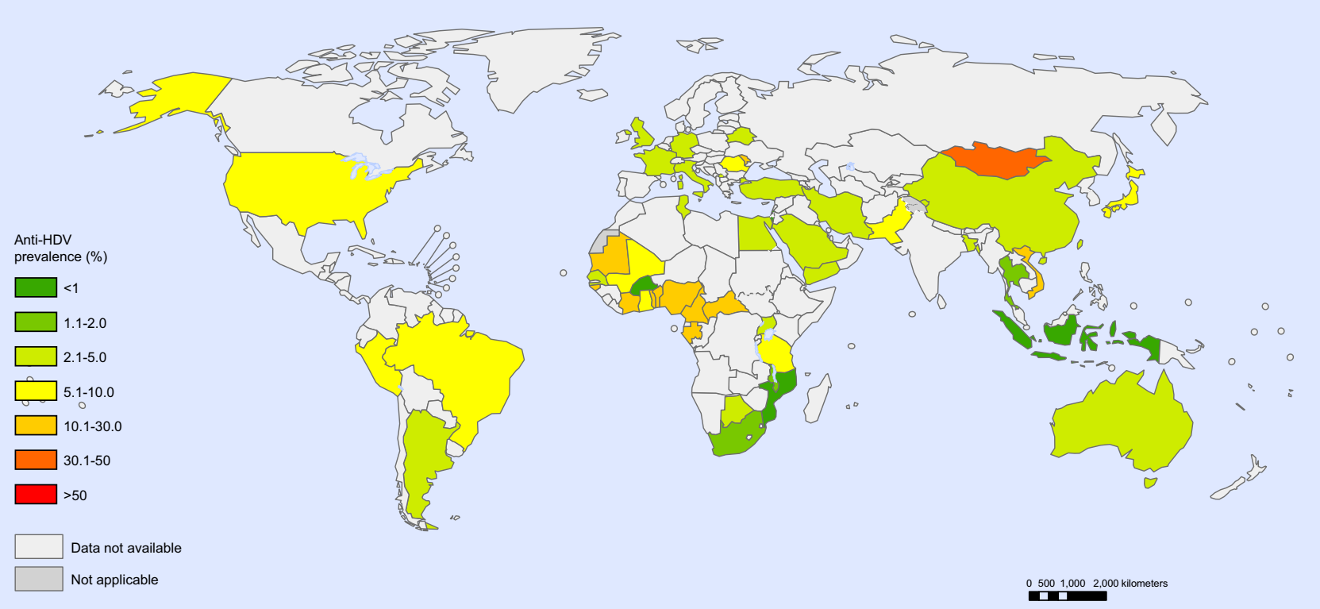
CHD – A Global Health Challenge with Clear Unmet Medical Needs
No precise official figure. Mid-Range Estimate (5-8% co-infection): ~90,000 - 200,000 HDV patients in Uzbekistan
HDV – a highly pathogenic virus
> 50% liver related death in 10 years⁴⁻⁶
Average 5-year progression to cirrhosis and liver failure⁶
Standard of Care Limitations
Bulevirtide is the only treatment specifically approved for CHD and by EMA only in 2020, highlighting the challenges and the unmet medical needs in managing this severe disease
Interferon used off-label
Tolerability issue
Prevalence of anti-HDV among HBsAg positive people in the general population¹
~12 Million people are living with hepatitis delta globally¹⁻²
Millions of people with HDV RNA positive in key markets¹⁻²
CHINA ~800,000 | US ~100,000 | EU ~680,000
Higher HDV prevalence among populations at increased risk of bloodborne virus infections²⁻³ The geographical distribution of HDV infection globally is very heterogeneous, with endemic high prevalence in Mongolia, the Republic of Moldova and countries in western and central Africa, central Asia, eastern Europe²
Addressing Unmet Needs
Slow disease progression via effective treatment
Improve tolerability
Affordable pricing
1. Stockdale et al. J Hepatol. 2020.; 2.WHO. Global hepatitis report 2024; 3.Wang et al. Int. J. Infect Dis. 2024; 4. Da et al. Gastroenterol Rep (Oxf) 2019; 5.Negro F. JAMA. 2023; 6. Pan C. Dig Dis Sci. 2023.

Slide 7
Competitive Landscape of Key Novel CHD Treatments
Unique MoA
Globally the only novel CHD treatment
in clinical stage targeting PreS1
Expedited Pathway
Globally the first CHD candidate with
both US FDA and China NMPA BTD
Near Term Commercialization
Libevitug is one of the most advanced among the clinical stage candidates and has filed NDA in China
Modality | Asset | Company | Target | Status | # of Patients Enrolled | Designation
Peptide | Bulevirtide | Gilead Sciences | NTCP | Approved by EMA | 150+ | EMA PRIME & ODD US FDA BTD & ODD
mAb | Libevitug | HHHbio | PreS1 | Ph 2a/2b | 9/101 | US FDA BTD/ CN NMPA BTD
 | HH-006 | HHHbio | PreS1 | Ph 1b (CHB) | - | -
 | VIR-3434 | Vir Biotechnology | HBsAg | Ph 2 | 71¹ | US FDA Fast Track¹
 | BJT-778 | Bluejay Therapeutics | HBsAg | Ph 2a | 28 | EMA PRIME & ODD
siRNA | VIR-2218 | Vir Biotechnology | HBV mRNA | Ph 2 | 71¹ | US FDA Fast Track¹
 | RBD1016 | Ribo | HBV mRNA | Ph 2 | 15 | -
Small Molecule | HH-1270 | HHHbio | NTCP | Preclinical | - | -
 | ABI-6250 | Assembly Biosciences | NTCP | Preclinical | - | -
Note: Not including Eiger BioPharma that filed for bankruptcy in 2024
1. For the combination of tobevibart and elebsiran for the treatment of CHD

Slide 8
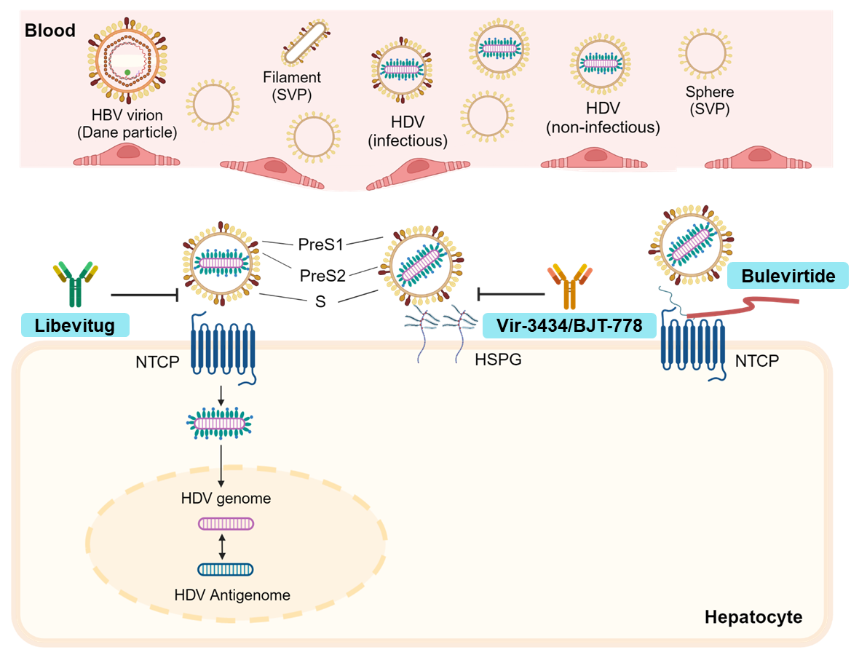
How Libevitug Differentiates from Other CHD Treatments
Libevitug uses a superior target engagement strategy and potentially offers several advantages
Schematic Illustration of Different Binding Sites of
Anti-preS1 and Anti-S mAbs on the Envelope of HBV/HDV
Libevitug vs. Bulevirtide (BLV)
Targeting PreS1 on the virus vs. Targeting NTCP on the cell receptor
Safer and more tolerable than BLV
Faster onset of efficacy than BLV
Bi-weekly vs. once daily
Libevitug vs. Anti-S Antibodies (VIR-3434 / BJT-778)
Targeting infectious virions vs. Targeting S antigen that exists in both infectious and non-infectious particles (containing RNA) and SVPs (including filaments and spheres)
  Anti-S mAb raises concerns about immunopathology due to the formation of large amounts of immune complexes involving the S antigen and anti-S antibodies
Potentially safer than anti-S antibodies
Not prone vs. prone to mutant escape¹
Similar to HBV particles, infectious HDV particles containing PreS1 are found at a ratio of only 1 in 1,000 to 1 in 10,000 among the total HDV particles present in the blood¹.
Libevitug vs. siRNAs
Safer than siRNAs due to the potential off-target effects and hepatotoxicity associated with siRNAs
1. Gerlich, W. H. Virol J. 2013; 2. Wang et al. Cell host and microbe. 2020

Slide 9
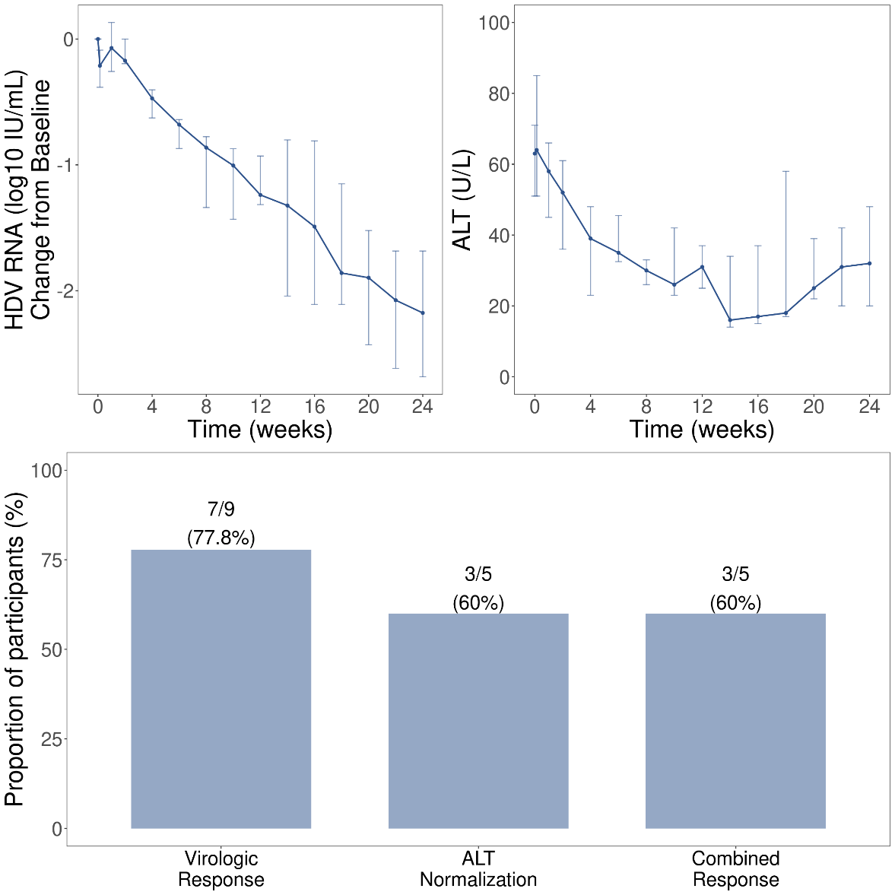
A POC study (HH003-201) Completed in CHD patients
Libevitug was granted BTD in 2023 by China NMPA based on this study
Libevitug has shown good safety in patients with CHD co-infected with HBV¹
  One subject (11.1%) experienced TRAE. No grade 3 or higher AEs or SAEs occurred, and no participants discontinued treatment due to AEs
Libevitug has shown good efficacy signal in treating CHD¹
  The comparison with Bulevirtide from its Ph2a study (MYR201²)
Clinical Endpoint at Week 24 | HH-003 | Bulevirtide
HDV RNA Response | 78% (7/9) | 57% (4/7)
ALT Normalization | 60% (3/5) | 75% (6/8)
Composite response | 60% (3/5) | ~ 13.3 - 50%³
* 6 subjects missed 1 dose of treatment due to lockdown from COVID-19 surge
¹EASL 2023, Vienna, Austria. Abstract# 4054. ²Bogomolov et al. J Hepatol. 2016.
³Range from MYR 201 (unknown) , MYR202 (2mg QD, 21.4% ), MRY203 (2mg QD ,13.3%), MYR204 (10mg QD, 50%), MYR301(2mg QD, 36.7%; 10mg QD, 28% ), at week 24;
MYR 301 (2mg QD , 45% ; 10mg QD, 48% ) at week 48

Slide 10
Efficacy Comparison Among Libevitug (Ph2a), Bulevirtide (Ph2a), Vir3434 (Ph2) and BJT-778 (Ph1b/2a)
Clinical Endpoint at Week 24 Response rate % (#/# case) | HH-003¹ 20mpk IV Q2W | Bulevirtide² 2mg SC QD | Vir3434^{3,**} 300mg SC Q2W | BJT-778^{3,***} 300mg SC QW
HDV RNA Response | 78% (7/9) | 57% (4/7) | 55% (6/11) | 90% (9/10)
ALT Normalization | 60% (3/5) | 75% (6/8) | 64% (7/11) | 67% (6/9)
Composite response | 60% (3/5) | 13.3 - 50%* | 55% (6/11) | 67% (6/9)
* Range from MYR 201 (unknown) , MYR202 (2mg , 21.4% ), MRY203 (2mg , 13.3%), MYR204 (10mg , 50%) and MYR 301 (2mg , 36.7%; 10mg , 28%) , at week 24;
MYR 301 (2mg , 45%; 10mg , 48%) at week 48
** Vir3434+Vir2218 Combo at week 24, composite response =7/11 (64%)
*** BJT-778 600mg SC QW at week 12, composite response = 50% (2/4)
EASL 2023
Bogomolov et al. J Hepatol. 2016
EASL 2024

Slide 11
A Pivotal MRCT (HH003-204) About Ending in CHD Patients
Results to be released at AASLD’25, and China NDA expected to be approved in Dec. 2025
A multicenter, randomized, controlled, open-label, Phase 2b clinical study to assess efficacy and safety of Libevitug in subjects of CHD infection
Screening
(~28 days)​
NrtIs Pre-treatment
(≤12 weeks)
Treatment
(24 + 24 weeks)​
Follow up
(24 weeks)​
Chronic HDV infection (N=90)
18~70y;
HBsAg positive;
HDV antibody positive;
HDV RNA ≥ 100 IU/mL
1 × ULN < ALT < 10 × ULN
Without deco mpensationcirrhosis
Treatment group 1 (N=36)：
Libevitug 20 mg/kg Q2W
+ TAF for 24 wk
Libevitug 20 mg/kg Q2W
+ TAF for 24 wk
Continue prior NrtIs
or TAF
R
2:2:1
TAF
Treatment group 2 (N=36)：
Libevitug 10 mg/kg Q2W
+ TAF for 24 wk
Libevitug 10 mg/kg Q2W
+ TAF for 24wk
Stratification：
cirrhosis and Country
Control group (N=18)：
TAF for 24 wk
TAF for 24W
Primary endpoints: Proportion of subjects with (1) HDV RNA < LLOQ or decline by ≥ 2 log₁₀ and (2) ALT normalization at week 24
*Libevitug (HH-003) vs BLV switch, HDV RNA < LLOQ or decline by ≥ 2 log₁₀ and ALT normalization at week 24

Slide 12
Libevitug Has Demonstrated Better Safety and Efficacy than Bulevirtide
 |  | Gilead
Product |  | Bulevirtide
Clinical Trial |  | Phase 3¹
Dosing Frequency |  | SC once daily
Dose Level |  | 2mg (Approved by EMA)
Population² |  | 49
Duration |  | 24w | 48w | 96w | 144w
Clinical Trial Results
Safety | Population %
 | AE | 65% | 84% | 96% | 98%
 | Grade 3 or 4 AE | 4% | 10% | 18% | 24%
 | TRAE | n.a. | 49% | 51% | 55%
 | AE leading to discontinue | 0% | 0% | 0% | 0%
Efficacy | Response Rate
 | HDV RNA | 55% | 73% | 76% | 73%
 | ALT | 53% | 51% | 63% | 59%
 | Combined | 37% | 45% | 55% | 57%
 | Reduction
 | HDV RNA | ~2.0 | ~2.5 | ~3.0
Highlights of Libevitug
Q2W (Libevitug) vs daily (BLV)
HHHbio is also working on a SC version, namely HH-006
Comparable safety in terms of % of AE
AE of Libevitug in injection groups were more of headache, discomfort, itching, and pain than the placebo group
BLV raises the concern of Grade 3 or 4 AE after long-time treatment
Comparable effect in the combined response (the primary endpoint, >40% at 48w for Libevitug) with superior efficacy in the % of ALT deduction responders (~70% for Libevitug)
Gilead (EASL 2021, EASL 2023, OS-068; New England Journal of Medicine)
Efficacy was measured by number of patients in ( ) due to data availability
12

Slide 13
Introducing HH-006 as a Next-Generation of Libevitug
An optimized version of Libevitug through Fc-engineering to complete Ph1b in Q3’25
With enhanced PK/PD, HH-006 is designed to use subcutaneous injection as the route of administration
Molecular Structure of HH-006
in comparison with that of Libevitug
Potential Functional Similarities or Advantages of HH-006
in comparison with Libevitug
Identical Fab region for identical target (PreS1)
Very similar binding affinity and
in vitro neutralizing activities
Engineered Fc region with enhanced Fc function
Extended half-life (~2 months)
Enhanced Fc-effector function (i.e., ADCC & ADCP)
Potential vaccinal effect

Slide 14
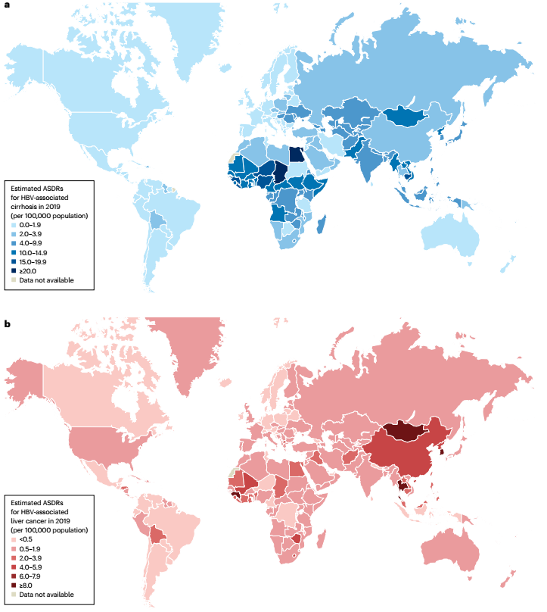
CHB – A Global Health Challenge with Clear Unmet Medical Needs
Global distribution of age-standardized death rates for cirrhosis (a)
and liver cancer (b) attributed to HBV¹
HBV
~300 million people worldwide affected by chronic HBV
~1 million deaths each year
High risk of progression to cirrhosis and liver cancer
Standard of Care Limitations
Two classes: Interferon (IFN) and nucleotide reverse transcriptase inhibitors (NRTIs)
Lifelong treatment, with disease rebound if treatment is discontinued
Tolerability / long term safety issue may be of concern
Addressing Unmet Needs
Functional Cure - Sustained undetectable circulating HBsAg and HBV DNA after a finite course of treatment
1. Hsu et al. Nat Rev Gastroenterol Hepatol. 2023.

Slide 15
CHB Functional Cure Requires a Combination of Multiple Mechanisms
Blocking entry inhibition is an indispensable component of combination therapy for HBV Functional Cure
Combination therapy with multiple mechanisms—'intracellular + extracellular + immunity'—is expected to ultimately eliminate the reservoir of intracellular HBV replication
    Reducing intracellular HBV replication to decrease viral release – NUCs, CpAM, siRNA/ASO
    Blocking HBV infection/re-infection extracellularly – Entry inhibitors such as NTCP inhibitors (Bulevirtide) and antibodies (Libevitug, HH-006)
    Enhancing innate/acquired immunity – IFN, TLRs, immune checkpoint inhibitors, vaccines
So far, investigational drugs targeting Mechanisms 1 and 3 have not achieved a functional cure—meaning HBV rebounds after treatment stops
As a result, the field is shifting its focus to Mechanism 2 and the potential of combination therapies
HHHbio is leading this effort:
  Discovered the NTCP receptor pathway
  Developed targeted molecules like Libevitug, HH-006, and HH-1270
  These are designed to address current treatment gaps and may serve as cornerstone drugs in future combination regimens
Clinical trials combining Libevitug with other mechanism-based agents are already underway or in planning
1
2
3

Slide 16

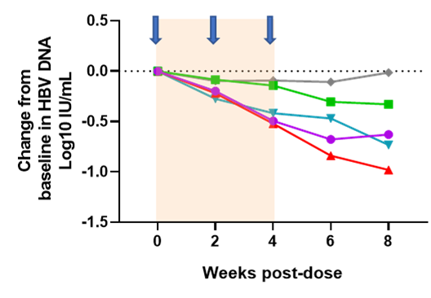
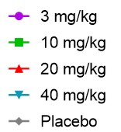
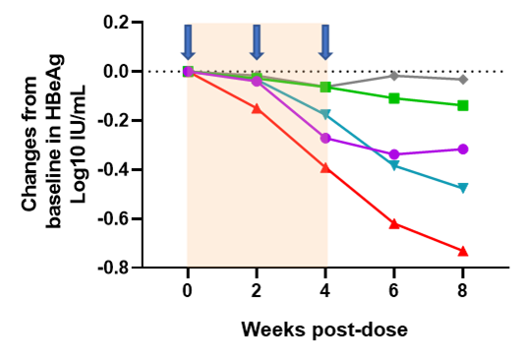
CHB – Libevitug Phase 1 Study Results
Libevitug demonstrated good safety, tolerability and PK in both healthy volunteers and CHB patients
HBeAg⁺ CHB patients at the immune-tolerant state (sub-group 1) and immune-active state (sub-group 2)
Virological Responses in Sub-Group 2 Patients
40 mg/kg
Change in HBV DNA
x 6A2P
3 doses
20 mg/kg
x 6A2P
10 mg/kg
x 6A2P
3 mg/kg
x 6A2P
Change in HBsAg
Key Findings on Libevitug in CHB Patients:
  Safe and well tolerated
  Strong antiviral activity in immune-active patients
  After just 3 doses (bi-weekly, at 20 mpk), >1 log drop in HBV DNA & >0.5 log drop in HBsAg
Why this is meaningful:
  Patients started with relatively high HBV DNA and HBsAg levels
  They received only 3 doses in total
  The HBsAg drop rate was faster than what we typically see with current treatments
  Importantly, Libevitug doesn’t directly target HBV DNA or HBsAg – So the virologic improvements likely reflect real changes in the underlying disease activity
3 doses
Change in HBeAg
3 doses
1. AASLD 2022, Washington, DC/Virtual. Abstract# 5063

Slide 17
Key Takeaways
HHHbio is a clinical-stage biopharma company focused on HBV/HDV, founded by a world-renowned HBV virologist
Our lead asset, Libevitug, an anti-PreS1 monoclonal antibody, is in Phase 2b and has received Breakthrough Therapy Designation from both the US FDA and China NMPA for the treatment of HDV infection
  Libevitug appears to show more favorable safety and efficacy than Bulevirtide, along with enhanced convenience —potentially leading to better patient compliance
  NDA submission in China was completed in Q4 2024; conditional approval is expected in Q4 2025
Libevitug has also shown excellent safety and clear antiviral activity in HBV patients, as monotherapy and in combination
  It is a strong candidate as a cornerstone agent in future combination therapies aimed at achieving a functional cure
HBV/HDV pipeline also includes:
  HH-006 (Phase 1): a next-gen Libevitug with enhanced Fc function and subcutaneous delivery
  HH-1270 (preclinical): a first-in-class NTCP inhibitor with strong ADME and safety profiles

Slide 18
Thank You!

