Slide 1



Elimination of Viral Hepatitis B and C: Global Initiatives, National Programs, and Scientific Advances
Upcoming Monograph Publication
Shokhista Bakieva
The Secretary General of The Association of Hepatologists of Uzbekistan
PhD, Senior Researcher at The Research Institute of Virology in Uzbekistan

Slide 2
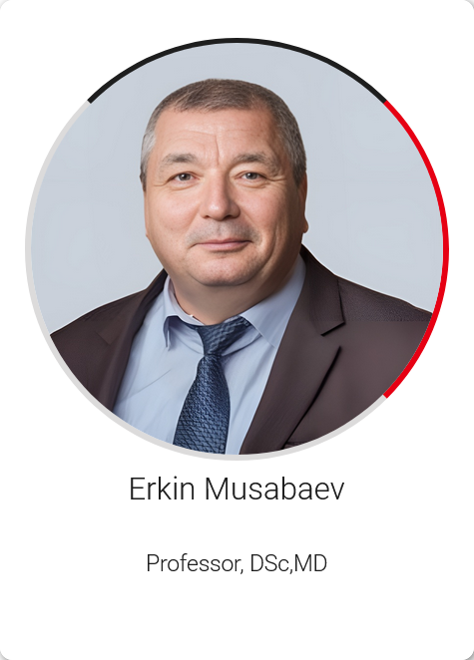
https://www.apasl-tashkent.uz

Slide 3


IntechOpen is a global leader in Open Access publishing, dedicated to making scientific knowledge freely available worldwide. By connecting academia and industry, it fosters research with real-world impact.
Committed to high editorial standards, IntechOpen is a member of COPE, STM, and other key organizations, with content indexed in Web of Science, Google Scholar, and DOAB.
It partners with major funders such as NASA, the European Commission, NIH, and the Gates Foundation. Its authors include top global experts and Nobel Laureates.
As a signatory of the UN SDG Publishers Compact, IntechOpen actively promotes research aligned with the Sustainable Development Goals, supporting global efforts in health, education, and sustainability.

Slide 4
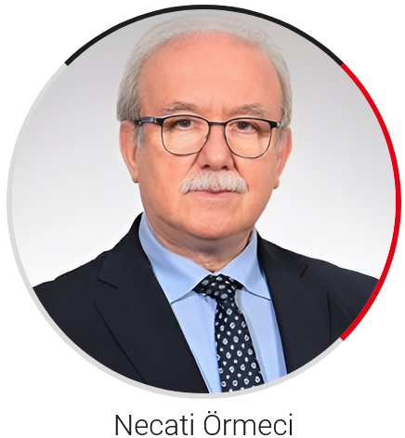

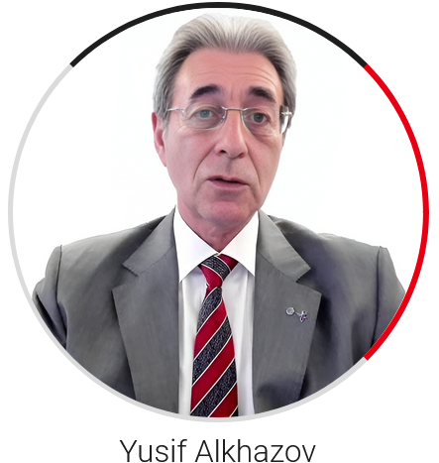

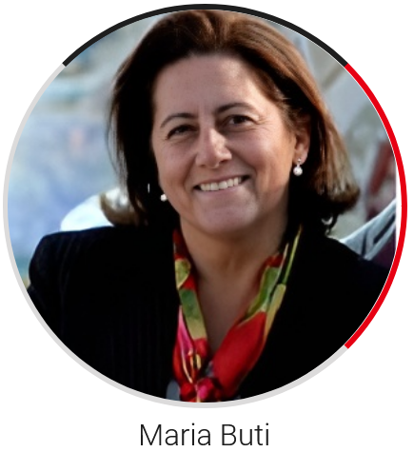

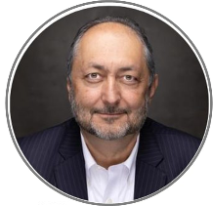


CO-AUTHORS
Homie Razavi
Huma Qureshi

Slide 5


Thank you

