Slide 1


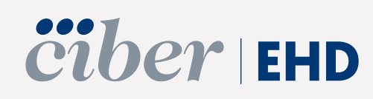
Elimination of HCV in People who inject drugs and Prisons in Spain
Prof. Rafael Esteban
Hospital General Universitario Valle Hebron, Barcelona. Spain

Slide 2
Disclosure of Conflicts of Interest
Speaker and advisory fees and grants from Gilead.
Speaker and advisory fees from AbbVie, and Gilead
Notes:
Mandatory Declaration of Conflicts of Interest (COI)
Please make sure to insert a declaration of conflicting interests as first slide of your presentation. This slide is mandatory for all speakers and for each presentation, even if there are no COI to declare.
UEG is committed to ensuring scientific rigour and objectivity in all of its educational activities. These include all aspects of the educational programme at UEG Week 2024, including those that are directly and jointly sponsored activities.
All presenters, whether invited faculty (speaker, chair and expert) or abstract (oral or poster) presenters at the UEG Week (hereinafter "Presenter(s)") are required to disclose to those organising and attending meetings any relevant financial or other relationship that may lead to a potential bias. UEG reserves the right to review the information disclosed for potential conflicts of interest. Please note that the sole responsibility for the content of each presentation lies with the Presenter.
UEG requires all Presenters to disclose any financial relationship with or any advisory or consultancy roles in the Biomedical Industry and the Biomedical Technology Industry during the past three years. These and any other potential conflicts of interest should be disclosed during introductory comments to the presentation. All Presenters are requested to disclose potential conflicts of interest on a PowerPoint slide to be shown immediately at the beginning of the presentation. Poster Presenters are required to disclose potential conflicts of interest at the bottom of their poster.
Conflicts of interest may exist through a financial relationship or when the individual has the opportunity to influence the content of a presentation, and can involve grants, honoraria, shares, paid positions on advisory boards, etc. Conflicts of interest are frequent and expected, and do not preclude an individual from making a presentation, provided the conflict is disclosed. If there is any doubt about the relevance of a potential conflict of interest, UEG requires all Presenters to act responsibly and to disclose such potential conflict of interest

Slide 3
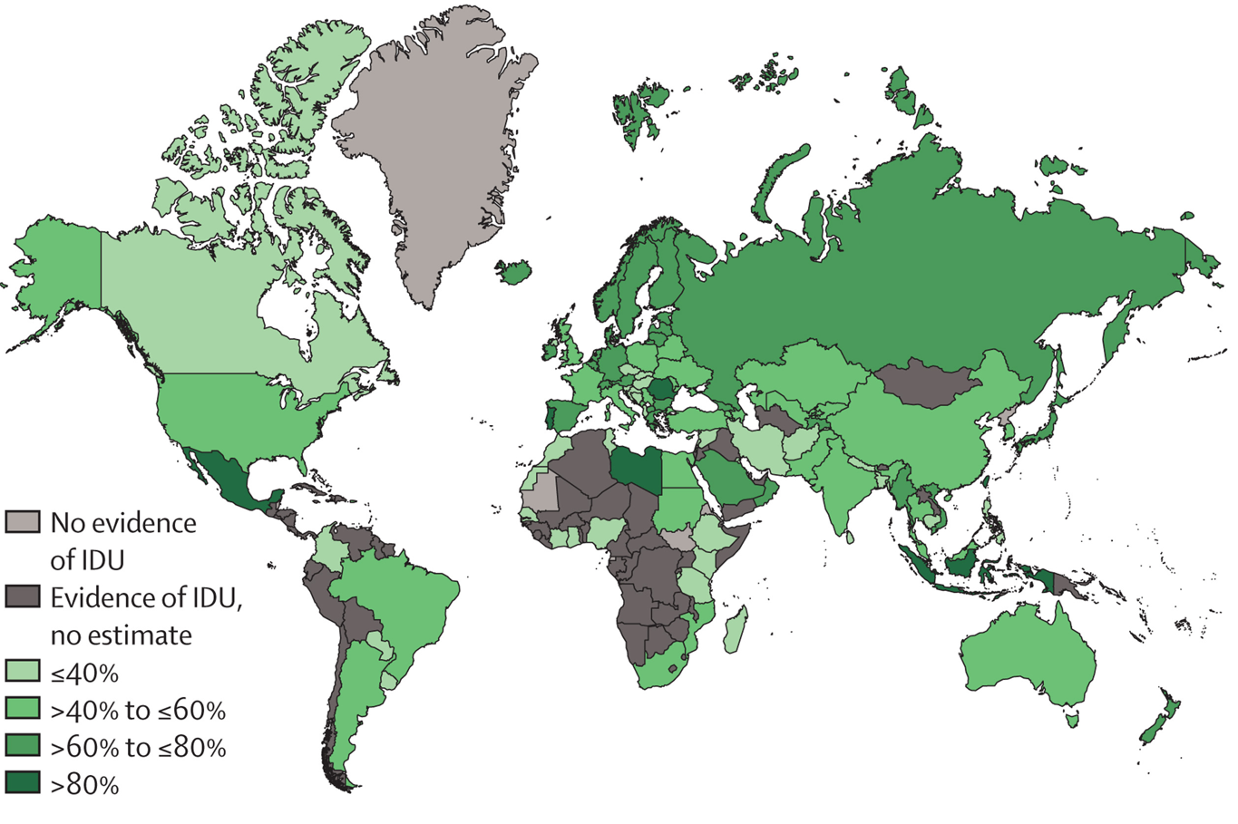
Hepatitis C infection among people with recent injecting drug use
57 million
living with HCV globally
5.8 (4.6-7.0) million people are recent PWID (39% prevalence)
China, United States, Russia, and Brazil make up >50% of all HCV infections among recent PWID globally
Polaris Observatory HCV Collaborators. Lancet Gastro Hep 2022, Degenhardt L, et al. Lancet Global Health 2023

Slide 4
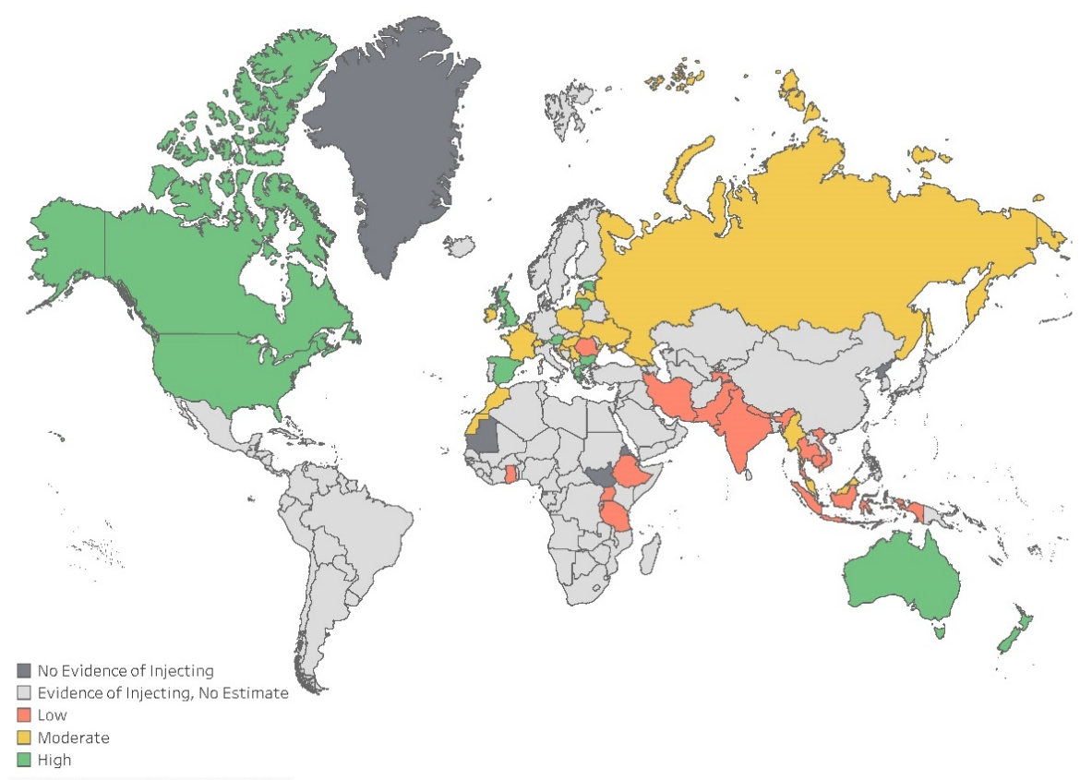
HCV testing and treatment among PWID remains low
47% (43-51%) of PWID had ever received HCV antibody testing (n=49 countries with available data, range <1%, 93%)
HCV treatment uptake ranged from 2% in India to 89% in Spain (n=23 countries with available data)
HCV treatment coverage was low (<25%) in 14 countries, moderate (25-75%) in 8 countries and high (>75%) in 1 country (Spain)
Hajarizadeh B, et al. Lancet Global Health 2023

Slide 5
HCV infection among people with recent injecting drug use
We now have the tools
Prevention Strategies
Simple Diagnosis
Effective Treatment
Needle/syringe programs
Opioid agonist therapy
Available blood tests
Point-of-care and dried blood spot testing
1-3 pills/day for 2-3 months
Cure rates over 95%
Few or no side effects
Combined these tools can be used to eliminate hepatitis C as a major public health threat
Feld JJ Canadian HCV Symposium, Montreal, Canada 2019. Slide Courtesy of Jordan Feld.

Slide 6
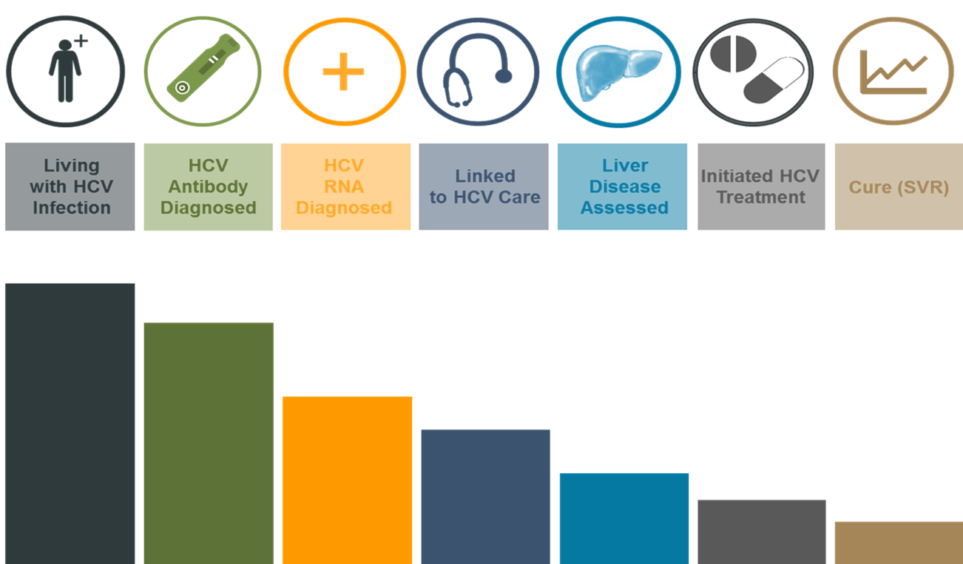
The problem
Avoid
Reinfection
Grebely J et al. Expanding access to prevention, care and treatment for hepatitis C virus infection among people who inject drugs. International Journal of Drug Policy 26 (2015) 893–898

Slide 7

The person infected with HCV
Venepuncture
Multiple visits to diagnosis
Stigma
Not a priority
Knowledge
of HCV
Low Resources
Homelessly
Lack of family and social support
Comorbidities
Prison
Information provided by the speaker based on his clinical experience
Notes:
What prevents people from accessing HCV services

Slide 8
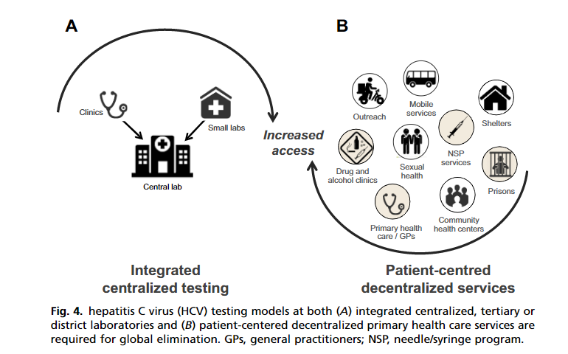
Patient-centered circuit
Applegate TL, et al. Hepatitis C Virus Diagnosis and the Holy Grail. Infect Dis Clin N Am 2018;32:425-445.

Slide 9

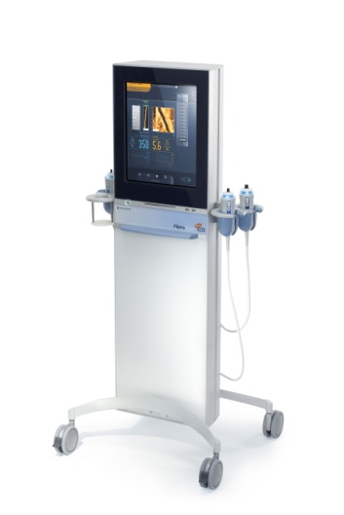


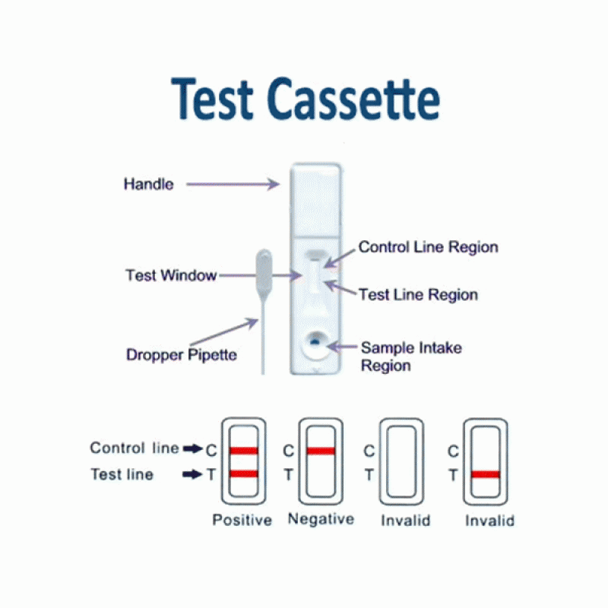



Diagnosis simplification
One-step diagnosis (if LAB)
Liver-stiffness (elastography)
Sample
IgG-HCV
Positive
HCV-RNA
Negative
Serum fibrosis tests
Alternative Tests
FIB-4
APRI
IgG anti-HCV
HCV-RNA
Unavailable? →Should not be a limitation
Information provided by the speaker based on his clinical experience

Slide 10
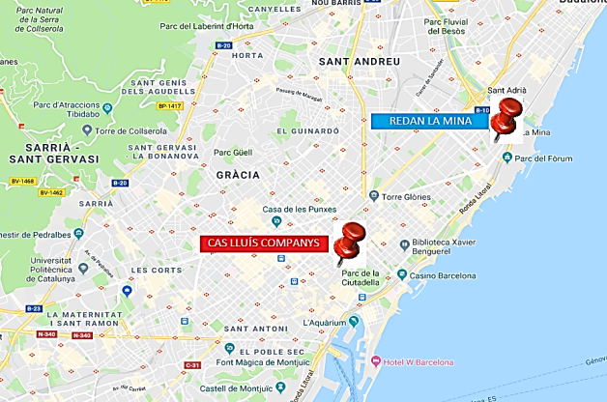
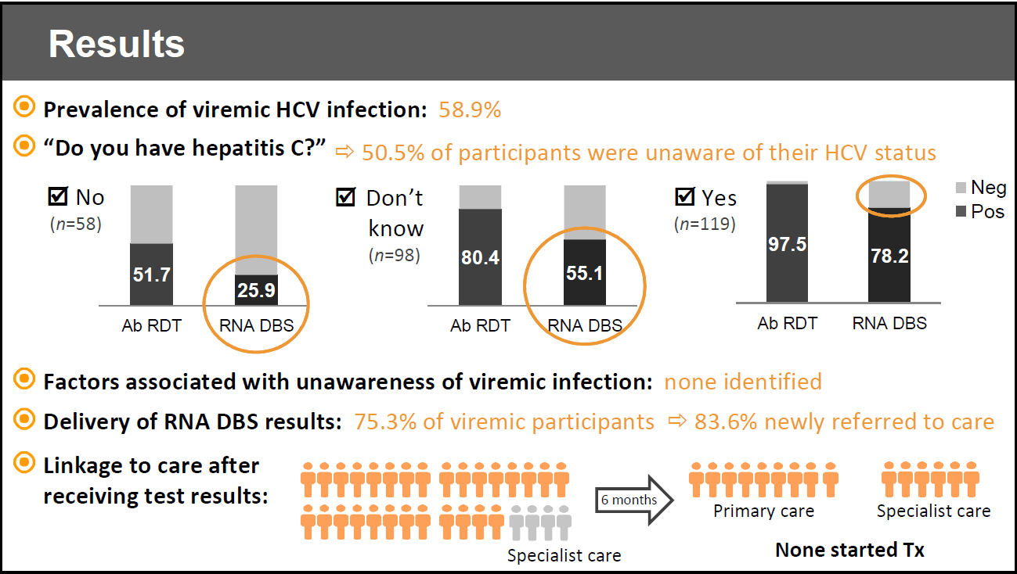
HCV microelimination program in PWID in Barcelona
HRC: Harm reduction Center
 | Users | Syringe Exchange n/user | Drug consumptions | Overdoses
HRC | 2273 | 90.8 | 87595 | 183
*Data from Hospital Clinic. Not published
Multidisciplinary team:
-Hepatologists/Nurses/Pharmacy (Hospital Clínic Barcelona)
-Microbiology (HGTiP)
-Public Health (Dept Salut)
Lens S, et al. AEEH 2020, EASL 2020, AASLD 2020. Martró et al. AASLD 2020. Martró et al. Diagnóstico y eliminación de las hepatitis virales.AASLD 2020.
Saludes et al, Utility of a one-step screening and diagnosis strategy for viremic HCV infection among people who inject drugs in Catalonia International Journal of Drug Policy 74 (2019) 236–245

Slide 11






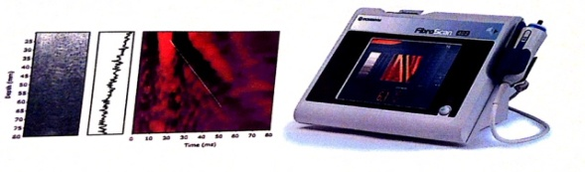

HCV microelimination program in PWID in Barcelona
Point-of-care diagnosis
Harm Reduction Center
Assessment SVR12
And re-infection
On-site treatment
Lens S, et al. HCV microelimination in harm reduction centres has benefits beyond HCV cure but is hampered by high reinfection rates. JHEP Rep. 2022 Sep 13;4(12):100580.

Slide 12
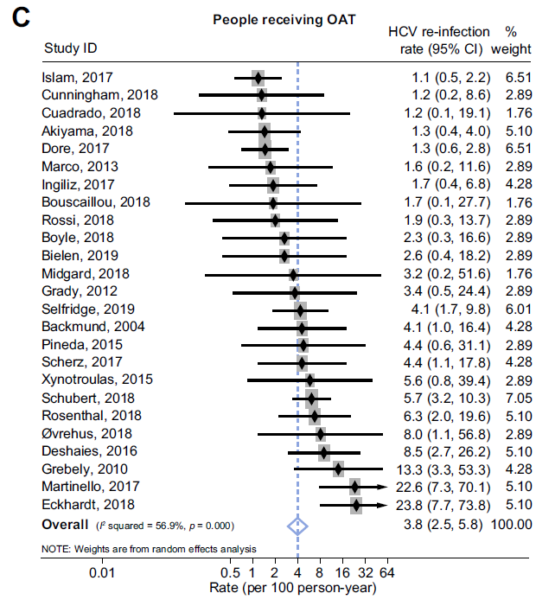
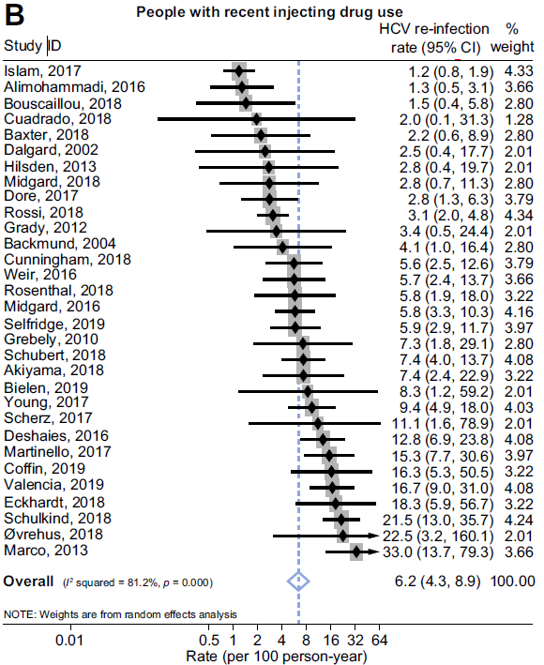
HCV reinfection among people on Opiod Agonist Therapy (OAT) and recent PWID
OAT (methadone/buprenorphine)
Recent injecting drug use
3.8 (2.5, 5.8)/100 p-yrs
6.2 (4.3, 8.9)/100 p-yrs
Hajarizadeh B, et al. Journal of Hepatology 2020

Slide 13
Take-home messages
Externalized HCV diagnosis and treatment is feasible even in the most ‘difficult-to-treat’ PWID population
Sub-optimal adherence does not impair achievement of SVR
HCV therapy has benefits beyond SVR
Reinfection and other intrinsic barriers (i.e screening refusal, lost to follow-up..) make HCV microelimination in this setting very challenging
HCV microelimination programs in this population should always include educative and harm-reduction interventions
Information provided by the speaker based on his clinical experience

Slide 14







Treating HCV: why do prisons matter?
Disproportionally high HCV prevalence among prisoner population versus general population
People who inject drugs – a key risk behaviour for HCV – are often involved in criminal behaviour and spend time in prisons
Risk behaviours in the prison context are more likely to be associated with HCV transmission
Prisons provide an opportunity to engage marginalised individuals into healthcare
Curing people of HCV in prison may positively impact HCV epidemiology in the prison and wider community
In many countries HCV care in prisons is limited, but the situation in some prisons is starting to change
Crespo J, et al Current Hepatology Reports. 2019;18(2):259-67. doi: 10.1007/s11901-019-00472-2.
Akiyama MJ, et al. Hepatitis C elimination among people incarcerated in prisons: challenges and recommendations for action within a health systems framework. Lancet Gastroenterol Hepatol. 2021; 6: 391-400.

Slide 15
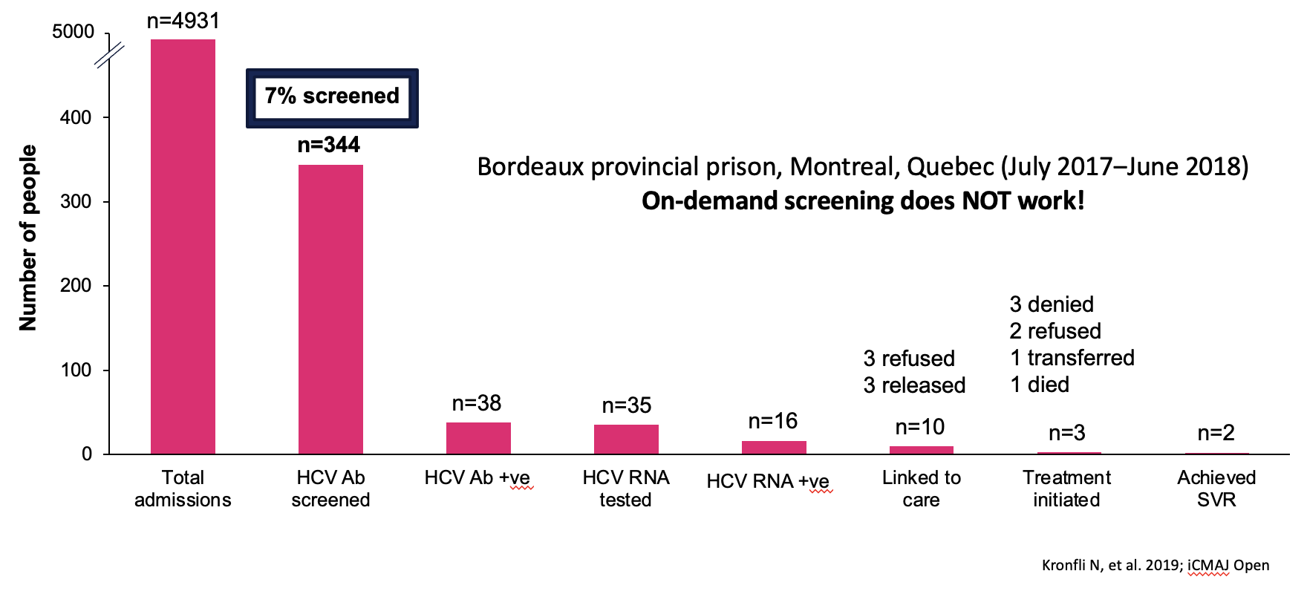
What barriers hinder the elimination of HCV in prisons?

Slide 16

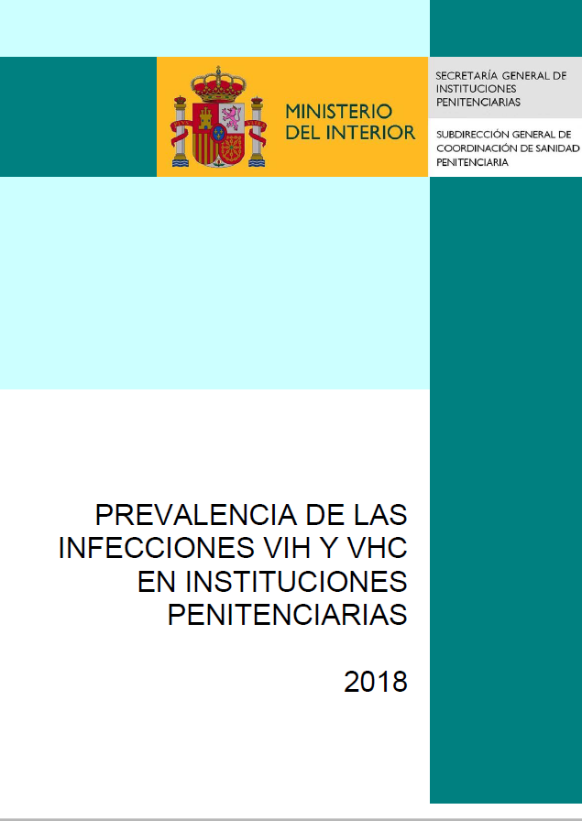

The impact of including penitentiaries in a national plan
The Spanish national plan included people in prison as a priority population
Penitentiary institutions were key collaborators in implementing the plan and evaluating key indicators of progress
The focus for people in prison was on prevention and diagnosis
Harm-reduction provision
Screening and diagnosis programmes
Strategic plan for addressing hepatitis C in the national health system. 2015. Available at:
http://www.mscbs.gob.es/ciudadanos/enfLesiones/enfTransmisibles/docs/plan_estrategico_hepatitis_C.pdf Prevalence of HIV and HCV infections in prisons. 2018. Available at: http://www.institucionpenitenciaria.es/web/export/sites/default/datos/descargables/saludpublica/Prevalencia_VIH_y_VHC_en_IIPP_2018.pdf
Notes:
The significant impact of including penitentiaries in a National Plan has been shown in Spain. In 2015 Spanish Strategic Plan to Tackle Hepatitis C in The National Health System was launched with the aim to make progress in eliminating HCV over a 3 year period from 2015-2017. The forward thinking plan included inmates as a priority population. The Plan was structured into 4 strategic lines, setting specific targets and priority actions to be carried out over the 2015-2017 in collaboration by Regional Health Services, management centres of the Ministry of Health, Social Services and Equality, Penitentiary Institutions and the Carlos III Health Institute.
The actions specific to prisons include:
Increase availability of access and the use of sterile material in intravenous drug users in Penitentiary institutions.
Consider prisoners as a priority population for HCV screening programmes
Establish collaborate programmes in prisons for prevention and diagnosis
To ensure appropriate implementation of the plan an Institutional Committee was formed which included representation from Penitentiary Institutions. The progress of plan was evaluated throughout its implementation period by a working group using key indicators, and included a memorandum of understating date with penitentiary Institutions to promote the prevention and diagnosis on HCV.
The plan in 2015 has considered the prison environment and has probably played a major role in the current prevalence of HCV RNA being around 3% as reported by the Penitentiary Institution Report of May 2019. The transparent publication of HCV data from prisons in Spain that is publicly accessible on line is also noteworthy

Slide 17





Simplifies strategies to HCV diagnosis
Reflex test:
Antibody HCV
+
HCV-RNA detection
Rapid tests / Point-of-care test
Oraquick
Gene Xpert
Dried Blood Spot
ELECTRONIC ALERTS
To test
To refer
Liver-disease assessment
Treatment prescription/delivery
One-stop shop
To improve
linkage-to-care
Buti M et al. Diagnóstico de la hepatitis C en un solo paso. Disponible en: http://aeeh.es/wp-content/uploads/2016/01/DX1P-AEEH-AEHVE-SEIMC-SEPD-definitivo.pdf.
Documento de consenso sobre el manejo de la infección por VHC en usuarios de drogas de GEHEP/SEIMC, Socidrogalcohol, SEPD y Somapa.
Disponible en: http://www.patologiadual.es/docs/documento-de-consensso-VHC.pdf. Con acceso: diciembre 2018.

Slide 18
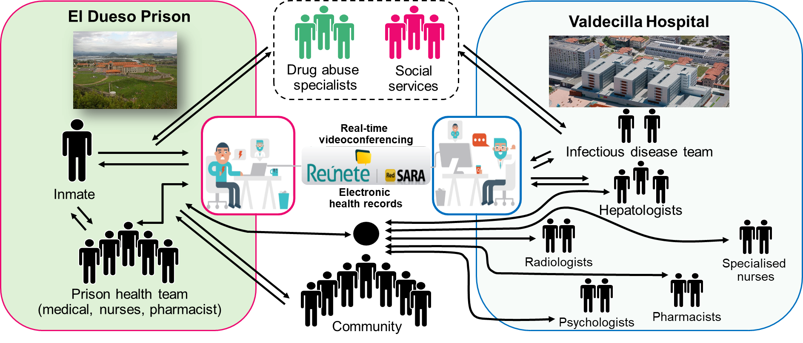
JAILFREE-C Program
Cuadrado A, et al. Am J Gastroenterol 2018;113:1639–48
Notes:
Last year Dr Javier Crespo told us about the JAILFREE-C project in the Cantabria region in Spain, led by him and his team in the Gastroenterology department Valdecilla hospital in collaboration with medical staff at El Dueso prison. This multidisciplinary collaboration included multiple specials from the Valdecilla hospital such as radiologists, specialised nurses, psychologists, pharmacists as well as medical and nursing staff from the prison, people from the community, social services and addiction specialists.
Background information
In Spain, treatment of HCV in prisons can be problematic. Primary healthcare teams in prisons are funded by the Ministry of Internal Affairs. Secondary care services, such as hepatology, are provided by National Healthcare System. This mixed system often results in communication breakdown. In general prison healthcare teams have little to no interaction with external health centres. As a rule any form of medical research or sharing of practices between prisons is near impossible as sharing of data externally is often not permitted. This hinders advances in healthcare delivery within these settings and can lead to a lack of consistency between the prison healthcare system (led by the Ministry of Justice) and traditional, external healthcare system (led by the Ministry of Health) or even between the prisons themselves.
Against this background it can be seen that The JAILFREE-C project is a truly remarkable initiative. Prison health care and secondary healthcare teams have collaborated and worked together to eliminate HCV from the prison. JAILFREE-C was initiated as a open-label clinical trial. Clinical trials are extremely unusual in a prison environments in many countries not only in Spain. JAILFREE-C has now become embedded in routine clinical practice at Valdecilla Hospital and the model of care has been transported to other hospitals and prisons in the Cantabria region. It has initiated a broadscale change how secondary healthcare is delivered in the prisons in the Cantabria region.
Importantly, data from JAILFREE-C was published in American Journal of Gastroenterology – a high impact journal. This brought widespread attention to their work and adds to the evidence base showing that HCV can be treated and eliminated in prisons. Published evidence such as this is needed in order to lobby for change from a broad range of stakeholders including politicians, medical and prison services.

Slide 19
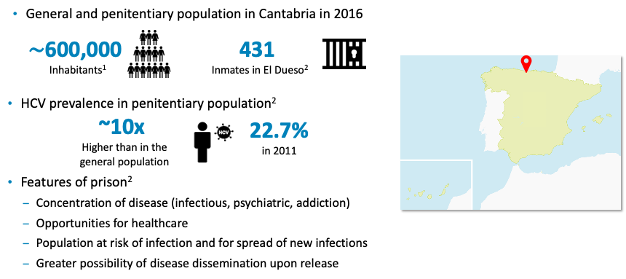
JAILFREE-C Program
City population of Cantabria, province in Spain. Available at: https://www.citypopulation.de/en/spain/admin/cantabria/39__cantabria/ (accessed Jan 2021); Cuadrado A, et al. Am J Gastroenterol 2018; 113:1639–1648; / Map of Spain. Available at: https://freevectormaps.com/spain/ES-EPS-02-0001?ref=atr

Slide 20
Impact of HCV management in Prison. The spanish example
Analysis of the systematic registry of the informatic database of Health Penitentiary Coordination Department of Spain.
Registries from January 2015 to June 2019.
There were included 71 prisons [not include prisons in Catalonia]
Penitentiary Institutions:
69 Penitentiary centers (regular prison)
2 Psychiatric penitentiary centers
http://www.institucionpenitenciaria.es/web/portal/centrosPenitenciarios
Cabezas J, et al. EASL-DILC 2020; J Hepatology. 2020;73:S33;

Slide 21
Impact of HCV management in Prison. The spanish example
Incidence in 2010 was: 0.47 per 1000 inmates/year
Rotation rate: ([Admission- Release]/Total inmates) x100.
- Mean 58%; SD 47; Rage 2-195%
http://www.institucionpenitenciaria.es/web/portal/centrosPenitenciarios
Cabezas J, et al. EASL-DILC 2020; J Hepatology. 2020;73:S33;

Slide 22

HCV elimination program in Catalan prisons
Since 2016
Number of DAA treatments and HCV infection in inmates in Catalonia (2016-2023)
Infection detection: Systematic screening on admission
Treatment in the center
Linkage to community specialist on leaving the centre (liaison nurse) ³
Reduction in loss of post-release follow-ups
Improvement of links with specialists
Data on viremia in inmates in Catalonia. Prison Health Program (ICS) 2024
Notes:
En les presons catalanes el nombre de persones que s’injecten drogues (PQID) s’ha reduït considerablement en els últims vint anys. A finals de 2021, el percentatge de persones amb presència d’anticossos contra el VHC en el total de persones internes a presons va ser del 3,0%, i d’un 0,8% de persones amb virèmia..

Slide 23
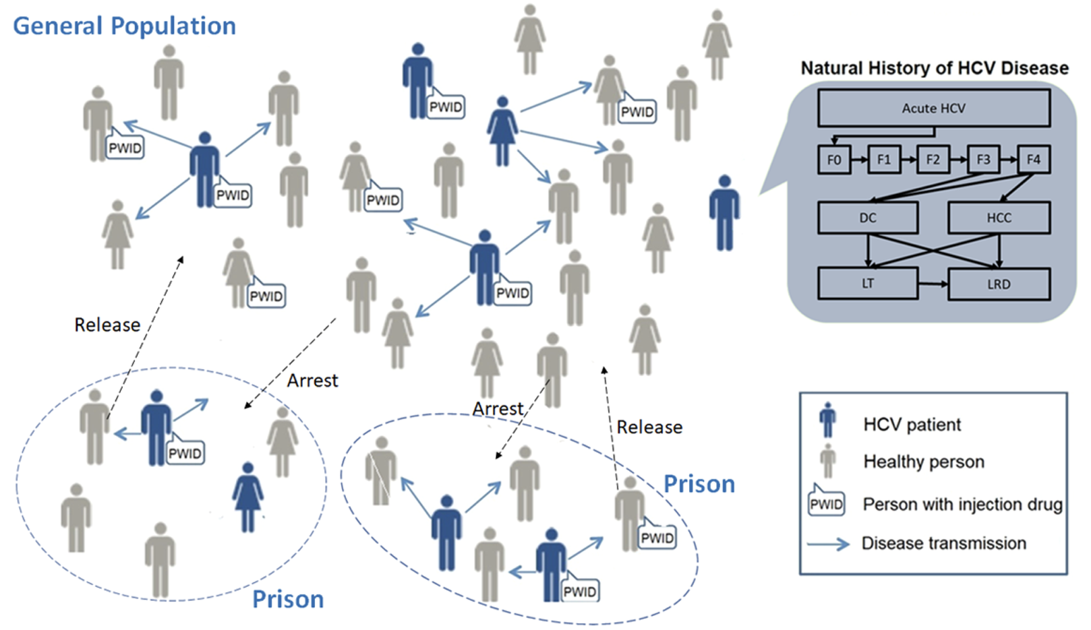
Treating HCV-infected prisoners is highly cost-effective and reducing the burden of HCV in the whole society
23
Our modeling-based study showed that scaling-up HCV treatment in all prisons in Spain is highly cost-effective.
Unrestricted treatment to all HCV-infected persons in prisons resulting in reduction of HCV prevalence in prisons by more than 80% and averting 8,300 HCV deaths and 10,200 HCV transmission by 2050.
Dalgic OO, et al. Scientific reports. 2019;9(1):16849

Slide 24
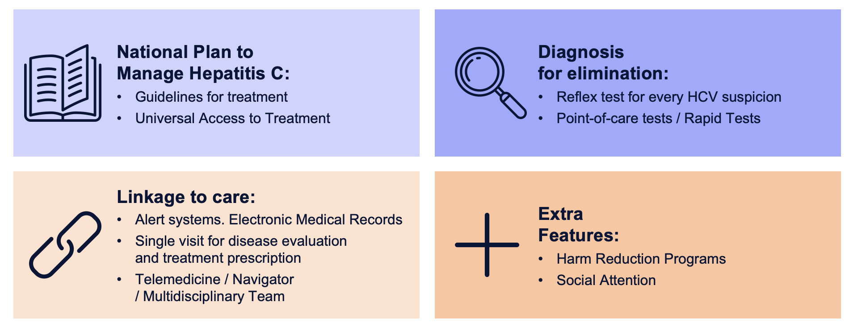
Summary of HCV elimination in vulnerable populations

Slide 25


Sitges, Barcelona
October 3rd and 4th, 2025
Directors: Rafel Esteban
Maria Buti

