Slide 1

HEPATITIS C ELIMINATION PROGRAM PAKISTAN
Huma Qureshi (TI)
Gastroenterologist
National Focal point hepatitis

Slide 2
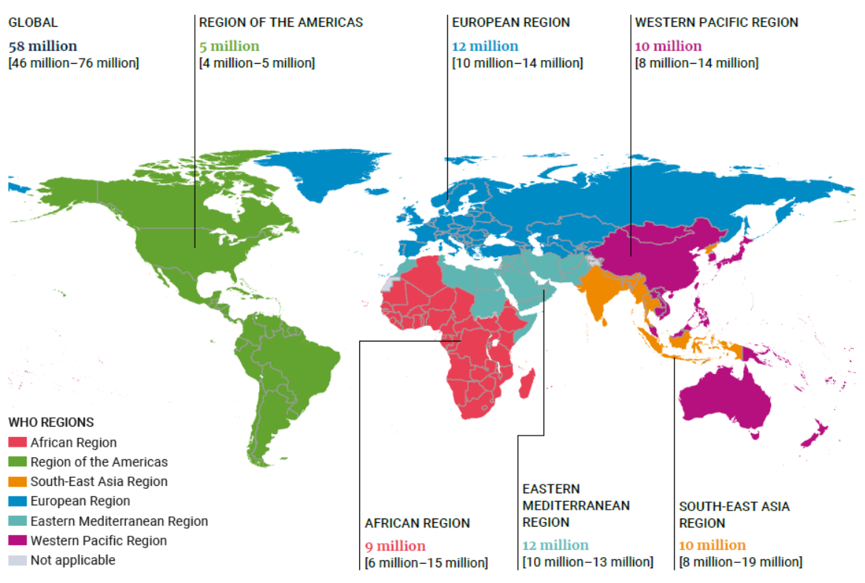
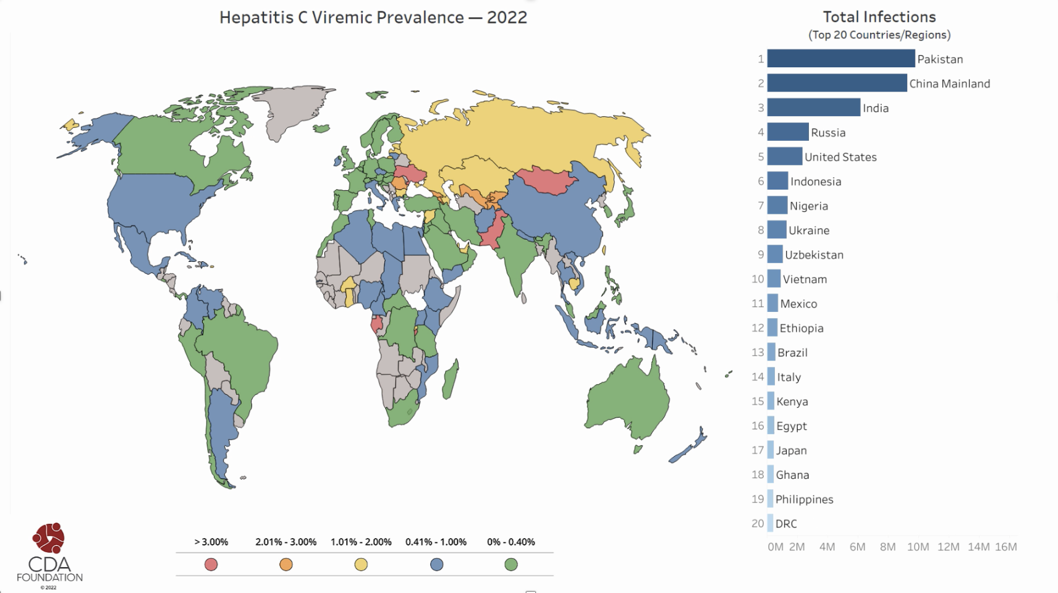
Pakistan is now home to the Word’s largest population of people living with Hepatitis C infection
Global burden of Hepatitis C viraemic infection, 2019*
10 Million Pakistanis** are living with viremic infection and actively in need of Diagnosis and Cure
* WHO 2019 estimate
** Global Epidemiology of Viral Hepatitis by CDA foundation 2020
© 2022. Confidential and Proprietary

Slide 3
As a result of high prevalence of Hepatitis C, Pakistan now also faces a liver cancer epidemic
Prevalence was around 5% as per 2008 survey* ; medical experts estimate current prevalence to be near 7.5%
Global Hepatitis C Prevalence %**
Consequently….
Every 20 minutes, a Pakistani dies of HCV related complications (liver cirrhosis and cancer)
  Around 500 patients with hepatitis related kidney and liver failures have received life saving transplants from PKLI
HCV carries the same cancer risk as smoking 20 cigarettes a day
  ~20,000 new HCV related Liver Cancer cases per year
Among provinces, Punjab has highest prevalence with an increasing trend
Punjab |  | Sindh |  | KP | Balochistan
6.7% (2008) | 8.9% (HPS 2018) | 5.0% (2008) | 6.1% (2019) | 1.1% (2008) | 1.5% (2008)
*Pakistan Medical Research Council Survey 2008
** Global Epidemiology of Viral Hepatitis by Center for Disease Analysis foundation
2020
© 2022. Confidential and Proprietary

Slide 4

HCV Prevalence:2022
Province | Anti-HCV Prevalence | Viremic Prevalence | Anti-HCV Prevalence Source | Viremic Infections in 2020
Punjab | 8.9% | 4.8% | APEX 2019 | 5,739,000
Sindh | 6.2% | 3.8% | Qureshi 2020, unpublished | 1,994,000
Balochistan | 5.2% | 3.1% | Sabeen 2021, unpublished | 419,000
Khyber Pakhtunkhwa | 6.5% | 3.8% | MOH 2020 | 1,256,000
GB, ICT, AJK | - | 4.3% | Extrapolated from provinces | 367,000
Pakistan |  | 4.3% |  | 9,775,000

Slide 5

If we don’t take actions now, HCV Infections are projected to reach
11 Million by 2035, resulting in:
30,000+ years of disability annually,
350,000+ years of life lost annually,
Death and disability related GDP loss of ~$3 Billion
Cost of Inaction:
Total Individuals infected with HCV: 2022 – 2035
In Millions
20% increase
350,000+ years of life lost annually:
30,000+ years of disability annually:
© 2022. Confidential and Proprietary

Slide 6




By adopting an aggressive test and treat approach, the Government can prevent over 130,000 Deaths and 100,000 new cases of liver cancer
By 2030, if we diagnose 90% of all infections and treat 80% of diagnosed cases, we can achieve:
This is not unprecedented, under your leadership Punjab made significant improvement in hepatitis elimination in 2016-18:
Reduced number of cases
Punjab’s strategy to eliminate hepatitis:
Total Infections
-7,135,000
New Infections
-1,542,000
Educate
Prevent
Aggressive Communication and Awareness (ACSM)
Hepatitis Bill
Registration of Barbers & beauticians
non-reusable AD Syringes
Infectious waste Mgmt
Reduced hospitalization due to complications
Cirrhosis
-482,000
Liver Cancer
-92,000
Test
Treat
Mass Screening camps
Screening of high risk groups
Enhance PCR testing capacity
PKLI and PKLI clinics
150+ hept clinics at DHQ/THQ
Quality Medication regime, SVR12
Door step medicines,
Certificate of cure
Less deaths
Deaths
-136,000
© 2022. Confidential and Proprietary

Slide 7
Confidential - FOR DISCUSSION ONLY
PRIME MINISTER’S
HEPATITIS C ELIMINATION PROGRAM
Location: All over Pakistan. Duration= 3 years (2024-27)
Sponsoring Ministry: Ministry of National Health Services Regulation and Coordination

Slide 8



Programme Overview
Objective: Comprehensive screening, testing, and treatment for Hepatitis C in Pakistan
7.5%
Prevalence of Hepatitis - C in Pakistan
PKR 68.25 billion
Project Cost will be shared among Federal and Provincial Governments (51:49)
3 years
Duration:
July 2024-June 2027

Slide 9
PM Program Targets for 3 years
Total pop= 253 million
Eligible pop (>12 years) = 165 million
50% (82.547 million)
addressed in 1st phase
Federal Govt will support
All screening=82.547 million
30% PCR= 1.7 million
50% treatment= 3.8 million

Slide 10
50% population in 4 Provinces and 2 regions & ICT
Punjab= 42.5 million
Sindh=18.5 million
KP=13.5 million
Balochistan=4.9 million
GB=0.5 million
AJK=1.4 million
Islamabad=0.7 million
Total= 82.5 million

Slide 11
Pilot projects of HCV elimination in GB and Sindh
Gilgit Baltistan
Sindh-Khairpur
GB had never treated HCV cases
Population of GB 1.7 million, 1 million are >12 years
2 UCs were selected – population of 14,300 people
All people were screened using WHO PQ RDT
All data entered electronically in EMR
Venous blood of positive cases sent to main lab for PCR
Prevalence was 1% all PCR positive were treated
Sindh had never used EMR or reflex blood test
45,000 population selected in 2 UCs
Daily temperatures are 48 degrees
WHO PQ RDT used.
48% (20912) screened, 2423 anti HCV+
Anti HCV prevalence was 11%
PCR positivity is 50%
Study is ongoing

Slide 12
Next steps
After the learning curve, we have planned to eliminate the disease from the whole region of GB in next 3-4 months
50% support from Federal government and 50% from Aga Khan foundation/network

Slide 13
Governance Model
National Task Force (NTF)
Leadership and oversight by the Prime Minister, Federal ministers, Chief ministers, and Secretaries (in place)
Technical Advisory Group (TAG)
Academic group assisting the ministry in project execution
Establishment of PMU by Ministry of National Health Services Regulations and Coordination (MoNHSR&C)
to lead Project Execution and Provincial Coordination under Ministry, TAG, and NTF
IT Cell
Media cell
Procurement Cell
@ M/o NHSR&C
Training Cell
Data Analysis, Monitoring and Evaluation
PROVINCES WILL BE THE IMPLEMENTING PARTNERS

Slide 14
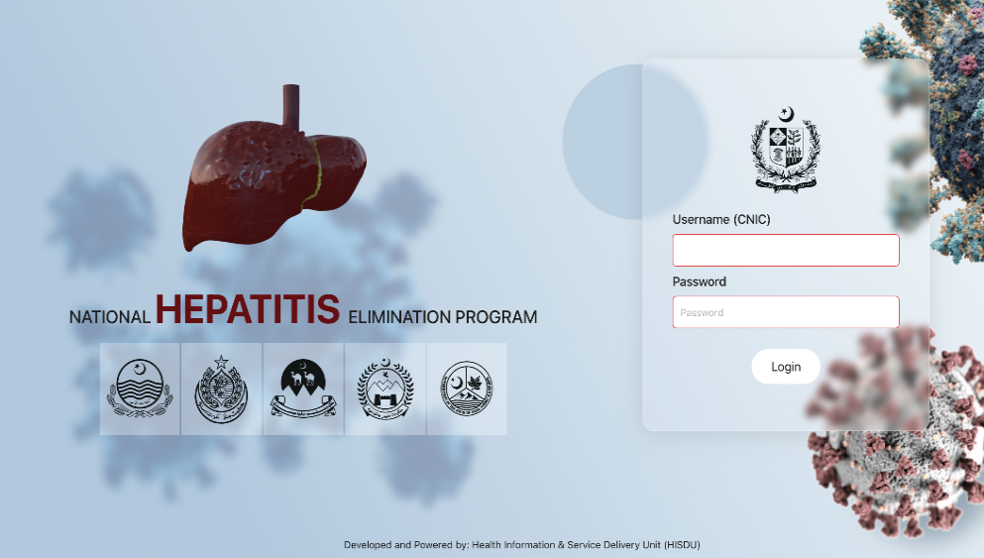
National EMR – Provincial/National Data Integration
Software to Capture Screening and Treatment
Platform: Smartphone/tablet-based with live geo-referencing; adaptable for offline access
PM Portal: Enables patients to register from home and schedule appointments at nearest screening facilities.
Call Centers: Will communicate lab results, medication pickup points, follow-up reminders, and issue "NO HEPATITIS C" certificates as incentives for screening or post-treatment cure.

Slide 15
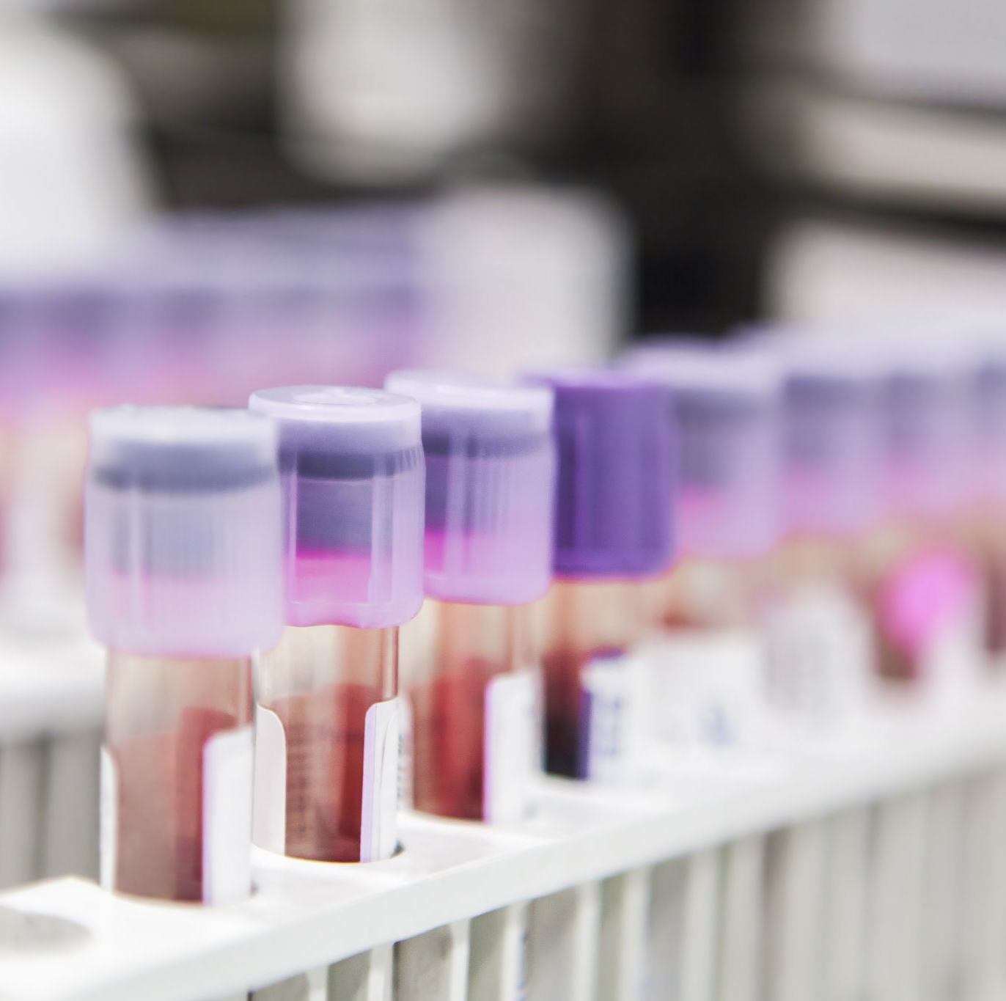
Only WHO prequalified tests shall be used
Rapid tests
SD bioline (Abbott)
Biosenser (Korea)
Intec (China)
PCR
Abbott
Roche
GeneXpert

Slide 16

HCV medicines-Made in Pakistan
Generic SOF and DCV: produced by 9 companies

Slide 17
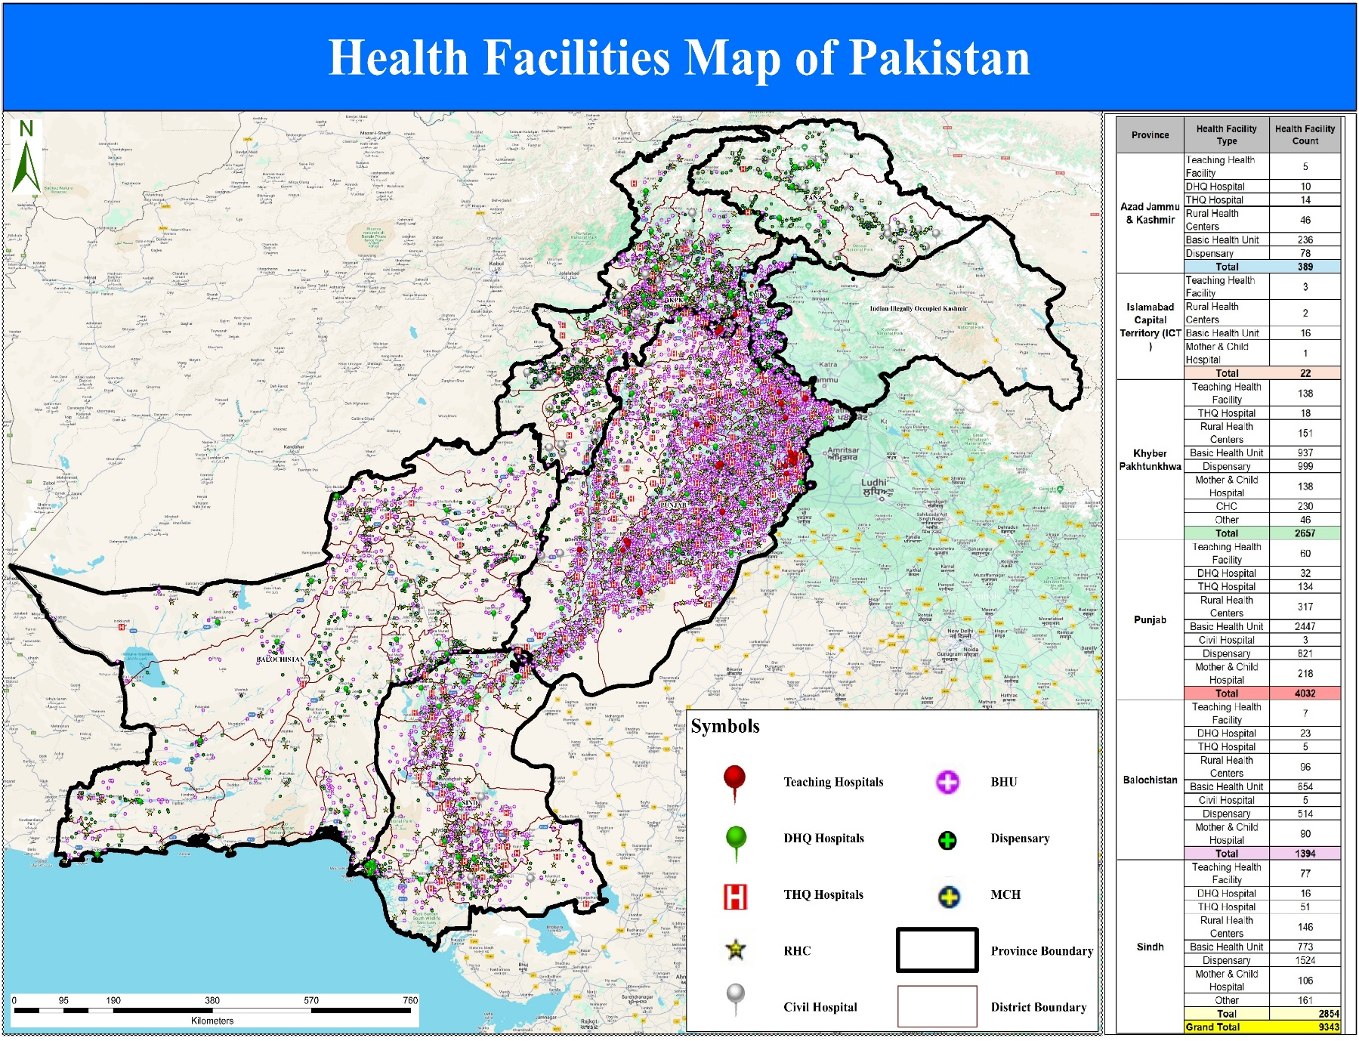
Health Facilities Map of Pakistan
Notes:
Add shahid bhai pic

Slide 18
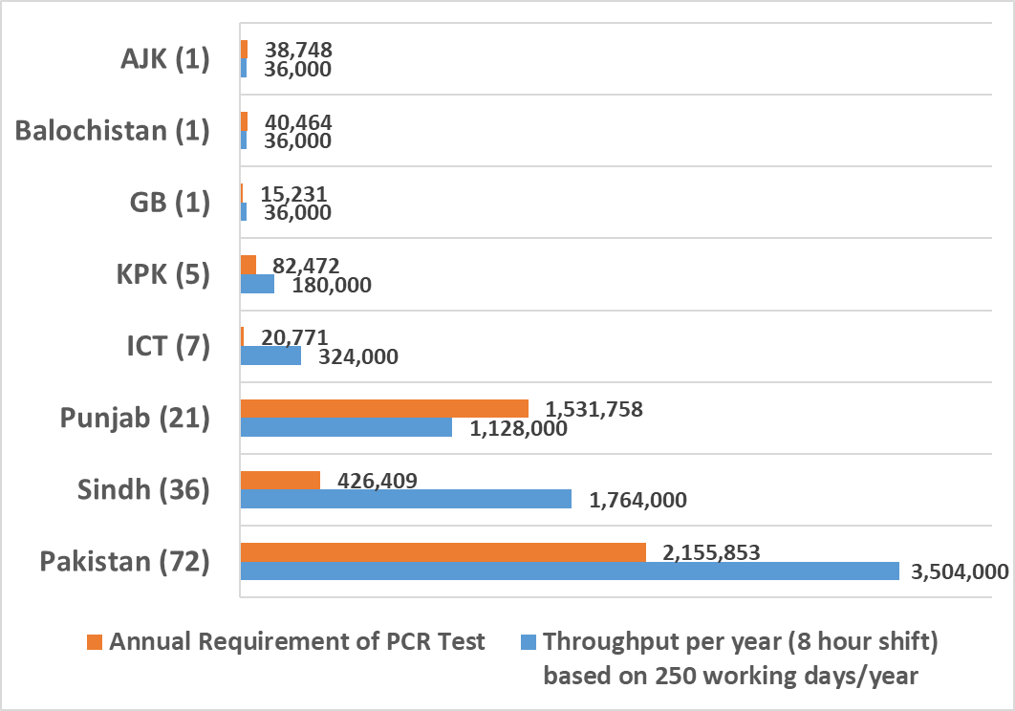
PCR Capacity in Pakistan

Slide 19
Current position of the Project
1st tranche released
Prequalification of the vendors done
Procurement will start in next few weeks
The workforce for the main federal office (PMU) has been advertised
We should be in the fields by 3rd quarter of 2025

Slide 20
Challenges addressed: 1.Paper based data
Only one province was using EMR, rest were using paper -based data
All provinces now shifted to electronic data entry
All public and private sites that agree and fulfill the requirements have been engaged & given a code
Censes and NADRA is engaged to prevent duplication
Personal identifiers like mobile phone and CNIC number are used for all persons who undergo screening, testing or treatment

Slide 21
Challenges addressed: 2. Silent killer
Large population is unaware of disease
No specific signs and symptoms
Mass campaigns to increase awareness and bring people out for screening
Using WHO prequalified POC rapid test
Active and passive HCV screening is undertaken on all who visit health facility for any reason
Engage private sector in active and passive screening of all adults >12 years

Slide 22
Challenges addressed: 3. Issues of LIMC
1st level care BHUs & RHCs were not very functional
Issues of HR, power supply, internet, equipment
Patients travel long distances to reach secondary and tertiary care health facilities
Timings of health facilities
Strengthened BHUs & RHCs to undertake RDT and enter data in computer (on line/off line).
Take reflex blood testing to ensure no one is missed
Blood samples are sent to main lab in cool boxes
Engage private sector at all levels of creating awareness, screening, testing and treatment

Slide 23
Challenges addressed: 4. PCR test and its reporting
PCR reporting is delayed for many days-weeks
PCR reporting is done daily.
We have adequate machines
Electronic reporting to ease quick linkage to care
Mobile companies engaged to send reports to the patients

Slide 24
Challenges addressed:5. Treatment
Who and where should the treatment be dispensed
Decentralisation and task shifting-WHO’s recommendations
National HCV testing and treatment guidelines- nurse or HCW can provide treatment
The primary care physician should (public/pvt) dispense the treatment and follow the patient

Slide 25
Conclusions
Pakistan has the highest HCV infected population
About 10 million cases are about to get diagnosed and treated through the PM program
Apart from public sector, Private sector and NGOs are also engaged
Challenges are many but can be addressed with joint efforts of all stakeholders
Together we can eliminate hepatitis C from Pakistan

Slide 26
Thank you

Slide 27
Districts with high HCV Prevalence
S.N. | Name of the districts- Punjab (42,548,822)
1 | Vehari
2 | Hafizabad
3 | Pakpattan
4 | Okara
5 | Lahore
6 | Chiniot
7 | Jhang
8 | Nankana Sahib
9 | Sheikhupura
10 | Jhelum
11 | Mandi Bahuddin
12 | Faisalabad
13 | Multan
14 | Khushab
15 | Bhakkar
16 | T.T Singh
17 | Sahiwal
18 | Sialkot
S.N. | Name of the districts- Sindh (18,566,450)
1 | Sanghar
2 | Ghotki
3 | Mirpurkhas
4 | Tando Allahyar
5 | Shikarpur
6 | Jacobabad
7 | Khairpur
8 | Dadu
9 | Sukkur
10 | Thatta
11 | Karachi Malir
12 | Jamshoro
13 | Hyderabad
14 | Karachi West
15 | Shaheed Benazirabad
16 | Larkana

Slide 28
High Prevalence HCV Districts
S.N. | Name of the districts- KP (13,594,254)
1 | Abbottabad
2 | Bannu
3 | Dera Ismail Khan
4 | Hangu
5 | Khyber
6 | Kurram
7 | Lower Dir
8 | Mardan
9 | Mansehra
10 | Peshawar
11 | Swat
S# | Name of the District- Balochistan (4,995,583)
1 | Sohbatpur
2 | Nasirabad
3 | Kachi
4 | Jhal magsi
5 | Jafferabad
6 | Sibbi
7 | Zhob
8 | Kohlu
9 | Harnai
10 | Derabugti
11 | Loarlai
12 | MusaKhel
13 | Duki
14 | Kalat
15 | Kuzdar
16 | Surab
17 | Mastung
18 | Lasbella/hub

Slide 29
Districts with high HCV Prevalence
S# | Name of the Districts AJK (1,473,309)
1 | Muzaffarabad
2 | Neelum
3 | Jahlum valley
4 | Bagh
5 | Haveli
6 | Poonch
7 | Sudhnuti
8 | Kotli
9 | Mirpur
10 | Bhimber
S.N. | Name of the districts GB (579,118)
1 | Gilgit
2 | Skardu
3 | Diamer
4 | Ghizar
5 | Ghanche
6 | Astore
7 | Shigar
8 | Nagar
9 | Hunza
10 | Kharmang
S# | Name of the District
1 | ICT (789,767)

