Slide 1
HCV Elimination in Türkiye
Prof Dr Necati Örmeci
İstanbul Health and Technology University
Vice Rector. The Head of Department of Internal Medicine

Slide 2
Challenges for eliminating of HCV infection
Globally, more than 1095 people die from HCV every day and 400 000 people die every year from HCV-related liver diseases even though HCV is curable with the availability of direct-acting antivirals (DAAs)
It has been estimated that, out of the 4.2 million adults affected by HCV infection in the 31 EU/ European Economic Area (EEA) countries, as many as 580 000 are migrants.
It has been estimated that 425 000 people affected with HCV infection in Türkiye.
The majority of people infected with chronic hepatitis C virus (HCV) in the European Union and Türkiye remain undiagnosed and untreated, while migration has become a challenge.
Hepatitis C virus elimination is feasible, and will result in cost savings.
Although HCV elimination represents a serious challenge for countries’ health budgets, we have to have an action to combat the HCV infection.
Hatzakis A et al, Liver International. 2020;40:260–270.© 2019

Slide 3
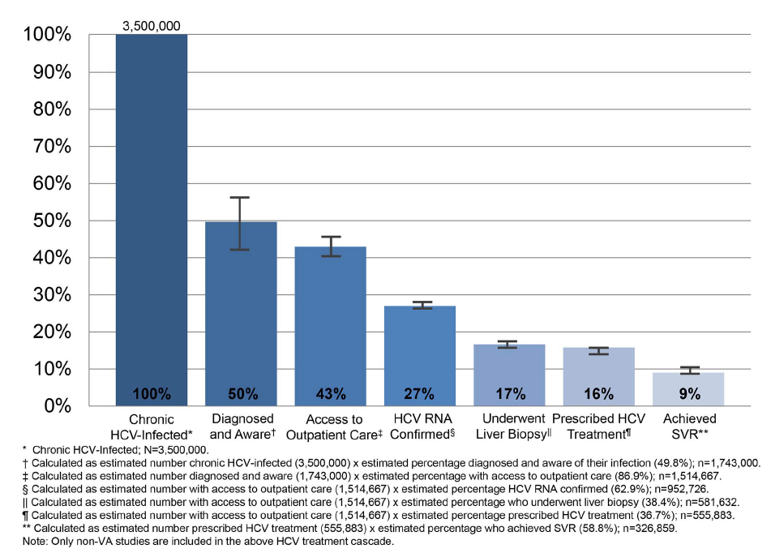
Treatment Cascade for People with Chronic Hepatitis C Virus (HCV) Infection, Prevalence Estimates with 95% Confidence Intervals.
Yehia BR. Et alPLoS ONE 9(7): e101554. doi:10.1371/journal.pone.0101554

Slide 4
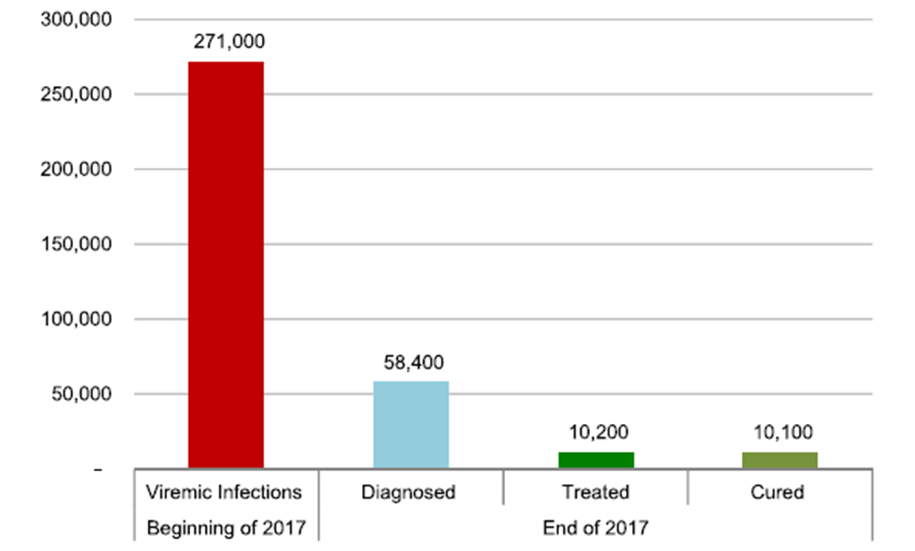
Estimated numbers of HV infection in Türkiye.
3.69%

Slide 5
Towards eliminating viral hepatitis
In May 2016, the World Health Assembly endorsed the Global Health Sector Strategy (GHSS) on viral hepatitis 2016–2021. The GHSS calls for the elimination of viral hepatitis as a public health threat by 2030 (reducing new infections by 90% and mortality by 65%).
The report focuses on hepatitis B and C, which are responsible for 96% of all hepatitis mortality.
World Health Organization Global Hepatitis Report, 2017.

Slide 6
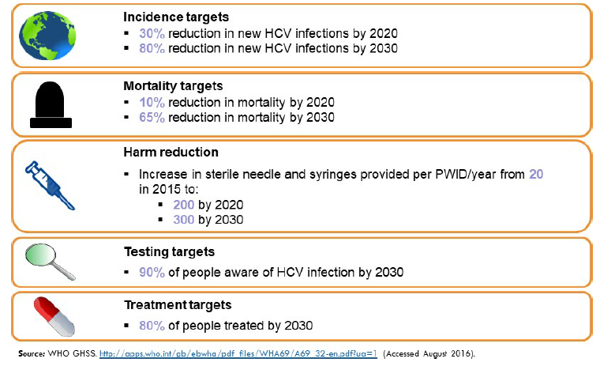
The World Health Organization targets
for HCV elimination at two time points (2020 and 2030)
Hatzakis A et al, Liver International. 2020;40:260–270.© 2019

Slide 7
Definition of Macro- and Micro-Elimination:
Macro-Elimination encompasses the entire country or region and reflects national-scale achievements.
Micro-Elimination focuses on specific groups (e.g., people who inject drugs, incarcerated individuals, or certain geographic areas) as a step toward broader elimination goals.

Slide 8
Challenges in Achieving Macro-Elimination:
*Insufficient funding for health programs.
*Limited access to diagnostic and treatment resources.
*Stigma and lack of awareness about HCV.
*Barriers in reaching high-risk and underserved populations.

Slide 9
Micro-elimination for HCV some advantages comparing total eradication strategies(1).
1. Targeting High-Risk Groups: Identifying populations at higher risk of hepatitis C infection, such as people who inject drugs, prisoners, or individuals with a history of blood transfusions, immunosupressed patients.
2. Screening and Diagnosis: Early detection and diagnosing individuals within targeted groups to improve treatment outcomes and reduce transmission.
3. Access to Treatment: Ensuring accessibility to direct-acting antivirals (DAAs), which offer highly effective treatment for hepatitis C.
4. Collaboration: Engaging with stakeholders, including healthcare providers, policymakers, and community leaders, to create a coordinated effort in eliminating hepatitis C.

Slide 10
Micro-elimination for HCV some advantages comparing total eradication strategies(2)
5- Sustainability and Monitoring: Implementing strategies that are sustainable over time, with regular monitoring to assess progress and adapt the approach as needed.
6-Public Health Initiatives: Raising awareness, reducing stigma, and integrating HCV elimination into broader health strategies are fundamental to success.
7-Tailored National Plans: Each country must adapt its strategy to its specific epidemiological, economic, and social conditions. To be successful in micro elimination we need for collaboration between policymakers, healthcare providers, and the public to meet the World Health Organization's (WHO) goal of eliminating HCV as a public health threat by 2030.

Slide 11
What do we need to achive the 2030 elimination targets
(a) financing of the national elimination program,
(b) implementation of harm reduction programs,
(c) expand capacity beyond specialists,
(d) remove treatment restrictions,
(e) implement monitoring and evaluation,
(f) implement awareness and national screening programs and
(g) implement national linkage to care program.

Slide 12
The patients who had high risk for HCV infection
The patients who had liver diseases
Intra venous drug users
Prisoners
The patients who had history of transplantation
The patients who have hemodialysis
The patients who have HIV infection
Endemic cities(Hatay , Nevşehir)
The patients who are older than 60 th, and had a history to had used blood product before years of 2000.

Slide 13
HCV Prevalance in patients with Intra venous drugs users
HCV | 2009 | 2010 | 2011 | 2012 | 2013
Number of patients (n) | 709 | 666 | 722 | 1.821 | 2.676
Pozitive cases (n) | 205 | 219 | 351 | 912 | 1.206
Per cent of Pozitive cases (%) | 28,9 | 32,9 | 48,6 | 50 | 45
%45,5 male
%35 female
Resource: Ministry of Health, Directorate of Health Services, 2014
Turkish Drug Report 2014

Slide 14
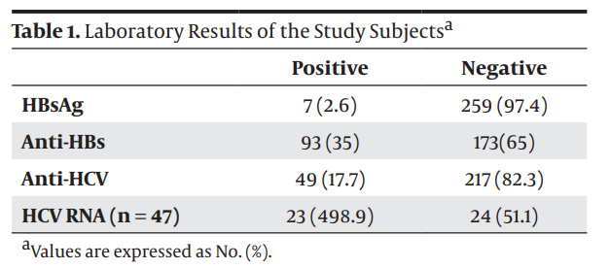
The prevalance of Hepatitis B and C among prisoners in Kahramanmaraş/Türkiye . N:266 prisoners
.
Keten D et al, Jundishapur J Microbiol. 2016 February; 9(2): e31598

Slide 15
HCV Prevalance in patients who have hemodialysis

Slide 16
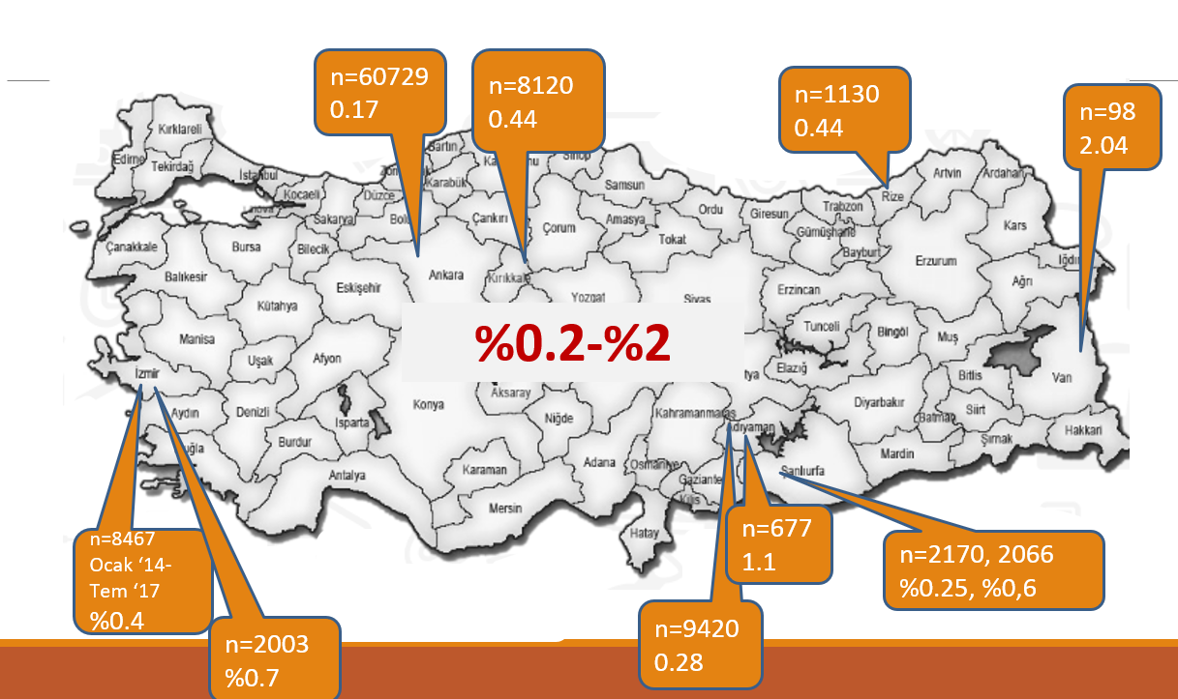
Prevalance of HCV infection in pregnant women

Slide 17
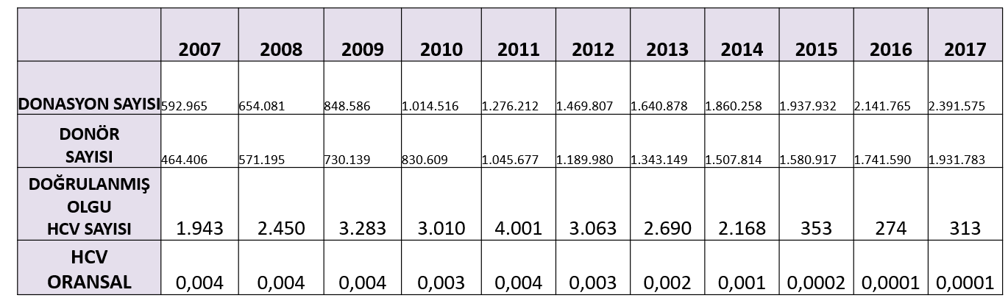
HCV Prevalance in Blood Donors

Slide 18
Türkiye Viral Hepatitis Prevention and Control Program
2018–2023

Slide 19
Türkiye Viral Hepatitis
Prevention and Control Program
Turkiye Viral Hepatitis Prevention and Control Program (2018-2023) was implemented. The program came into effect on September 12, 2018, and has been communicated to all healthcare institutions and organizations, as well as program stakeholders. The objectives of this program are as follows, using appropriate public health approaches:
To reduce diseases, complications, and deaths caused by Viral Hepatitis
To improve the care of Viral Hepatitis patients.
To mitigate the socioeconomic impact of Viral Hepatitis in community settings.

Slide 20
Strategic Actions
The program outlines the following strategies:
1. Increasing awareness
2. Expanding immunization
3. Strengthening surveillance
4. Improving access to treatment

Slide 21
Additional Strategies
5. Preventing mother-to-child transmission
6. Ensuring safe blood products
7. Preventing transmission among people who inject drugs
8. Preventing healthcare-associated hepatitis

Slide 22
Implementation of harm-reduction strategies to prevent new infections
*Needle exchange programs.
*Safe blood transfusion practices.
*Education about transmission risks
*Vaccination for hepatitis A and B (to reduce co-infections).
*Screening and Early Diagnosis
*Scaling up screening efforts to identify HCV infections early, especially in high-risk populations, and linking them to care.
*Reduced mortality and morbidity associated with HCV-related complications, such as liver cirrhosis and hepatocellular carcinoma.

Slide 23
Some of Activities regarding the elimination of HCV
in Progress in Türkiye
*A lots of banner and leaflet related viral hepatitis were pressed and were distributed nationwide.
*The educational videos were prepared regarding viral hepatitis and were distributed on televisions and educational programs.
*Family doctors were educated about viral hepatitis.
*Blood checking for viral hepatitis in the people who are the candidates of new marriage and pregnant women to protect transmission from mather to child of viral hepatitris.
*Vaccinating for Hepatitis A and B virüs infection.
*All bloood banks have been checking the viral markers

Slide 24
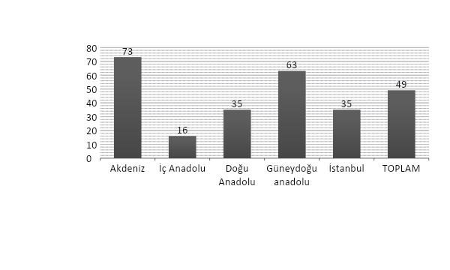
Screening
Increasing the diagnostic rate of HCV infection
  Applications designed for smartphones or tablets.
  Utilize device features such as GPS, camera, and sensors
To increase types of On-Site Survey Programs
(Mobile bus which has well developed lab visitsTürkiye from west to east. 2009-2010)
The Prevalance of HCV
0.49%

Slide 25
Connection with the treatment
Integration between family health center and specialists’ treatment
Integration between health center and prisoner
Integration between AMATEM (alcohol and substance addiction treatment center) and health systems.
Adding of HCV diagnosis on electronic medical record system.

Slide 26
Reaching the well qualified doctor
  The role of family doctors as an observer.
  The number of doctors who can prescribe direct anti-viral agents
  Reachness to treatment for the patients with active HCV infections

Slide 27
Reaching the drug (DAAs)
Contents of HCV treatment and special finance
The agreement of reimbursement
Reachness to direct anti-viral drugs

Slide 28
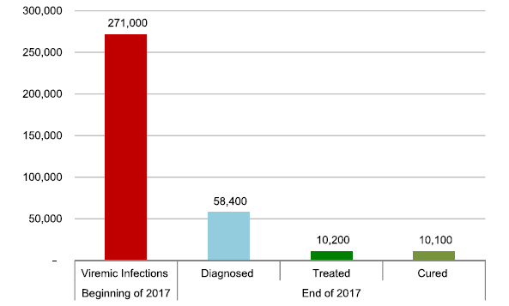
According to Turkey Viral Hepatitis Prevention and Control Program, three senaryos were planned
a-base 2017:
At the beginning 271 000 viremic patients were estimated. Among them, 58 400 patients were diagnosed, and
10 200 patients were treated.
3.69%

Slide 29
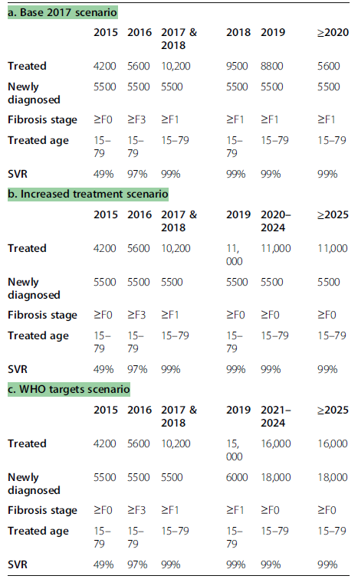
: Estimations used to model
the burden of HCV in Türkiye
Idilman R, Razavi H, Robbins S, et al. A micro-elimination approach to addressing hepatitis C in Turkey. *BMC Health Serv Res.* 2020;20:249. doi:10.1186/s12913-020-5019-8.

Slide 30
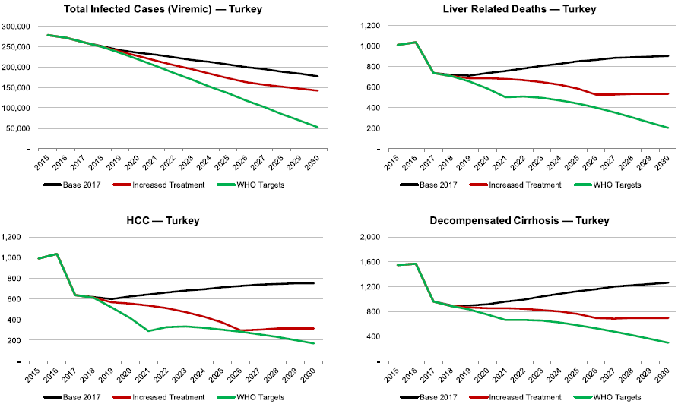
Total infected cases, liver-related deaths, prevalent HCC and prevalent decompensated cirrhosis in Turkey, 2015–2030
By 2030 the total number of viremic infections would decline by 35%. The number of decompensated liver cirrhosis and hepatocellular carcinoma cases would decrease by 10-25% by the same year.

Slide 31
Conclusion
HCV infection can be treated with high cure rates and treatment is cost effective.
To reach The world Health Organization targets, every country should spend more effort to early diagnosis and early treatment of HCV infection.

Slide 32


