Slide 1


Epidemiology of viral hepatitis in Azerbaijan based on Referans Medical Group data
Aslıhan Dağdemir,PhD
Referans CLC, Laboratory Chief and Genetics
21/05/2025-Uzbekistan
Notes:
It is a great pleasure for me to be here with you today.Let me start by briefly introducing our institution.
Reference Laboratory was established 10 years ago, initially offering only laboratory services.
Our goal has always been to support doctors in achieving accurate and timely diagnoses.
Today, I am proud to say that Reference has evolved into a comprehensive medical group, expanding beyond Azerbaijan’s borders.
In fact, we have been actively operating in Tashkent for the past two years, continuing our mission abroad.

Slide 2

Objectives
Explain the epidemiological situation in Azerbaijan
Viral hepatitis- Autoimmun Hepatitis
Review prevention and control strategies
Notes:
In this presentation, I would like to share with you some key statistics and insights from our work in hepatology at Reference Laboratory over the past decade.
These numbers reflect our dedication and progress in supporting the fight against hepatitis B and C, both nationally and regionally.
Thanks to the national health program, which has incorporated hepatitis in the last three years,
we have successfully extended our services to reach patients outside of Baku, significantly increasing access to care.

Slide 3
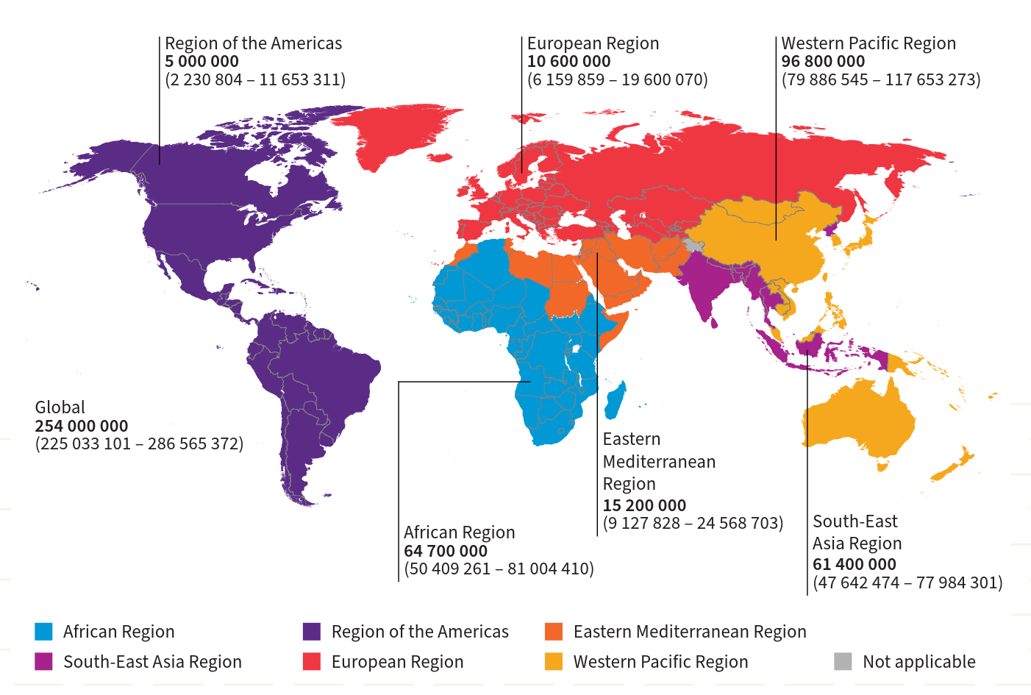
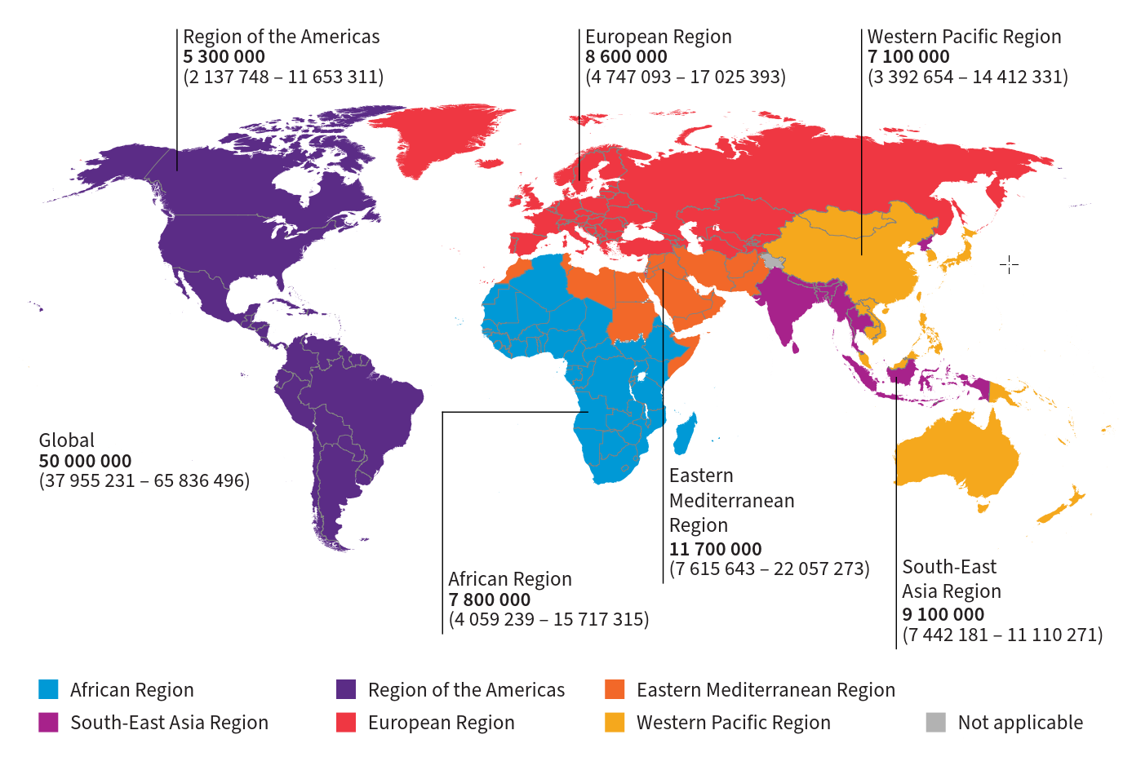
Prevalent cases of chronic hepatitis B and C
HBV
HCV
Azerbaijan Hepatitis Infections
Notes:
Azerbaijan, like many countries in the WHO European Region, faces a moderate burden of viral hepatitis, particularly Hepatitis B (HBV) and Hepatitis C (HCV).
Hepatitis A is less common due to improvements in sanitation and hygiene, but still appears in localized outbreaks.
• 325 million people infected worldwide
• Approximately 1.1 million deaths per year
• Most deaths due to HBV and HCV

Slide 4

Health System in Azerbaijan
• Universal health coverage improving
• Increased access to primary care
• Limited rural health infrastructure
Notes:
Thanks to changes made in the healthcare system over the past three years, laboratory testing in rural areas outside the capital city Baku has significantly increased with the support of Referance Lab.
The results have shown that:
•There is a moderate level of endemicity for HBV and HCV.
•The prevalence of HAV has decreased, but local outbreaks still per

Slide 5
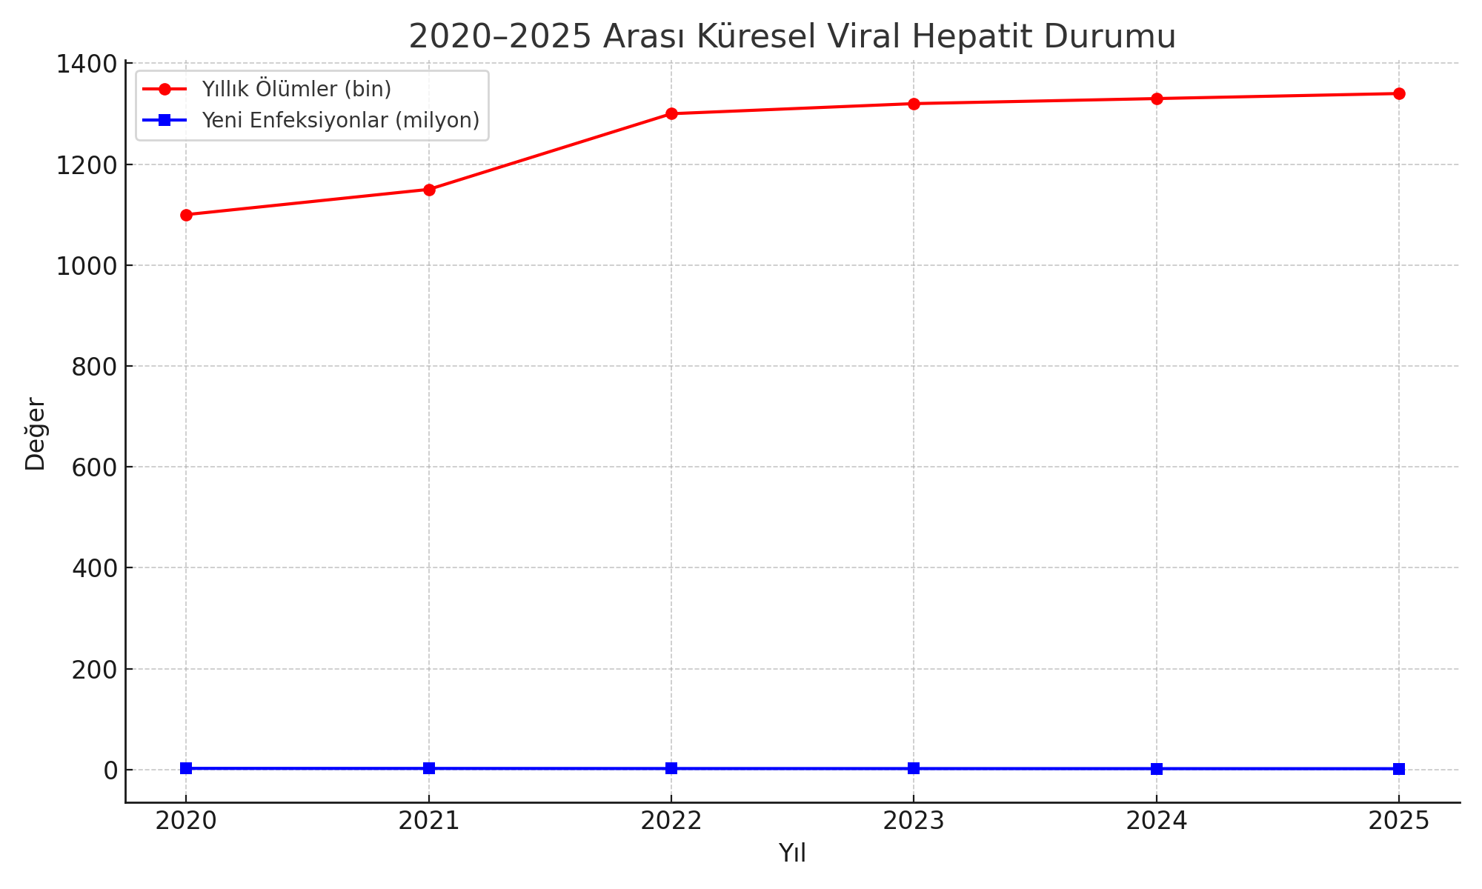
Hepatitis in Azerbaijan
• Mostly affects children
• Fecal-oral transmission
• Vaccine available and part of national immunization
Notes:
The number of estimated new HBV infections was around 20,000 annually during 2015-2019, which decreased significantly in 2020 to approximately 14,000 infections per year.
This number has remained relatively stable since then.
The global prevalence of chronic HBV infection affects about 296 million people, with Azerbaijan's prevalence showing varying rates across different regions.

Slide 6
HBV DNA in RMG
%62 POSITIVE
%42 FEMALE
%58 MALE
GENOTYPE D
Notes:
When we look our study of HBV DNA results

Slide 7
HBV Prevalence by Age Group (%)
• Intermediate endemicity
• Estimated 2-6% prevalence
• High risk of chronic infection in newborns
Notes:
Although the positivity rate seems to be higher in young people • Chronic HBV often acquired at birth

Slide 8
Hepatitis C in Azerbaijan
Estimated 1.5–3% prevalence,
Higher among high-risk groups such as:
People who inject drugs (PWID)
Prisoners
People receiving unsafe blood transfusions in the past

Slide 9
Hepatitis C Prevalence by Risk Group (%)
• Higher prevalence in rural areas
• Urban centers have better access to care
• Regional surveillance needed

Slide 10
Hepatitis C in RMG
%27 Positive
%59 Male
Notes:
When we look our study of Hcv rNA results

Slide 11
Age and Gender Patterns
• HCV more common in older males
• Young adults increasingly affected
Notes:
• HCV yaşlı erkeklerde daha yaygındır • Genç yetişkinler giderek daha fazla etkilenir

Slide 12
Hepatitis D in RMG
• Hepatitis D only co-infects with HBV
• Limited data available

Slide 13
AUTOİMMUN HEPATİTİS

Slide 14
Recent Outbreaks or Trends
Occasional HAV outbreaks
HCV declining due to better screening
Harm reduction programs growing

Slide 15
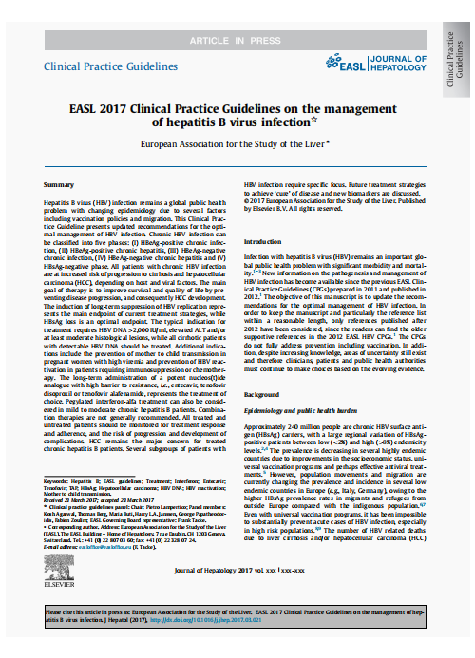


As a useful marker, HBV RNA Has Been Recommended By Authoritative Guidelines/Expert Consensus Abroad
New edition (2017) of
European Association for the Study of the Liver (EASL), Clinical Practice Guidelines: Management of Hepatitis B Virus Infection
Expert Consensus on
Functional Cure of Chronic Hepatitis B
Guidelines for the Prevention and Treatment of Chronic Hepatitis B (2019 Edition)
Clinical Significance:
The concentration of HBV RNA in serum can well reflect the transcriptional activity of cccDNA
Evaluate and monitor the efficacy of antiviral therapy
Evaluate the risk of recurrence at and after discontinuation of treatment
Multiple predictive values (e.g., HBeAg seroconversion...)

Slide 16
Surveillance Gaps
Lack of nationwide reporting
Future Prospects
New antiviral treatments
Limited laboratory confirmation
Underreporting in rural areas
Public Health Implications
Point-of-care testing
Improved digital health tools
Integrate hepatitis services with primary care
• Educate the public
• Improve data collection
Notes:
Finally, I would like to express my sincere gratitude to the organizers of this informative and inspiring congress for including me.
On behalf of Reference Medical Group, thank you for giving us this platform to share our experience and contribute to the global discussion on viral hepatitis.

Slide 17





+994774910033
referans-genetika@referansclc.com
referansgenetika
Thank you for your attention!
Notes:
Thank you for your attention.

